Slide 1

GRAVITY: REASON FOR BSM, STABILIZER OF SM + BSM
Durmuş Demir
Sabancı University, İstanbul
Conference on Neutrinos and Dark Matter (NDM 2020) (January 13, 2020; Hurghada, Egypt)

Slide 2

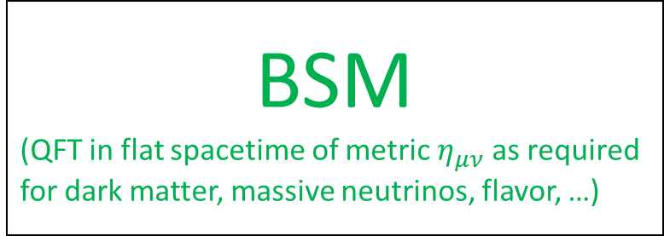

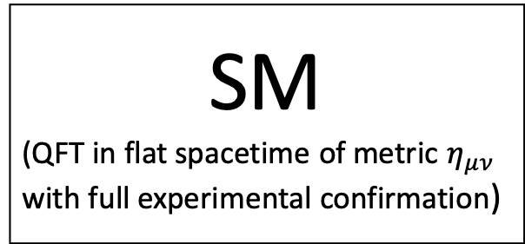

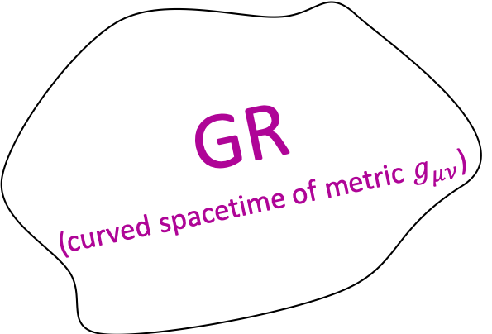
GR
(curved spacetime of metric $g_{μν}$)
SM
(QFT in flat spacetime of metric $η_{μν}$ with full experimental confirmation)
BSM
(QFT in flat spacetime of metric $η_{μν}$as required for dark matter, massive neutrinos, flavor, …)
QFT and GR are incompatible:
$QFT\left(η,ψ\right)$
$$η_{μν}↪g_{μν}$$
$$Qℱ𝒯\left(g,ψ\right)$$
(R. Wald, 0907.0416,2009)

Slide 3
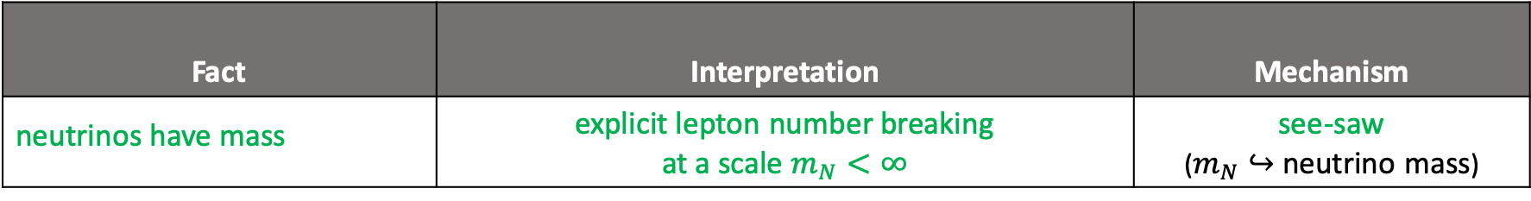
Each extension comes with a specific UV scale and specific mechanism:
Fact | Interpretation | Mechanism
neutrinos have mass | explicit lepton number breaking at a scale $m_{N}<∞$ | see-saw ($m_{N}↪$ neutrino mass)
gravity exists | explicit Poincare breaking at a scale $Λ_{℘}<∞$ | covariance ($Λ_{℘}^{2}↪$ curvature)

Slide 4


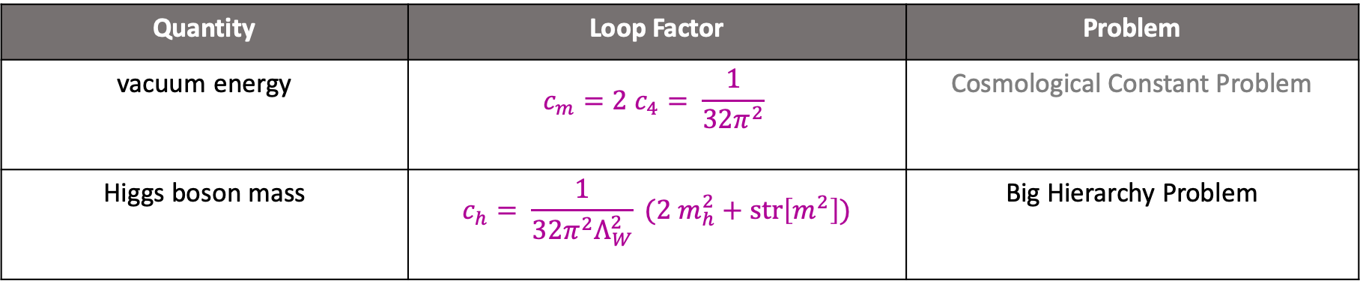

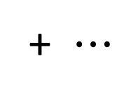

The vacuum and the Higgs sectors are both destabilized:
+
+
$$h$$
$$h$$
+ $⋯$
$$ℓ^{2}≤Λ_{℘}^{2}$$
$$ℓ^{2}≤Λ_{℘}^{2}$$
$$δS_{OH}\left(η, Λ_{℘}\right)=−∫d^{4}x \sqrt{−η} {\{c}_{4} str\left[1\right]Λ_{℘}^{4}+c_{m} str\left[m^{2}\right]Λ_{℘}^{2}+{ c}_{h}Λ_{℘}^{2}h^{2}\}$$
Quantity | Loop Factor | Problem
vacuum energy | $$c_{m}=2 c_{4}= \frac{1}{32π^{2}}$$ | Cosmological Constant Problem
Higgs boson mass | $$c_{h}= \frac{1}{32π^{2}Λ_{W}^{2}} (2 m_{h}^{2}+str\left[m^{2}\right])$$ | Big Hierarchy Problem
(Ya. Zeldovich, 1967, M. Veltman, 1981)

Slide 5
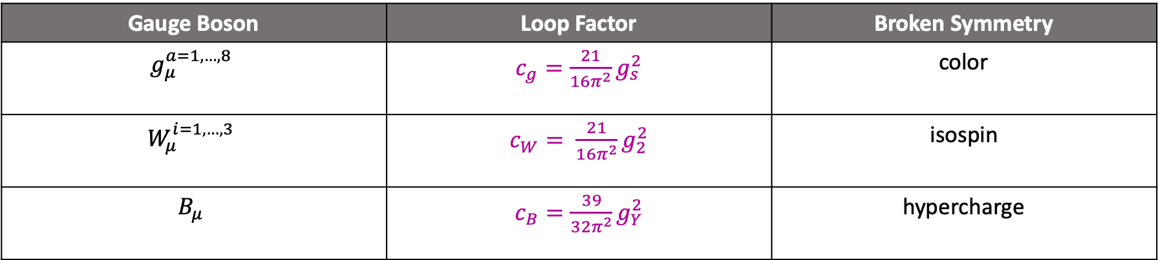



The photon, gluon, … all acquire masses:
$$V^{μ}(k)$$
$$ℓ_{ }^{2}≤Λ_{℘}^{2}$$
$$V^{ν}(k)$$
$$δS_{V}\left(η, Λ_{℘}\right)=∫d^{4}x\sqrt{−η} \left\{c_{V}Λ_{℘}^{2}+0.logΛ_{℘}\right\}tr\left[V_{μ}V^{μ}\right]+"transverse part"$$
Gauge Boson | Loop Factor | Broken Symmetry
$$g_{μ}^{a=1,…,8}$$ | $c_{g}=\frac{21}{16π^{2}}g_{s}^{2}$ | color
$$W_{μ}^{i=1,…,3}$$ | $c_{W}= \frac{21}{16π^{2}}g_{2}^{2}$ | isospin
$$B_{μ}$$ | $c_{B}=\frac{39}{32π^{2}}g_{Y}^{2}$ | hypercharge
$$A_{μ}$$ | $c_{W}≠2c_{B}⟹\tan{θ_{w}}≠\frac{g_{Y}}{g_{2}}$ | electric charge
(D’Attanasio, hep-ph/9602156, 1996; Peskin & Schroeder, 1995)
(L. Okun, 1977; A. Ignatiev & G. Joshi, 1996)

Slide 6
How to stabilize the Higgs boson mass ?
How to prevent charge and color breaking ?

Slide 7




In search for an answer, start with a trivial identity:
$$δS_{V} ≡−I_{V} +∫d^{4}x \sqrt{−η}{ c}_{V}Λ_{℘}^{2} tr\left[V_{μ}V^{μ}\right]+∫d^{4}x \sqrt{−η} c_{V}tr[V^{μ}\left(−D_{μν}^{2}\right)V^{ν}+∂_{μ}(V_{ν}V^{μν})]$$
$$δS_{V} ≡−I_{V} + δS_{V}+I_{V}$$
$$≡−I_{V}\left(η\right)+∫d^{4}x \sqrt{−η} c_{V}tr[V^{μ}\left(−D_{μν}^{2}+Λ_{℘}^{2} η_{μν}\right)V^{ν}+∂_{μ}(V_{ν}V^{μν})]$$
$$I_{V}\left(η\right)=∫d^{4}x \sqrt{−η} \frac{c_{V} }{2}tr\left[V_{μν}V^{μν}\right]$$
$$D_{μν}^{2}=D^{2}η_{μν}−D_{μ}D_{ν}−V_{μν}$$
$$D_{μ}=∂_{μ}+ig V_{μ}$$
(DD, 1901.07244, 2019; 1605.00377, 2016)

Slide 8






… and invoke general covariance to take the “new $δS_{V}$” into curved spacetime:
$$η_{μν}↪g_{μν}$$
$$δS_{V}\left(η,Λ_{℘}\right)$$
$$δS_{V}\left(g,Λ_{℘}\right)$$
$$≡−I_{V}\left(g\right) +∫d^{4}x \sqrt{−g} c_{V}tr[V^{μ}\left(−𝒟_{μν}^{2}+Λ_{℘}^{2} g_{μν}\right)V^{ν}+∇_{μ}(V_{ν}V^{μν})]$$
$$𝒟_{μν}^{2}=𝒟^{2}g_{μν}−𝒟_{μ}𝒟_{ν}−V_{μν}$$
$$𝒟_{μ}=∇_{μ}+ig V_{μ}$$
${}_{ }^{g}{Γ_{μν}^{λ}}= \frac{1}{2} {g }^{λρ}(∂_{μ}g_{νρ}$ +$∂_{ν}g_{ρμ}$ - $∂_{ρ}g_{νμ}^{ })$

Slide 9
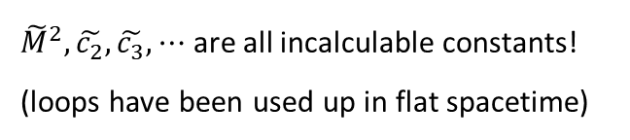


… but a curvature sector is needed for metric $g_{μν}$ to be dynamical:
$$δS_{V}\left(g,Λ_{℘}\right)$$
+
curvature sector
$∫d^{4}x \sqrt{−g} \{{\tilde{M}}^{2}R\left(g\right)$ + ${\tilde{c_{2}}}^{ }{R(g)}^{2}+ \frac{\tilde{c_{3}}}{{\tilde{M}}^{2}}{R(g)}^{3}$ + $⋯\}$
$$R\left(g\right)=g^{μν}R_{μν}({}_{ }^{g}Γ)$$
${\tilde{M}}^{2},\tilde{c_{2}},\tilde{c_{3}}, ⋯$ are all incalculable constants!
(loops have been used up in flat spacetime)
curvature-by-hand works only for classical FT !
for ${QFT}_{eff}\left(g,Λ_{℘}\right)$curvature must arise from “within”

Slide 10






How to make curvature arise from within effective QFT?
E. Krestchmann, 1915,
J. D. Norton, 2001,
R. D. Sorkin, 2002 , …
general covariance alone does not mean gravity;
any theory (say, Newtonian) can be made covariant
curvature must be included separately; either by hand
… or by a new rule giving birth to curvature :
$$η_{μν}↪g_{μν}$$
$$Λ_{℘}^{2} g_{μν}↪ℝ_{μν}(Γ)$$
$$QFT_{eff}\left(η,Λ_{℘}\right)$$
$$QFT_{eff}\left(g,Λ_{℘}\right)$$
$$QFT_{eff}\left(g,ℝ\right)$$
$$Γ_{μν}^{λ}≠{}_{ }^{g}{Γ_{μν}^{λ}} ⟹ℝ_{μν}\left(Γ\right)≠R_{μν}({}_{ }^{g}Γ)$$
“affine curvature” is the substance needed to
fix the “vacuous” nature of general covariance
(DD, PPC, Texas A&M, 2017)

Slide 11


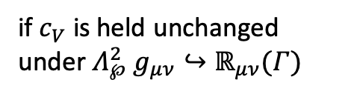
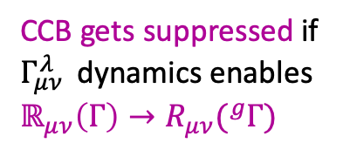
Extended general covariance makes $δS_{V}$ purely geometrical:
$$η_{μν}↪g_{μν}$$
$$δS_{V}\left(η,Λ_{℘}\right)$$
$$−I_{V}\left(g\right)+∫d^{4}x \sqrt{−g} c_{V} tr\left[V^{μ}\left(−𝒟_{μν}^{2}+ℝ_{μν}\left(Γ\right) \right)V^{ν}+∇_{μ}\left(V_{ν}V^{μν}\right)\right]$$
$$Λ_{℘}^{2} g_{μν}↪ℝ_{μν}(Γ)$$
$$= ∫d^{4}x \sqrt{−g} c_{V}tr\left[V^{μ}\left(ℝ_{μν}\left(Γ\right) −R_{μν}({}_{ }^{g}Γ) \right)V^{ν}\right]$$
if $c_{V}$ is held unchanged
under $Λ_{℘}^{2} g_{μν}↪ℝ_{μν}(Γ)$
CCB gets suppressed if
$Γ_{μν }^{λ}$ dynamics enables
$$ℝ_{μν}\left(Γ\right)→R_{μν}({}_{ }^{g}Γ)$$

Slide 12
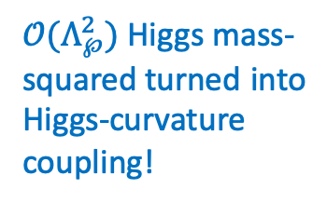
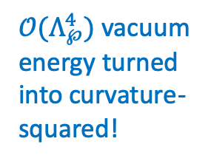
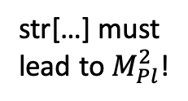
Extended general covariance cools down the vacuum and Higgs sectors ($ℝ\left(g,Γ\right)=g^{μν} ℝ_{μν}\left(Γ\right)$):
$δS_{OH}\left(g, ℝ\right)={∫d}^{4}x \sqrt{−g} \{−\frac{c_{h}}{4}ℝ\left(g,Γ\right)h^{2}−\frac{c_{4}}{16} str\left[1\right]{\left(ℝ\left(g,Γ\right)\right)}^{2}−\frac{c_{m}}{4}str\left[m^{2}\right]ℝ\left(g,Γ\right)\}$
str[…] must
lead to$M_{Pl}^{2}$!
$𝒪(Λ_{℘}^{4})$ vacuum energy turned into curvature-squared!
$𝒪(Λ_{℘}^{2})$ Higgs mass-squared turned into Higgs-curvature coupling!

Slide 13
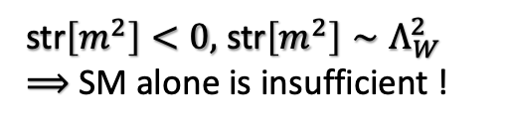
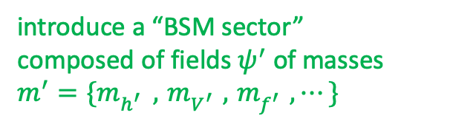
Newton’s constant necessitates a BSM sector:
$δS_{OH}\left(g, ℝ\right)={∫d}^{4}x \sqrt{−g} \{−\frac{c_{h}}{4}ℝ\left(g,Γ\right)h^{2}−\frac{c_{4}}{16} str\left[1\right]{\left(ℝ\left(g,Γ\right)\right)}^{2}−\frac{c_{m}}{4}str\left[m^{2}\right]ℝ\left(g,Γ\right)\}$
str$\left[m^{2}\right]<0,$ str$\left[m^{2}\right]∼Λ_{W}^{2}$
$⟹$ SM alone is insufficient !
introduce a “BSM sector”
composed of fields $ψ^{′}$ of masses
$$m^{′}=\{m_{h^{′} }^{ } ,{ m}_{V^{′}}^{ } ,{ m}_{f^{′}}^{ } , ⋯\}$$

Slide 14


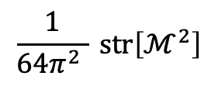
SM and BSM do not have to couple to each other:
$M_{Pl}^{2}= \frac{1}{2} \left(c_{m} str\left[m^{2}\right]+c_{m^{′}} str\left[m^{′2}\right]\right)$
one-loop
$$\frac{1}{64π^{2} } str\left[ℳ^{2}\right]$$
$$ℳ=\{{m_{h} , m_{V} , m_{f}, m}_{h^{′} }^{ } ,{ m}_{V^{′}}^{ } ,{ m}_{f^{′}}^{ } , ⋯\}$$
no need to SM-BSM coupling!
(in contrast to SUSY, compositeness,
extra dimensions, little Higgs, …)

Slide 15



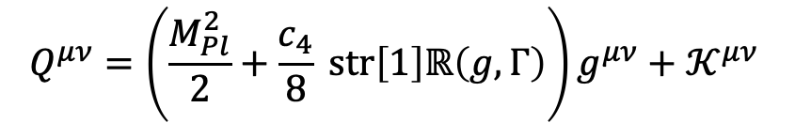
Extended general covariance sets the complete curvature sector (on the SM+BSM basis):
$$δS\left(g, ℝ\right)=∫d^{4}x \sqrt{−g} \{−Q^{μν}ℝ_{μν}\left(Γ\right)+ \frac{c_{4}}{16} str\left[1\right]{\left(ℝ\left(g,Γ\right)\right)}^{2}−c_{V}R_{μν}\left({}_{ }^{g}Γ\right)tr\left[𝒱^{μ}𝒱^{ν}\right]\}$$
$$Q^{μν}=\left(\frac{M_{Pl}^{2}}{2}+\frac{c_{4}}{8} str\left[1\right]ℝ\left(g,Γ\right)\right)g^{μν}+{ 𝒦}^{μν}$$
$𝒦^{μν}=$ $\frac{c_{ℋ}}{4}ℋ^{2}g^{μν}−c_{𝒱} tr\left[𝒱^{μ}𝒱^{ν}\right]$
$${ℋ=\{h, h^{′}\}}^{ }$$
$$𝒱_{μ}^{ }=\{V_{μ}^{ } ,V_{μ}^{′}\}$$

Slide 16


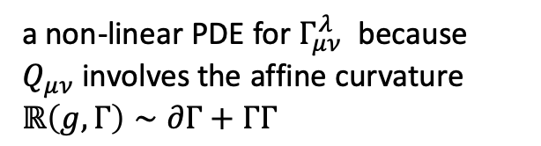

GR is possible only for a specific solution o$f Γ_{μν}^{λ}$:
$${{}_{ }^{Γ}∇}_{α} Q_{μν}=0$$
$Γ_{μν}^{λ}=$ ${}_{ }^{g}{Γ_{μν}^{λ}+ }\frac{1}{2} {\left(Q^{−1}\right)}^{λρ}\left(∇_{μ}Q_{νρ}+∇_{ν}Q_{ρμ}−∇_{ρ}Q_{μν}\right)$
a non-linear PDE for $Γ_{μν}^{λ}$ because $Q_{μν}$involves the affine curvature $ℝ\left(g,Γ\right)∼∂Γ+ΓΓ$
GR emerges only if $ℝ$ dependence is erased

Slide 17


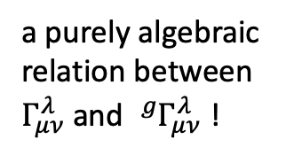

erasing $ℝ\left(g,Γ\right)$ from $Γ_{μν}^{λ}$
$$str\left[1\right]=0⟹n_{SM+BSM}^{(b)}= n_{SM+BSM}^{(f)}$$
$Q^{μν}=$ $\frac{M_{Pl}^{2}}{2}g^{μν}+{ 𝒦}^{μν}$
$Γ_{μν}^{λ}=$ ${}_{ }^{g}{Γ_{μν}^{λ}+ }\frac{1}{2} {({\overline{Q}}^{−1})}^{λρ}\left(∇_{μ}{\overline{Q}}_{νρ}+∇_{ν}{\overline{Q}}_{ρμ}−∇_{ρ}{\overline{Q}}_{μν}\right)$
$=$ ${}_{ }^{g}{Γ_{μν}^{λ}+ }\frac{1}{M_{Pl}^{2}} \left(∇_{μ}𝒦_{νρ}+∇_{ν}𝒦_{ρμ}−∇_{ρ}𝒦_{μν}\right)+𝒪($ $\frac{∇𝒦^{2}}{M_{Pl}^{4}})$
a purely algebraic relation between
$Γ_{μν}^{λ}$ and ${}_{ }^{g}{Γ_{μν}^{λ} }$!

Slide 18
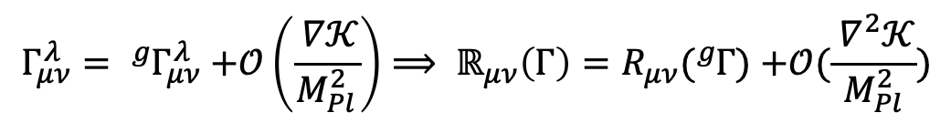
Extended general covariance suppresses Charge and Color Breaking (CCB):
$$Γ_{μν}^{λ}= {}_{ }^{g}{Γ_{μν}^{λ} }\text{+}𝒪\left(\frac{ ∇𝒦}{M_{Pl}^{2}}\right)⟹ ℝ_{μν}\left(Γ\right)=R_{μν}({}_{ }^{g}Γ) \text{+}𝒪(\frac{ ∇^{2}𝒦}{M_{Pl}^{2}})$$
$δS_{V}\left(g,ℝ\right)$ $≡ ∫d^{4}x \sqrt{−g} c_{V}tr\left[V^{μ}\left(ℝ_{μν}\left(Γ\right) −R_{μν}\left({}_{ }^{g}Γ\right) \right)V^{ν}\right]=0+∫d^{4}x \sqrt{−g} c_{V} 𝒪(\frac{ ∇^{2}𝒦}{M_{Pl}^{2}})$
CCB is suppressed !
no gauge or Higgs mass
terms at all!

Slide 19
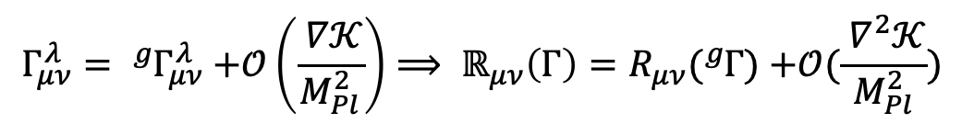
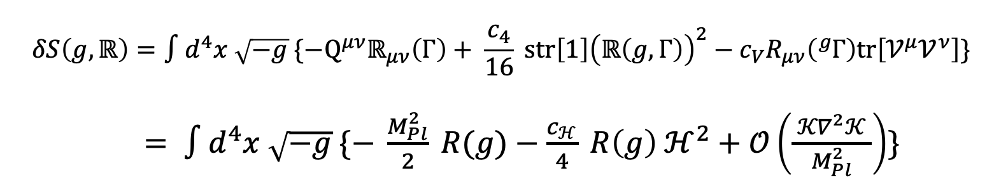
Extended general covariance leads to exact Einstein gravity:
$$Γ_{μν}^{λ}= {}_{ }^{g}{Γ_{μν}^{λ} }\text{+}𝒪\left(\frac{ ∇𝒦}{M_{Pl}^{2}}\right)⟹ ℝ_{μν}\left(Γ\right)=R_{μν}({}_{ }^{g}Γ) \text{+}𝒪(\frac{ ∇^{2}𝒦}{M_{Pl}^{2}})$$
$$δS\left(g, ℝ\right)=∫d^{4}x \sqrt{−g} \{−Q^{μν}ℝ_{μν}\left(Γ\right)+ \frac{c_{4}}{16} str\left[1\right]{\left(ℝ\left(g,Γ\right)\right)}^{2}−c_{V}R_{μν}\left({}_{ }^{g}Γ\right)tr\left[𝒱^{μ}𝒱^{ν}\right]\}$$
$= ∫d^{4}x \sqrt{−g} \{− \frac{M_{Pl}^{2}}{2} R(g)−\frac{c_{ℋ}}{4} R\left(g\right) ℋ^{2}+𝒪\left(\frac{ {𝒦∇}^{2}𝒦^{ }}{M_{Pl}^{2}}\right)\}$
exact Einstein gravity
(no higher-curvature terms; impossible to get with general covariance alone!)

Slide 20
Extended general covariance solves the big hierarchy problem:
$$Γ_{μν}^{λ}= {}_{ }^{g}{Γ_{μν}^{λ} }\text{+}𝒪\left(\frac{ ∇𝒦}{M_{Pl}^{2}}\right)⟹ ℝ_{μν}\left(Γ\right)=R_{μν}({}_{ }^{g}Γ) \text{+}𝒪(\frac{ ∇^{2}𝒦}{M_{Pl}^{2}})$$
$$δS\left(g, ℝ\right)=∫d^{4}x \sqrt{−g} \{−Q^{μν}ℝ_{μν}\left(Γ\right)+ \frac{c_{4}}{16} str\left[1\right]{\left(ℝ\left(g,Γ\right)\right)}^{2}−c_{V}R_{μν}\left({}_{ }^{g}Γ\right)tr\left[𝒱^{μ}𝒱^{ν}\right]\}$$
$= ∫d^{4}x \sqrt{−g} \{− \frac{M_{Pl}^{2}}{2} R(g)−\frac{c_{ℋ}}{4} R\left(g\right) ℋ^{2}+𝒪\left(\frac{ {𝒦∇}^{2}𝒦^{ }}{M_{Pl}^{2}}\right)\}$
big hierarchy problem is gone
(little hierarchy problem is there!)

Slide 21
GR has emerged in a way restoring gauge invariance (broken explicitly by Poincare breaking scale):
$$Γ_{μν}^{λ}= {}_{ }^{g}{Γ_{μν}^{λ} }\text{+}𝒪\left(\frac{ ∇𝒦}{M_{Pl}^{2}}\right)⟹ ℝ_{μν}\left(Γ\right)=R_{μν}({}_{ }^{g}Γ) \text{+}𝒪(\frac{ ∇^{2}𝒦}{M_{Pl}^{2}})$$
$$δS\left(g, ℝ\right)=∫d^{4}x \sqrt{−g} \{−Q^{μν}ℝ_{μν}\left(Γ\right)+ \frac{c_{4}}{16} str\left[1\right]{\left(ℝ\left(g,Γ\right)\right)}^{2}−c_{V}R_{μν}\left({}_{ }^{g}Γ\right)tr\left[𝒱^{μ}𝒱^{ν}\right]\}$$
$= ∫d^{4}x \sqrt{−g} \{− \frac{M_{Pl}^{2}}{2} R(g)−\frac{c_{ℋ}}{4} R\left(g\right) ℋ^{2}+𝒪\left(\frac{ {𝒦∇}^{2}𝒦^{ }}{M_{Pl}^{2}}\right)\}$
GR has emerged in a way restoring the explicitly broken gauge symmetries (symmergent gravity)

Slide 22
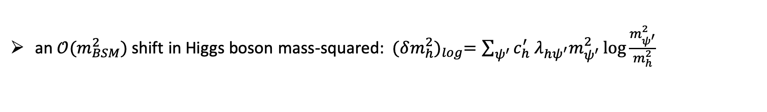
Logarithmic corrections are important:
an $𝒪(M_{Pl}^{4})$ shift in vacuum energy: ${(δV)}_{log}= \frac{ℳ^{4}}{64π^{2}}(\log{\frac{ℳ^{2}}{Λ_{℘}^{2}}} −\frac{1}{2})$
cosmological constant problem (severest form)
an $𝒪(m_{BSM}^{2})$ shift in Higgs boson mass-squared: ${(δm_{h}^{2})}_{log}={\sum_{ψ^{′}}{c_{h}^{′} λ_{hψ^{′}}m_{ψ^{′}}^{2}\log{\frac{m_{ψ^{′}}^{2}}{m_{h}^{2}}}} }_{ }$
little hierarchy problem
(heavier the BSM larger the Higgs mass)

Slide 23
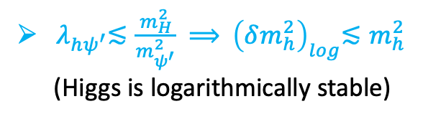

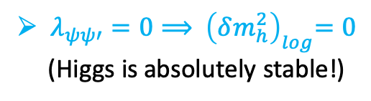

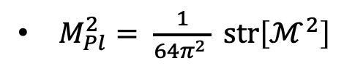
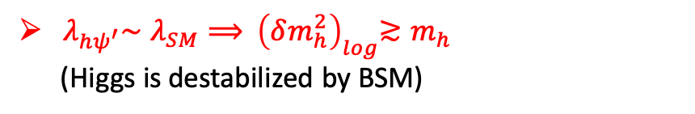
difference from other models: BSM and SM do not have to interact!
BSM couples to SM unnaturally
${ λ}_{hψ^{′}}∼λ_{SM}⟹{ \left(δm_{h}^{2}\right)}_{log}≳m_{h}$
(Higgs is destabilized by BSM)
BSM does not couple to SM
BSM is visible yet «fine-tuned»
(BSM can be detected!)
$λ_{ψψ′}=0⟹{ \left(δm_{h}^{2}\right)}_{log}=0$
(Higgs is absolutely stable!)
BSM = split-SUSY (broken at $8πM_{Pl}$)
BSM is pitch-dark
(BSM evades detection!)
$str\left[1\right]=0$
$M_{Pl}^{2}= \frac{1}{64π^{2} } str\left[ℳ^{2}\right]$
BSM couples to SM naturally
${ λ}_{hψ^{′}}≲\frac{m_{H}^{2}}{m_{ψ^{′}}^{2}}$ $⟹{ \left(δm_{h}^{2}\right)}_{log}≲m_{h}^{2}$
(Higgs is logarithmically stable)
(N. Arkani-Hamed
and S. Dimopoulos,
hep-th/0405159)
BSM is dark
(BSM can be detected!)

Slide 24
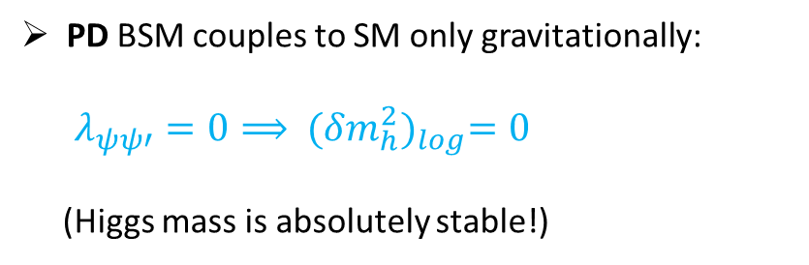

Pitch-Dark BSM agrees with all the current data:
no coupling
PD BSM couples to SM only gravitationally:
$$λ_{ψψ′}=0⟹{ (δm_{h}^{2})}_{log}=0$$
(Higgs mass is absolutely stable!)
X
PD BSM is home to Dark Energy.
(It might compensate ${(δV)}_{log}$to solve the CCP)
PD BSM is home to Dark Matter
(Data seem to favor «undetectable» Dark Matter)
PD BSM can be formed by gravitational particle
production at the end of inflation.
(P. Peebles and A. Vilenkin, arXiv:astro-ph/9904396)

Slide 25
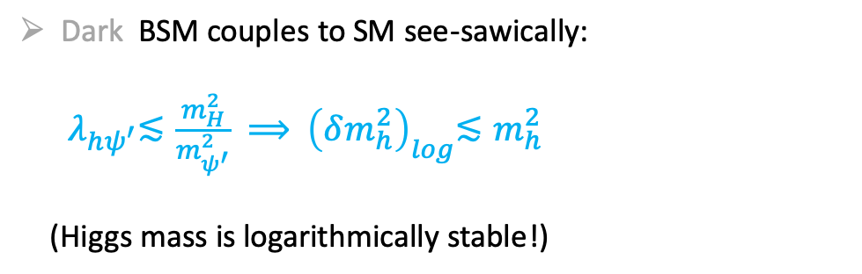
Dark BSM ensures Higgs stability and offers a rich astro-particle physics:
Dark BSM couples to SM see-sawically:
${ λ}_{hψ^{′}}≲\frac{m_{H}^{2}}{m_{ψ^{′}}^{2}}$ $⟹{ \left(δm_{h}^{2}\right)}_{log}≲m_{h}^{2}$
(Higgs mass is logarithmically stable!)
coupling
Dark BSM is home to Dark Energy/Dark Photon
(They might be observed at high-luminosity)
Dark BSM is home to Dark Matter
(Data may hide suchlike Dark Matter)

Slide 26

Dark BSM can be searched variously:
SM
BSM
$${ λ^{2}}_{SM/BSM}^{ } ≲ \frac{m_{H}^{2}}{m_{BSM}^{2}}$$
production
annihilation
SM
BSM
detection

Slide 27

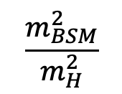
Dark BSM particles can be detected mainly at high-luminosity colliders.
$${ λ^{ }}_{SM/BSM}^{ }$$
1
heavier the BSM
feebler the couplig
disallowed
allowed
$$\frac{m_{BSM}^{2}}{m_{H}^{2}}$$
excluded by LHC !

Slide 28







Scalar Dark Matter mass is bounded from above (when ${ m_{h}< m}_{h^{′}}$):
h$′$
$$h$$
h$′$
$$h$$
$${ {λ^{ }}^{2}}_{hh^{′}}^{ }$$
h$′$ remains stable if it ejoys a $ℤ_{2} symmetry$
$h′$ acquires correct relic density if${ {λ^{ }}^{2}}_{hh^{′}}^{ } ≃2.1×{10}^{−4} (\frac{m_{h^{′}}}{GeV})$
and see-sawic structure imposes ${ m_{h}≲ m}_{h^{′}}≲3.38 m_{h}≃420 GeV$
quite a low bound!
(DM may have various forms, though!)

Slide 29
See-sawic bounds can put restrictions on Dark Matter exclusion limits (depending on mediator and DM candidate)
only scalar DM!
(T. Lin, arXiv:1904.07915)

Slide 30
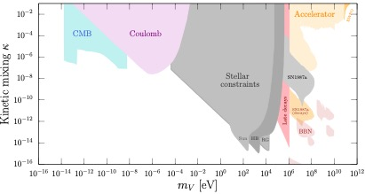
Dark photon coupling (kinetic mixing with hypercharge) is already within the see-sawic range:
$$λ_{BZ^{′}}$$
$$m_{V′}^{ }$$
(T. Lin, arXiv:1904.07915)

Slide 31

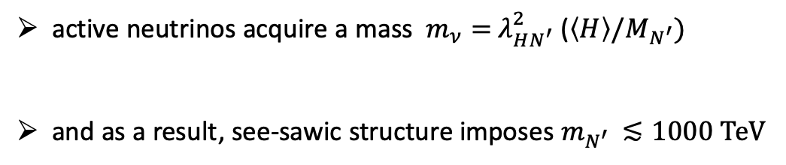






Dark Neutrios must be relatively light:
$$⟨H⟩$$
$$N′$$
$$⟨H⟩$$
$$λ_{HN^{′}}$$
$$λ_{HN^{′}}$$
$$L$$
$$L$$
active neutrinos acquire a mass $m_{ν}=$ $λ_{HN^{′}}^{2}$ ($\left\langle H\right\rangle /M_{N^{′}})$
and as a result, see-sawic structure imposes $m_{N^{′} }≲1000 TeV$
a fairly light RH neutrino sector!
(F. Vissani, hep-ph/9709409, 1998)

Slide 32
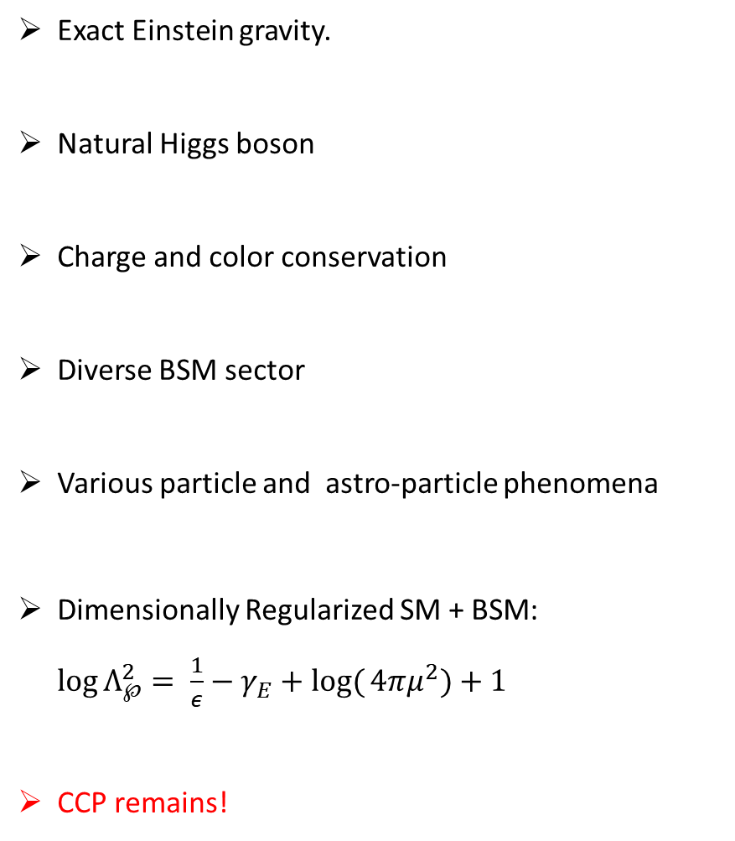
Symmergence leads to a natural, diverse and wide SM+BSM:
Exact Einstein gravity.
Natural Higgs boson
Charge and color conservation
Diverse BSM sector
Various particle and astro-particle phenomena
Dimensionally Regularized SM + BSM: $\log{Λ_{℘}^{2}}= \frac{1}{ε}−γ_{E}+log({4πμ^{2})+1}$
CCP remains!
BSM
SM
BSM
GR

Slide 33
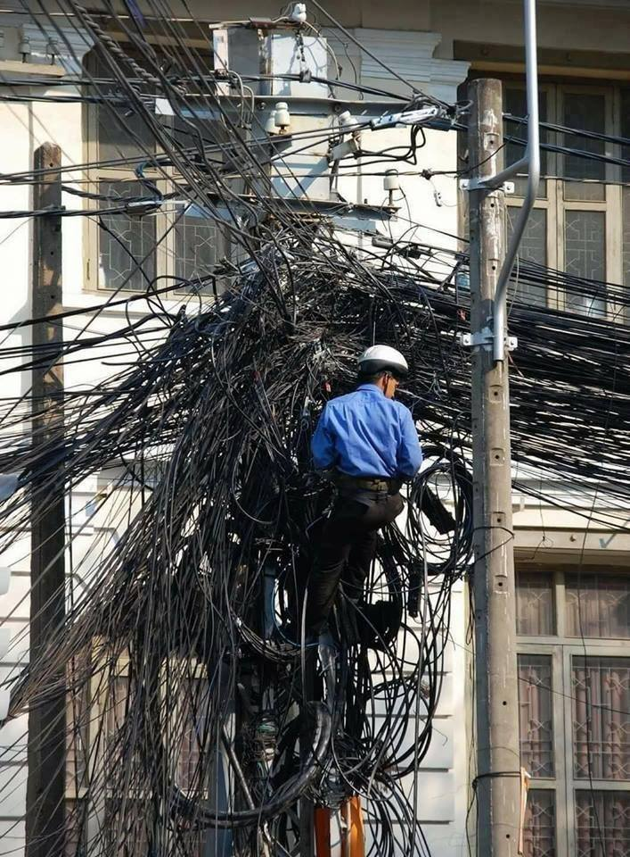
Thank you!
particle physicist in the time of LHC

Slide 34
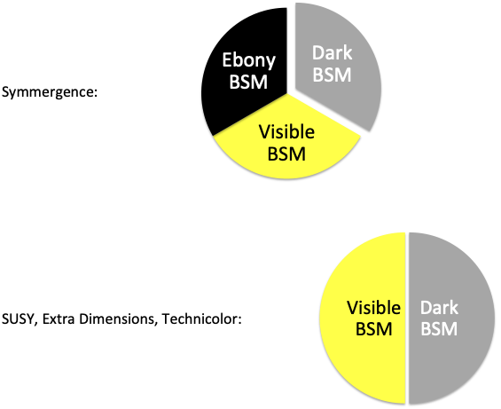

Slide 35
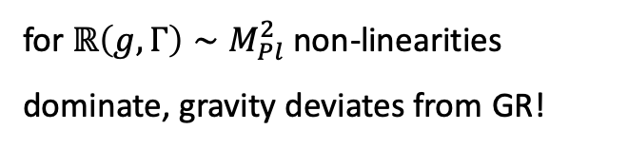

The affine curvature obeys a non-linear PDE ($ℋ$ and $𝒱_{μ}$ are dropped, for simplicity):
$ℝ=R−3∇^{2}\log{(1+\frac{2str\left[1\right]ℝ}{M_{Pl}^{2}}})−$ $\frac{3}{2}∇_{μ}\log{(1+\frac{2str\left[1\right]ℝ}{M_{Pl}^{2}}})∇^{μ}\log{(1+\frac{2str\left[1\right]ℝ}{M_{Pl}^{2}}})$
$ℝ\left(g,Γ\right)≃R$(${}_{ }^{g}Γ$) for $ℝ\left(g,Γ\right)≪M_{Pl}^{2}$
for $ℝ\left(g,Γ\right)∼M_{Pl}^{2}$ non-linearities dominate, gravity deviates from GR!

Slide 36

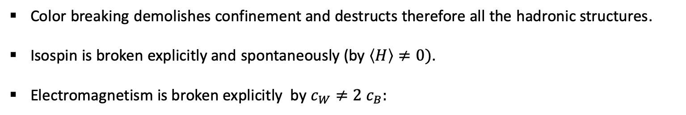





Color breaking demolishes confinement and destructs therefore all the hadronic structures.
Isospin is broken explicitly and spontaneously (by $\left\langle H\right\rangle ≠0)$.
Electromagnetism is broken explicitly by $c_{W}≠2 c_{B}:$
$$\tan{2{\tilde{θ}}_{W}}= \frac{\left(g_{2}^{2}−g_{Y}^{2}\right) {\left\langle H\right\rangle }^{2}}{\left(g_{2}^{2}−g_{Y}^{2}\right){\left\langle H\right\rangle }^{2}+2\left(c_{W}−2 c_{B}\right)Λ_{℘}^{2}} \tan{2θ_{W} }⟹∂_{μ} J_{EM}^{μ}≠0$$
$$ν$$
$$e_{L}$$
$$e_{R}$$
$$ν$$
$$e_{L}$$
$$e_{R}$$
(L. Okun & M. Voloshin, ‘77; A. Ignatiev & G. Joshi, ‘96)

