Slide 1
BIOSENOSRS
BIO 580
Label-free Impedance Biosensors
Dielectric relaxation spectroscopy
WEEK-4
Fall Semester
Faculty: Dr. Javed H. Niazi KM
Faculty of Engineering & Natural Sciences
Sabanci University

Slide 2
Label Free Impedance Biosensor
Notes:
2

Slide 3
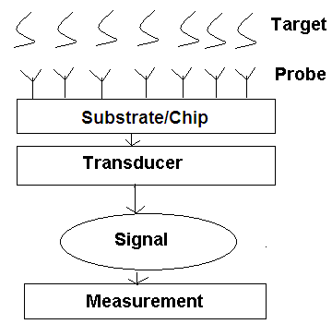
What is Biosensor?
A biosensor is a device which detect the bimolecular interactions for different concentrations of probe and target (analyte) and transforms in to a measureable signal.
Typical structure of bio-sensor
Notes:
.
3

Slide 4
BIOSENSOR CLASSIFICATION-I
Name of Biosensor Types of Biological Recognition
Enzyme electrode Enzymes
Proteins
Immunosensor Antibodies
DNA sensor DNA
Organelles
Microbial sensor Microbial cells
Plant and animal tissues

Slide 5
BIOSENSOR CLASSIFICATION-II
Types of Transducers Measured Property
Electrochemical Potentiometric Amperometric
Voltametric
Electrical /capacitive/Impedance Dielectric properties
Electrolyte conductivity
Optical Fluoresence
Adsorption
Reflection
Mass sensitive Resonance frequency of piezocrystals
Thermal Heat of reaction
Heat of adsorpsion

Slide 6
Electrical biosensors
Voltammetric, Amperometric/Coulometric
Impedance
Voltammetry and amperometry involve measuring the current at an electrode as a function of applied electrode-solution voltage; these approaches are DC or pseudo-DC and intentionally change the electrode conditions
Impedance biosensors measure the electrical impedance of an interface in AC steady state with constant DC bias conditions often this is accomplished by imposing a small sinusoidal voltage at a particular frequency and measuring the resulting current; the process can be repeated at different frequencies. The current-voltage ratio gives the impedance. This approach, known as electrochemical impedance spectroscopy (EIS), has been used to study a variety of electrochemical phenomena over a wide frequency range. If the impedance of the electrode-solution interface changes when the target analyte is captured by the probe, EIS can be used to detect that impedance change. Alternatively, the impedance or capacitance of the interface may be measured at a single frequency. Impedance measurement does not require special reagents and is amenable to label-free operation
Notes:
A biosensor is a device designed to detect or quantify a biochemical molecule such as a particularDNAsequence or particular protein. Many biosensors are affinity-based,meaning they use an immobilized capture probe that binds the molecule being sensed – the target or analyte –selectively, thus transferring the challenge of detecting a target in solution into detecting a change at a localized surface. This change can then be measured in a variety of ways. Electrical biosensors rely solely on the measurement of currents and/or voltages to detect binding [1 – 3]. Thus, this category excludes sensors which require light (e.g.,surface plasmon resonance or fluorescence), use mechanical motion (e.g., quartz crystal microbalance or resonant cantilever), use magnetic particles, etc. Due to their low cost, low power, and ease of iniaturization, electrical biosensors hold great promise for applications where minimizing size and cost is crucial, such as point-of-care diagnostics and
biowarfare agent detection.

Slide 7
Electrical Biosensors
Voltammetric
Amperometric
Label-free type
Transducing formats
Electrochemical types
Impedometric
Impedance/ Redox mediator
Faradaic
Non-Faradaic
Signal modes
Capacitance/ dielectric charges
Capacitance/ dielectric charges
Ref: Daniels & Pourmand. 2007. Electroanal 19: 1239-1257.
Notes:
Electrical biosensors can be further subdivided according to how the electrical measurement is made,
FARADAIC – current generated by the reduction or oxidation of some chemical substance at an electrode
NON-FARADAIC – current generated by capacitive transfer, that is, by charging and discharging the double-layer capacitance
Voltammetry and amperometry involve measuring the current at an electrode as a function of applied electrode-solution voltage;
In contrast,impedance biosensors measure the electrical impedance of an interface in AC steady state with constant DC bias conditions.
Most often this is accomplished by imposing a small voltage at a particular frequency and measuring the resulting current;
the process can be repeated at different frequencies.
The current-voltage ratio gives the impedance. This approach, known as electrochemical impedance spectroscopy (EIS),

Slide 8
A closely realted but separate class of electrical biosensor
Ion-sensitive field-effect transistors (ISFETs)
Enzyme field-effect transistor (EnFETs)
Field-effect biosensor (BioFETs)
These biosensors are operated by field-effect modulation of carriers in a semiconductor due to nearby charged.
Similar mechanisms operate in semiconducting nanowires , semiconducting carbon nanotubes, electrolyte-insulator-semiconductor structures, suspended gate thin film transistors, and light-addressable potentiometric sensors.
These field-effect sensors rely on the interaction of external charges with carriers in a nearby semiconductor and thus exhibit enhanced sensitivity at low ionic strength where counter ion shielding is reduced and evidenced by the low salt concentrations often used.
Even though the response of field effect sensors can be characterized by channel conductance or capacitance of the electrolyte-insulator-semiconductor interface.

Slide 9
Impedance Biosensor
Impedance biosensors can detect a variety of target analytes by simply varying the probe used. Here we focus on-
Detection of DNA and proteins

Slide 10
Why Study Impedance Biosensors?
Low cost, small instrument size, and speed of analysis are crucial, but cutting-edge accuracy and detection limits are not
Point-of-care diagnostics – a measurement and diagnosis at a bedside, in an ambulance,or during a clinic visit – are a promising application
Other applications include biowarfare agent detection, consumer test kits, bioprocess monitoring, and water quality testing
Another potential application is the label-free determination of biomolecular affinity coefficients, in which pure target samples are used. In short, impedance biosensors have potential for simple, rapid, label-free, low-cost detection of biomolecules.

Slide 11
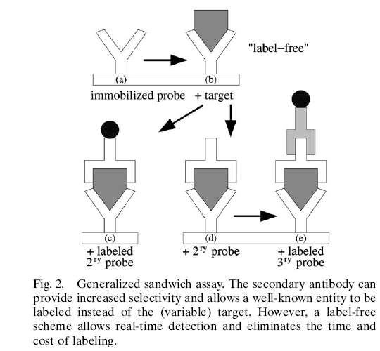
To Label or Not to Label?
The major motivation for studying impedance biosensors is their ability to perform label-free detection
An indirect labeling scheme often referred to as a sandwich assay is commonly used for protein detection
This requires two probes that bind to different regions of the target, yielding enhanced selectivity but increasing development costs and limiting use in research settings
The first probe is immobilized on the solid support, the analyte is introduced, and then a secondary probe is introduced after washing
This second probe is labeled or can be detected by introducing yet another labeled probe that binds to all the secondary probes
The widespread ELISA (Enzyme-Linked ImmunoSorbent Assay) technique is the canonical example of a sandwich assay

Slide 12
Label-Free Operation
When a target biomolecule interacts with a probe-functionalized surface, changes in the electrical properties of the surface (e.g., dielectric constant, resistance) can result solely from the presence of the target molecule
No label is required for impedance sensing; this is particularly advantageous for protein detection
some impedance biosensors in the literature use a label. However, labeling requires extra time, expense, and sample handling
Besides the time and expense benefits of omitting the labeling step, label-free operation enables detection of target-probe binding in real time, which is generally not possible with label-based systems
Real-time sensing confers at least twomajor advantages over endpoint detection. First, time averaging of binding/unbinding events can improve measurement accuracy. Second, it allows determination of affinity constants by curve-fitting the sensor output vs. time

Slide 13
Affinity Biosensor Concepts
Affinity Biosensor = Affinity + Sensor
Probe-Target Binding
Selectivity
Limit of Detection and Reproducibility
Dynamic Range
Amplification
Multiplexing
What Really Limits Biosensor Performance?

Slide 14
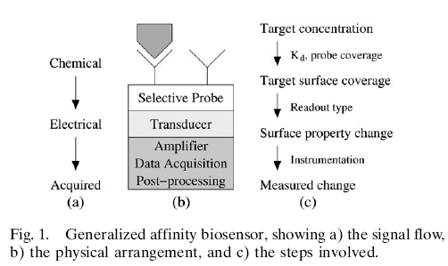
Affinity Biosensor Concepts
Affinity Biosensor = Affinity + Sensor
Affinity-based biosensors divide the problem of detecting a particular biomolecule
into two parts:
binding the desired target while excluding nontarget binding (we call this the affinity step) and
(2) detecting a change in the surface properties (the readout step)

Slide 15
Affinity Biosensor Concepts
(B) Probe-Target Binding
Affinity biosensors are based on a probe binding a target and can thus be treated in terms of receptor-ligand binding theory
The fraction of probe bound at equilibrium (q) is determined by the relative values of the dissociation constant Kd and target concentration:
This is one form of the Langmuir adsorption isotherm, which describes surface binding for identical noninteracting binding sites.
Affinity-based biosensors divide the problem of detecting a particular biomolecule into two parts:
binding the desired target while excluding nontarget binding (we call this the affinity step) and
(2) detecting a change in the surface properties (the readout step)

Slide 16
Affinity Biosensor Concepts
(C) Selectivity
Selectivity means that the sensor responds only to the target analyte and not to other similar molecules.
Generally label-free biosensors cannot distinguish between specific and nonspecific interactions except by probe selectivity, regardless of the readout method.
Selectivity is especially important in real-world samples where the target concentration can be much less than the concentration of nontarget biomolecules present.
A closely related concept is nonspecific binding, in which nontarget biomolecules stick to the probe layer, preventing target binding or causing a false positive signal.
To alleviate this problem, the sensor chamber is often preexposed to a solution containing a blocking agent such as bovine serum albumin (BSA) or salmon sperm DNA which nonspecifically adsorbs (hopefully not occupying the probe binding sites), reducing subsequent nonspecific binding from the actual sample.
Antifouling agents such as polyethylene glycol can also be deposited on areas surrounding the sensor to prevent target depletion via nonspecific binding
Use of blocking agents is not a systematic science, but several approaches have been found to work in specific situations
Washing the sensor surface before readout can sometimes improve selectivity by washing away nonspecifically adsorbed molecules while leaving the target intact, but this in an endpoint measurement and not real-time approach.
In a homogeneous assay this washing step is not necessary

Slide 17
Affinity Biosensor Concepts
(D) Limit of Detection and Reproducibility
The most cited figure of merit for any chemical sensor is the limit of detection, or the smallest amount of target that can be reliably detected
Occasionally the term sensitivity is used, which can also refer to the slope of the response curve
The detection limit can be determined by measuring the sensor response to a dilution series and determining the target smallest concentration at which the sensor response is clearly distinguishable from the response to a blank solution
Other investigators calculate a limit of detection based on the slope of the dose-response curve and the standard deviation of the blank response according to without actually demonstrating reproducible detection at the reported concentration
Detection limits are almost always determined in the absence of confounding nontarget biomolecules
To demonstrate clinical utility, biosensors should be challenged with mixed
target/nontarget samples to simultaneously test selectivity and sensitivity
Real-time readout may improve the achievable detection limit by monitoring the transient sensor response, allowing the binding signal to be separated from the slower nonspecific adsorption signal and drift in the readout electronics

Slide 18
Affinity Biosensor Concepts
(E) Dynamic Range
The dynamic range is the ratio of the largest measurable target concentration and the limit of detection
The upper limit is almost invariably set by the saturation of the probe with target molecules (θ=1), and thus is determined by the affinity step
Dynamic range can be extended on the upper end by simply performing measurements with dilution series of the sample. Real time measurements also can enhance dynamic range
The smallest detectable change in target concentration is the resolution (defined as output uncertainly, due to both systematic and irreducible noise, divided by the slope of the response curve)

Slide 19
Affinity Biosensor Concepts
(F) Amplification
All chemical amplification schemes for electrical biosensors rely on either target labeling (including sandwich approach) or cycling of a redox species
Thus amplification techniques lay outside the domain of label-free impedance biosensors
(G) Multiplexing
Multiplexing is desirable because it reduces both cost and sample volume per data point
Because electrical signals are readily steered, it is possible to detect various analytes using a single readout circuit
Regardless of readout mechanism, multiplexed protein detection is complicated by cross-reactivities – a probe binds to multiple targets or vice versa – which severely limits the possible degree of multiplexing and is especially troublesome in real-world situations
However, a panel of several biomarker measurements has far more diagnostic power than a single biomarker can provide

Slide 20
Affinity Biosensor Concepts
(H) What Really Limits Biosensor Performance?
It is apparent that the limits of label-free affinity biosensor performance are more often set by the affinity step than the readout step
This suggests the need for further research efforts in probe immobilization chemistries and minimization of nonspecific binding, while recognizing the fundamental limits of finite probe affinity, selectivity, and sensitivity

Slide 21
Measuring Electrochemical Impedance
Apply a Voltage, Measure a Current
Electrodes
Instrumentation
Faradaic vs. Nonfaradaic
Data Fitting
Circuit Models
Constant Phase Element
Double Layer Capacitance
Scaling Electrode Size

Slide 22
Measuring Electrochemical Impedance
Apply a Voltage, Measure a Current
Electrical impedance is defined as the ratio of an incremental change in voltage to the resulting change in current
Either an AC test voltage or AC test current is imposed while the other variable is measured
Mathematically, if the applied voltage is
and the resulting current is
then the complex valued impedance Z(w)has magnitude V_{AC}/I_{AC} and phase θ
The electrode-solution impedance depends on both the bias conditions (V_{DC}) and the measurement frequency (w).

Slide 23
Measuring Electrochemical Impedance
Apply a Voltage, Measure a Current
In impedance biosensors, the applied voltage should be quite small –usually 10mV amplitude or less – for several reasons-
First, the current-voltage relationship is often linear only for small perturbations, and only in this situation is impedance strictly defined
A second reason is to avoid disturbing the probe layer; covalent bond energies are on the order of 1 – 3 eV but probe-target binding energies can be much less (and in some cases the probe is not covalently attached to the electrode), and applied voltages will apply a force on charged molecules. This second consideration also applies to DC bias voltages across the electrode-solution interface.
Correctly performed, electrochemical impedance spectroscopy does not damage the biomolecular probe layer, an important advantage over voltammetry or amperometry where more extreme voltages are applied

Slide 24
Measuring Electrochemical Impedance
(B) Electrodes
At minimum two electrodes are needed to measure electrolyte-solution impedance, and usually three are used
The current is measured at the working electrode and is biofunctionalized with the probe
In order to establish a desired voltage between the working electrode and solution, electrical contact must be made with the solution using a reference electrode and/or counter electrode
A reference electrode maintains a fixed, reproducible electrical potential between the metal contact and the solution, allowing a known voltage to be applied
A simple piece of wire – a pseudoreference or quasireference electrode– can sometimes suffice
A counter electrode supplies current to the solution to maintain the desired electrode-solution voltage, usually in electronic feedback with the reference electrode monitoring the solution voltage

Slide 25
Measuring Electrochemical Impedance
(C) Instrumentation
Apotentiostat imposes a desired command voltage between the solution and working electrode while simultaneously measuring the current flowing between them
The command voltage for impedance sensing is an AC excitation plus an optional DC offset, and the impedance is simply the ratio of the AC voltage to the AC current
EIS analyzers are potentiostats designed especially for measuring AC impedance, and have typical frequency ranges of 10 MHz – 100 kHz
Computer control is ubiquitous for both potentiostats and EIS analyzers, and digital post-processing is commonly employed

Slide 26
Measuring Electrochemical Impedance
(D) Faradaic vs. Nonfaradaic
Faradaic
In electrochemical terminology, a faradaic process is one where charge is transferred across an interface
In faradaic EIS a redox species is alternately oxidized and reduced by the transfer of an electron to and from the metal electrode. Thus, faradaic EIS requires the addition of a redox-active species and DC bias conditions such that it is not depleted
Nonfaradaic
However, transient currents can flow without charge transfer in nonfaradaic processes (e.g., charging a capacitor)
In contrast, no additional reagent is required for nonfaradaic impedance spectroscopy, rendering nonfaradaic schemes somewhat more amenable to point-of-care applications
The term capacitive biosensor usually designates a sensor based on a nonfaradaic scheme

Slide 27
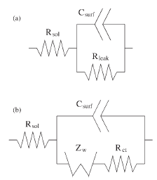
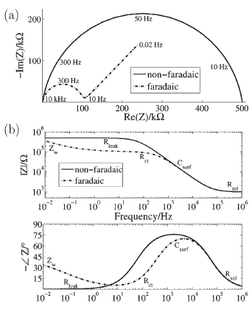
Measuring Electrochemical Impedance
Fig. Common circuit models for a) nonfaradaic and b) faradaic interfaces.
(D) Data Fitting
Fig. Example nonfaradaic and faradaic impedance data in both Nyquist (a) and magnitude/phase (b) representations, along with dominating element.
Complex nonlinear least squares (CNLS) fitting is needed to incorporate both magnitude and phase in the fitting process and is available in several free (e.g., LEVM) and commercial (e.g., ZView, ZSimpWin) software packages.

Slide 28
Measuring Electrochemical Impedance
(D) Circuit Models
Nonfaradaic case
The solution resistance R_{sol} arises from the finite conductance of the ions in bulk solution, and thus is generally not affected by binding
The capacitance between the metal electrode and ions in solution, C_{surf}, can be modeled as a series combination the surface modification capacitance and the double layer capacitance
The component due to surface modification depends on the thickness and dielectric constant of the probe layer. It can be thought of as a parallel plate capacitor, whose capacitance is given by
Fig. Common circuit models for a) nonfaradaic and b) faradaic interfaces.
where ε_{r} is the relative dielectric constant, A is the electrode area, and t is the insulator thickness. The capacitance C_{surf} is often modeled by a constant phase element instead of a pure capacitance.
In parallel with this capacitance there is a resistive path modeled by R_{leak} for nonfaradaic sensors.
For an ideal insulator or when no redox species is present, R_{leak} is theoretically infinite.

Slide 29
Measuring Electrochemical Impedance
(D) Circuit Models
Faradaic Case
In parallel with capacitance there is a resistive path modeled by the series combination of Zw and Rct for faradaic sensors.
The Warburg impedance (Zw), only of physical significance in faradaic EIS, represents the delay arising from diffusion of the electroactive species to the electrode
It is only appreciable at low frequencies, is affected by convection (and thus may be invalid for experimental time scales), and has a phase shift of 45⁰.
The charge transfer resistance (Rct) is a manifestation of two effects:
the energy potential associated with the oxidation or reduction event at the electrode (i.e. the overpotential) along with
(2) the energy barrier of the redox species reaching the electrode due to electrostatic repulsion or steric hinderance. The two circuit elements most commonly used as indication of affinity binding are C_{surf} for nonfaradaic biosensors and R_{ct} for faradaic ones.

Slide 30
Measuring Electrochemical Impedance
(E) Constant Phase Element
It has long been recognized that the impedance of solid electrodes usually deviates from purely capacitive behavior; this is empirically modelled as a constant phase element (CPE)
The complex impedance of a CPE is given by
where A is analogous to a capacitance, w is the frequency expressed in rad/s,
and 0.5<m<1 (m = 1 corresponds to a capacitor and m = 0.5 corresponds to a
Warburg element; m for C_{surf} modelling is typically between 0.85 and 0.98).
This introduces a sub-90⁰ phase shift, or equivalently a frequency-dependent resistor in addition to a pure capacitor.

Slide 31
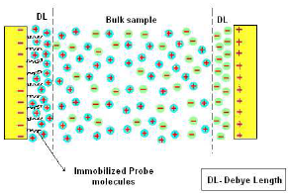
Measuring Electrochemical Impedance
(F) Double Layer Capacitance
When an electrode is polarized relative to the solution, it attracts ions of opposite charge. This tendency is countered by the randomizing thermal motion of the ions, but results in a local buildup of excess ions of opposite charge.
Thus, any electric field arising at the electrode or within ionic solution decays exponentially because the excess ions screen the field.
The characteristic length of this decay, or Debye length, is proportional to the square root of ion concentration (about 1 nm for biological ionic strengths).
This effect creates a capacitance called the double layer capacitance or diffuse layer capacitance.

Slide 32
Measuring Electrochemical Impedance
(E) Scaling Electrode Size
What is the optimal electrode size for affinity impedance biosensors?
Electrode size greatly impacts the actual impedance measured, and can be chosen so that the instrument’s frequency range yields as much useful information as possible
Conversely, the range of measurement frequencies can be chosen according to what circuit element one is trying to measure
Nonfaradaic Case
Decreasing C_{surf} (e.g., by reducing the electrode area or increasing insulator thickness) increases the capacitive impedance, allowing measurement of capacitive behavior at higher frequencies
For nonfaradaic sensors, decreasing R_{leak} (insualtor thickness decreases i.e. R leak decrease) tightens the circle in the Nyquist representation, shortens the transition region in the Bode magnitude plot, and makes it difficult to measure C_{surf} at low frequencies
Decreasing R_{sol} (e.g., by increasing salt concentration) mainly affects the high-frequency impedance plateau, and shifts the transition region slightly to higher frequencies

Slide 33
Measuring Electrochemical Impedance
(E) Scaling Electrode Size
If a typical nonfaradaic system is scaled down in in all dimensions by a factor
λ<1,
C_{surf} and Z_{w} will decrease by λ² (increasing the impedance),
R_{leak} and R_{ct} will increase by λ², and
R_{sol} will decrease by λ
Thus, isomorphically decreasing the cell dimensions is expected to shift the impedance curve to higher frequencies and higher impedances
It also increases the range of frequencies over which Csurf dominates, but the transition frequency between R_{leak} and C_{surf} remains unchanged
This simple analysis neglects many second-order effects such as electrode shape and nonuniformity of current flow at the electrode

Slide 34
Practical Issues in Label-free Impedance Biosensors
What Causes an Impedance Change?
Response Curve
Differential Measurement
Self-Assembled Monolayers
DNA vs. Protein Biosensors

Slide 35
Practical Issues in Label-free Impedance Biosensors
What Causes an Impedance Change?
Faradaic Case
A charged surface presents either an attractive or repulsive force on ions near the electrode; because the interaction of the charged redox species with the charged probe layer can significantly impact R_{ct} (the same phenomenon could also be observed by a shift in the redox potential).
This effect has been used to rationalize changes in R_{ct} upon binding of a charged target for SAMs, for DNA sensors, and for protein sensors.
Changes in molecular conformation could also introduce a change in impedance, both in C_{surf} and R_{ct} .
The former was exploited for a sensor using a protein whose conformation changed upon binding of heavy metal ions.
Note that surface charge is also dependent on pH, temperature, and other factors.

Slide 36
Practical Issues in Label-free Impedance Biosensors
What Causes an Impedance Change?
Nonfaradaic Case
In nonfaradaic sensors, it is common to rationalize changes in C_{surf} as occurring due to displacement of water and ions from the surface upon target binding.
Binding should increase thickness and/or decrease ε_{r} of the probe layer (ε_{r} 2 – 5 for biomolecules versus 80 for water), both decreasing capacitance and negligible at higher frequency
A typical conceptual explanation includes three capacitors in series: dielectric layer of the insulation (SAM or otherwise), dielectric layer of the probe layer, and the double-layer capacitance
To allow measurement of the probe layer capacitance, the insulating layer should be as thin as possible. Imperfect insulation, modeled by R_{leak} in parallel with the capacitance, can reduce the sensitivity of the measured impedance to the change in C_{surf}.
Changes in R_{leak} are occasionally employed as a sensor output, as in, and can be independently assessed using cyclic voltammetry with a redox couple.

Slide 37
Practical Issues in Label-free Impedance Biosensors
What Causes an Impedance Change?
Nonfaradaic Case
Dipoles in the SAM head group can contribute to measured capacitance because dipoles affect the dielectric constant ε_{r}
This observation could partially explain variation in response between otherwise similar targets.
Note that ε_{r} is not strictly constant over frequency, as dipoles may be able to react to slow-moving excitation fields but not to higher-frequency ones.
This research area, termed dielectric spectroscopy, has received limited attention in the biosensing community but tends to be applied to measuring bulk solutions at high frequencies (>>1 MHz, C_{surf} negligible) and is thus quite distinct experimentally from conventional surface-sensitive impedance biosensors ( <<1 MHz, C_{surf} important)

Slide 38
Practical Issues in Label-free Impedance Biosensors
(B) Response Curve
The response curve is the relationship between the sensor output variable (e.g., R_{ct}, change in imaginary part of the impedance at a particular frequency, etc.) and the target concentration
For all affinity biosensors, this response curve arises from two separate relations-
The first corre-sponds to the affinity step (θ([Target]), relating target surface coverage to bulk concentration)
The second corresponds to the readout step (ᐃZ(θ), relating impedance change to surface coverage)
When [Target] >>Kd, θ≈1 and the impedance response saturates
Thus one would expect the sensor output to be proportional to the target
concentration in the low-concentration regime

Slide 39
Practical Issues in Label-free Impedance Biosensors
(C) Differential Measurement
Utilizing a differential measurement scheme can eliminate variations in the sensor output caused by disturbances unrelated to the sensed quantity
For example, R_{sol} and C_{surf} are affected by salt concentration, pH, and temperature; impedance changes due to uncontrolled changes of these factors may swamp out the tiny impedance change caused by target-probe binding
In complex samples, nonspecific binding is also expected to give response unrelated to target concentration

Slide 40
Practical Issues in Label-free Impedance Biosensors
(D) Self-Assembled Monolayers
Most impedance biosensors utilize self-assembled monolayers (SAMs) to attach probes at the electrode-solution interface
The most common types of attachment chemistries are based on thiols bound to gold surfaces and siloxanes to oxide surfaces.
Here, we focus on thiol SAMs because they are prevalent in impedance biosensors
The SAM can be formed and the probes subsequently immobilized on top or else the probes themselves can be thiol-modified and formed as a SAM
SAMs with longer carbon chains form more dense monolayers due to
hydrophobic interactions of the chains
The general rule of thumb is that C₁₁ or greater gives packed films but Mirksy et al. reportedCsurf drift due to thiol desorption using a C₁₁ SAM but not for a C₁₆ SAM.
SAM desorption is one reason why a sensor might have a response to a blank solution. Boubour reported that over 40 hours of incubation was required to form a tightly-packed SAM, as determined by observing purely capacitive behavior at low frequencies , but others report 15 – 20 hours depending on SAM composition and as little as 2 hours .

Slide 41
Practical Issues in Label-free Impedance Biosensors
(E) DNA vs. Protein Biosensors
DNA
Using oligonucleotides (most often DNA) as probes and targets may be somewhat more convenient than using antibodies or other proteins. Oligonucleotides are readily available in purified form, immobilization chemistry is relatively mature, and hybridization exhibits relatively robust selectivity.
However, it is unclear whether impedance DNA biosensors have any commercial viability because various detection technologies already exist for DNA (e.g., DNA microarrays, pyrosequencing, real time polymerase chain reaction), and other technologies are being researched (e.g., voltammetry using redox-labeled DNA).
However, DNA-based sensors can demonstrate proof-of principle for protein impedance biosensors and elucidate properties of the electrode/solution interface.

Slide 42
Practical Issues in Label-free Impedance Biosensors
(E) DNA vs. Protein Biosensors
Aptamers
Aptamers are oligonucleotide or peptide sequences which bind selectively to a desired target, including proteins
They are chosen by an in vitro selection process that identifies a monomer sequence that tightly binds the target from a large library of random sequences.
Aptamers are considered promising alternatives to antibodies for capture probes because of facile production, well understood tethering chemistry, and perhaps reduced crossr eactivity

Slide 43
Practical Issues in Label-free Impedance Biosensors
(E) DNA vs. Protein Biosensors
Protein
Protein detection appears to be the more likely real-world application of affinity impedance biosensors because
(1) labeling proteins is difficult and impedance sensing can be label-free and
(2) difficulties in cross-reactivity and nonspecific binding severely impact all protein sensors, allowing less sensitive readout techniques to be utilized with equal overall results
Key issues include poor reproducibility, nonspecific binding, and the complex and highly variable nature of clinical samples

Slide 44
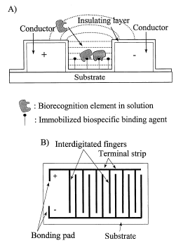
Early Affinity Impedance Biosensors
Credit for the first capacitive affinity biosensor is widely given to
Newman who in 1986 used interdigitated electrodes covered by
insulation and an antibody probe.
The capacitance can be described by Equation
C = εε₀A/d
where, ε is the dielectric constant of the medium between plates,
ε₀ =8.85419 pF/m (permittivity of free space),
A = the area of the plates and d the distance between them.
Thus, when there is a change in the dielectric properties in the
material between the plates, a change in the capacitance will
occur.
Two copper conductors (25 μm high and 50 μm wide) were positioned on a surface of an insulating material, having a distance of 50 μ m between them

Slide 45
Summary of Published Label-Free Affinity Impedance Biosensors
Early Affinity Impedance Biosensors
Potentiostatic Step
Nonfaradaic Studies
Faradaic Studies
Polymer Films
Special Electrode Surfaces
Interdigitated Electrodes
Miniaturization Efforts
http://www3.interscience.wiley.com/journal/114263704/abstract

Slide 46
Interdigitated Capacitive Biosensor
The measuring principle of these sensors is based on:
Changes in dielectric properties,
Charge distribution, and conductivity change
when an antibody-antigen complex formed on the surface of an electrode.
The capacitance between the interdigitated electrodes
C = 2 n ε ε₀ A/d,
with ε is the dielectric constant of the medium between the plates,
ε₀ permittivity of free space,
A the area of the electrodes and
d the distance between the two electrodes, n being the number of electrodes
Notes:
46

Slide 47
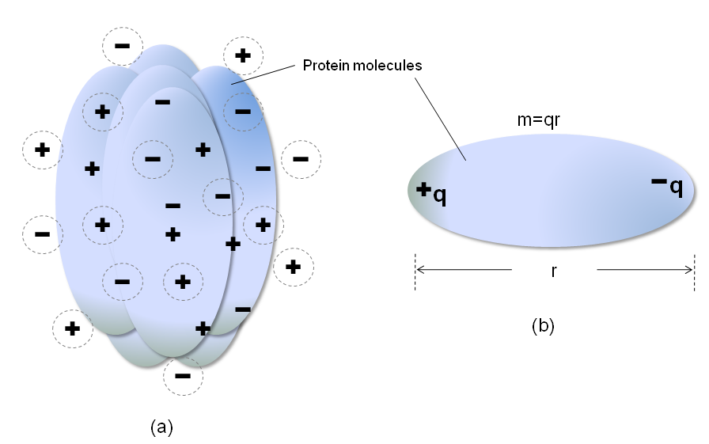
Dielectric measurements
In a complex protein
positive and negative charges
from the ionizable side chains of acidic and basic amino acid present in the protein structure.
Notes:
47

Slide 48
Dielectric measurements
The simplest molecular dipole consists of a pair of opposite electrical charges with magnitude of +q and –q and separated by r, vector distance.
The molecular dipole moment m is given by the equation
m=qr
protein-analyte complex formation will give rise to an increase in molecular size of a protein-analyte complex.
This increase in size of a protein-analyte complex therefore leads to a relatively large permanent dipole moment.
Notes:
48

Slide 49
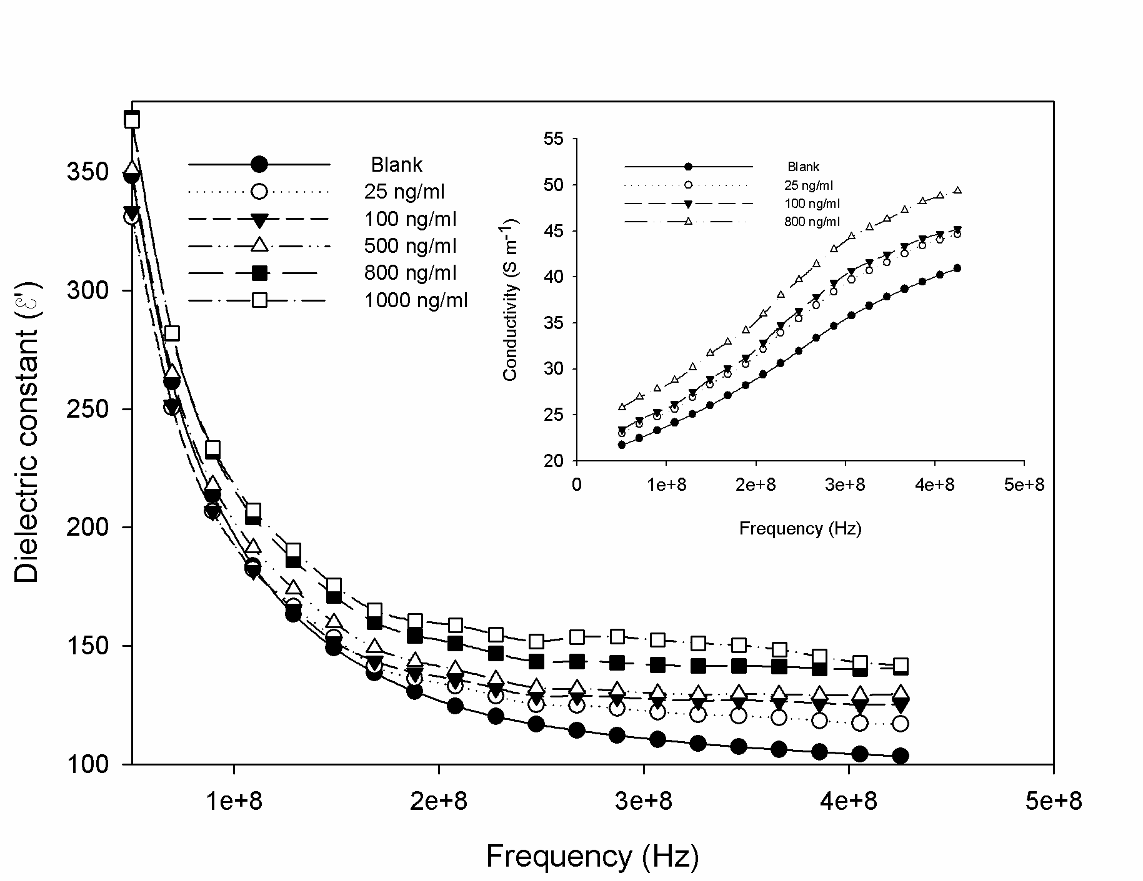
The dielectric constant passed through dieletric dispersion and decreased with frequency.
It was also observed that the dielectric dispersion Δε′ (= ε′_{s} - ε′∞) for control is lower than the antigen treated sample.
The changes in the value of Δε′ were attributed to change in shape and volume of protein molecules is clear from the figure that the values of conductivity increased which accompanied by a decrease in the values of dielectric constant.

Slide 50
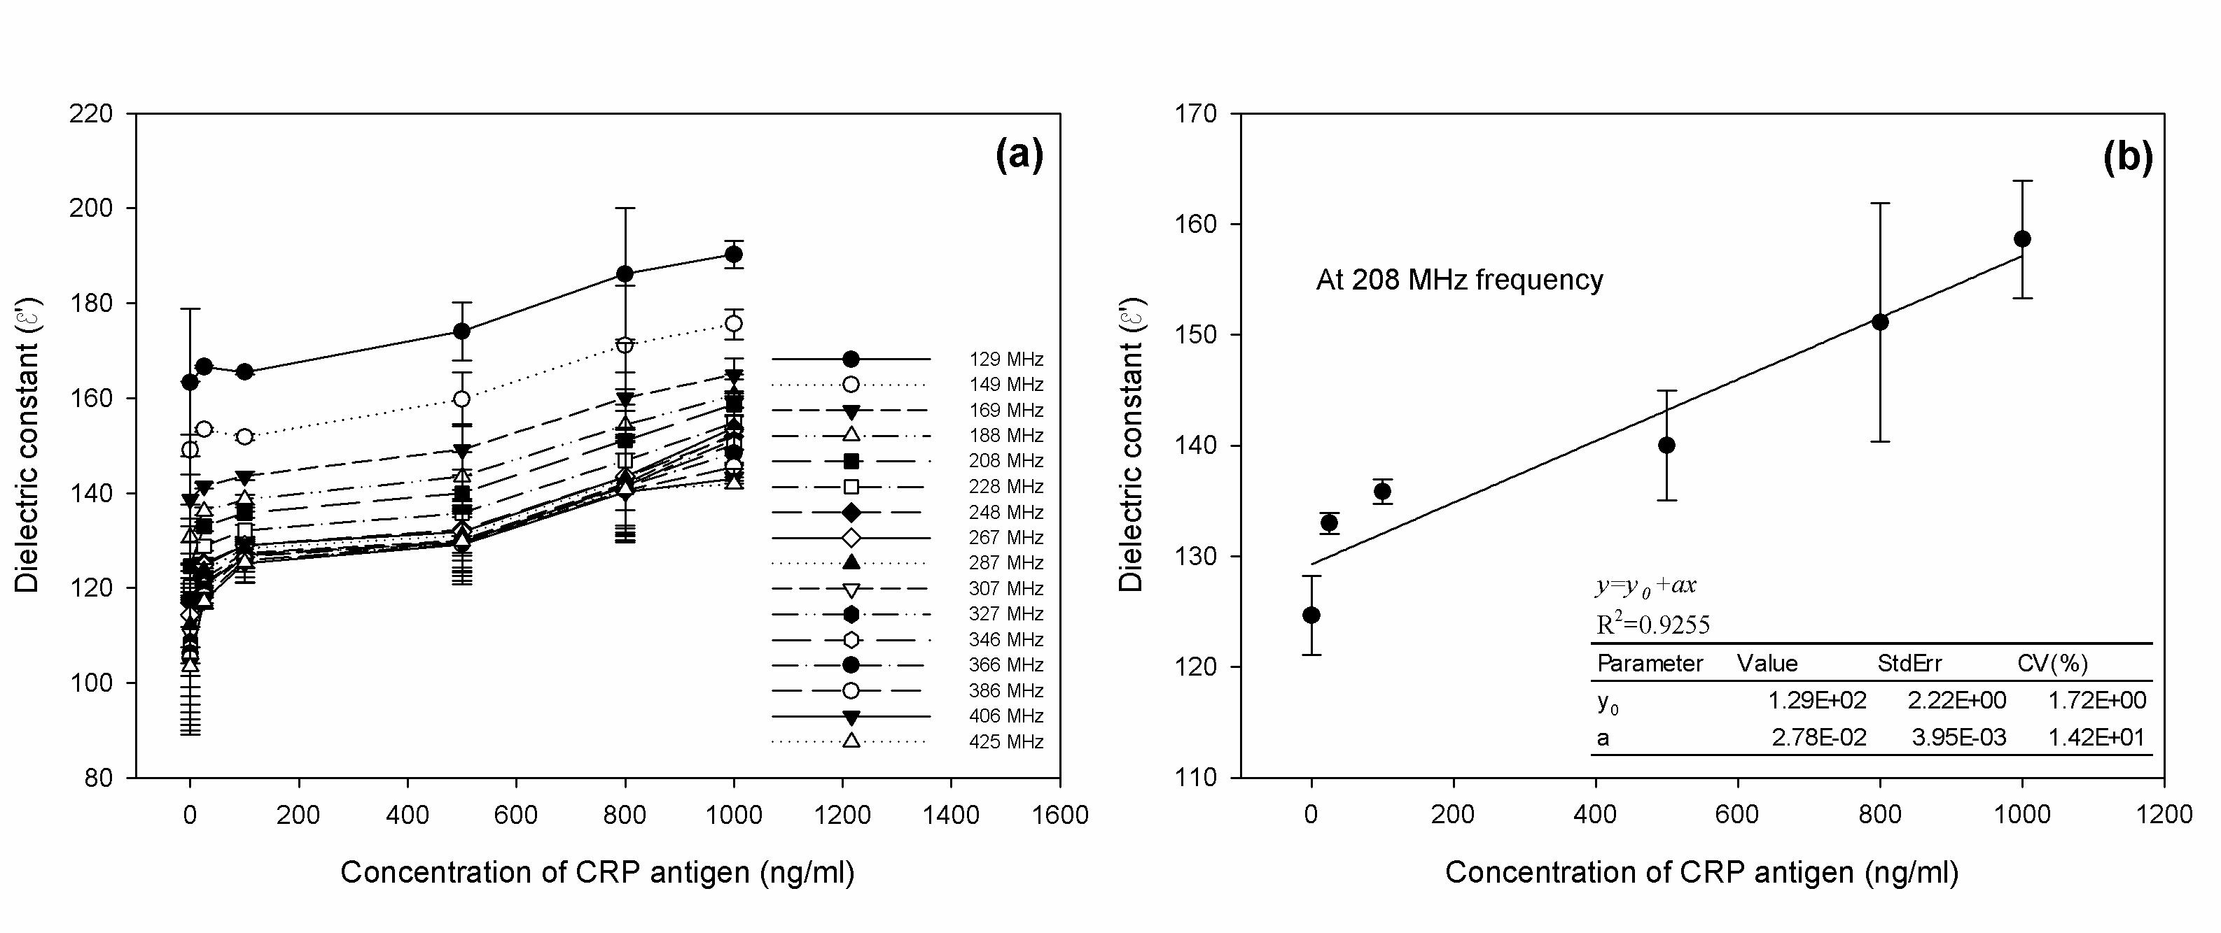
The response of this capacitive based sensor for CRP-antigen protein was dependent on concentration in a range 25-800 ng/ml of CRP-antigen as well as frequency at a range 50-350 MHz.
The concentration and frequency above 800 ng/ml and 350 MHz, respectively showed no increase in response by this sensor system.
This was possibly because of saturation of antibody binding sites on the sensor surface.
The sensor surface was bio-functionalized with a constant amount of CRP-antibody (100 µg/ml). It is clear that there are limited binding sites on CRP-antibodies and thus the limitation of CRP-antigen binding capacity.

Slide 51
The impedance equivalent network circuit based on Cole-Cole model of GID-NCD sensor is given by the following equations,
where, R∞ is function of the high frequency impedance, R_{o} is the function of the low frequency impedance, m is the polarizability constant, and τ is the relaxation time constant.
The polarizability constant value of only antibody on the sensor surface was calculated to be 0.5093, and this value was increased to 0.766 after incubation with CRP antigen.
The relaxation time for CRP antibody alone was in the range 10⁻¹⁶ to 10⁻¹³ s. This relaxation time was found to be elevated to 10⁻¹¹ s when a series of CRP-antigen concentration was exposed.

Slide 52
Conclusion
we have developed a novel capacitive biosensor for detection of CRP-antigen, using interdigitated electrodes/nanocrystalline diamond and silicon dioxide capacitive structure, immobilized with human CRP-antibodies.
The response and sensitivity of this capacitive-based biosensor for CRP antigen was dependent on both concentration and applied frequency.
The values of relaxation time (τ) and polarizability constants (m) of CRP were increased upon incubation with increasing concentration of antigen suggesting that the CRP antigen was captured by the antibodies on the sensor platform.
The dynamic detection range using optimized conditions for a given antibody concentration (100 μg/ml) was found to be in the range 25-800 ng/ml of CRP-antigen.
This range falls within the concentration levels of CRP-antigen in a cardiovascular disease risk conditions.
The sensitivity can be greatly improved by manipulating the surface area of capacitive-sensor as well as the antibody concentration for immobilization.
Notes:
52

Slide 53
Challenges
Minimization of Nonspecific Binding
High Selectivity
Limit of Detection and Reproducibility
Geometry and Structure Of Sensor Surface And Optimization

