Slide 1
Performance Enhancement For Spiral Indcutors, Design And Modeling
Efe Öztürk

Slide 2
Contents
Introduction
Loss Mechanism in Inductors
Ways to improve quality
Conclusion

Slide 3
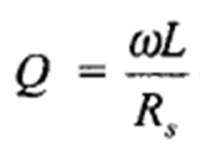
Introduction
Important inductor parameters
Inductance value
Self resonance frequency
Quality factor
With a low-Q inductor :
Increased phase noise in oscillators
High insertion loss in filters & baluns
High power consumption in amplifiers
Poor I/O impedance matching

Slide 4
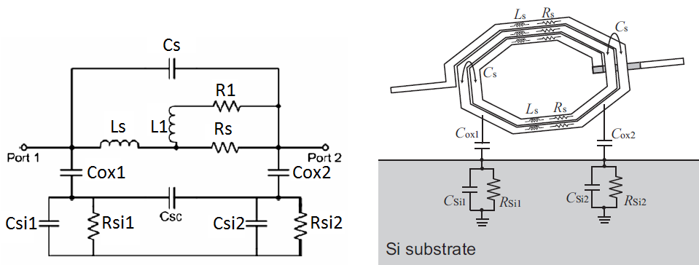
Loss Mechanism
Desired Inductance value : Ls
Metal sheet resistance : Rs
Series feed-forward capacitance or sum of all overlap capacitance: Cs

Slide 5
Loss Mechanism
Spiral to substrate capacitance : Cox
Substrate capacitance : Csi
Substrate resistance : Rsi

Slide 6
Loss Mechanism
Eddy current components, skin effects, proximity effects : R1 & L1
On substrate
On metal trace

Slide 7
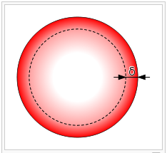
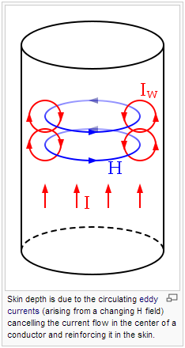
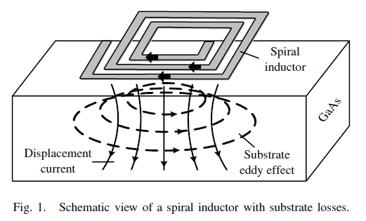
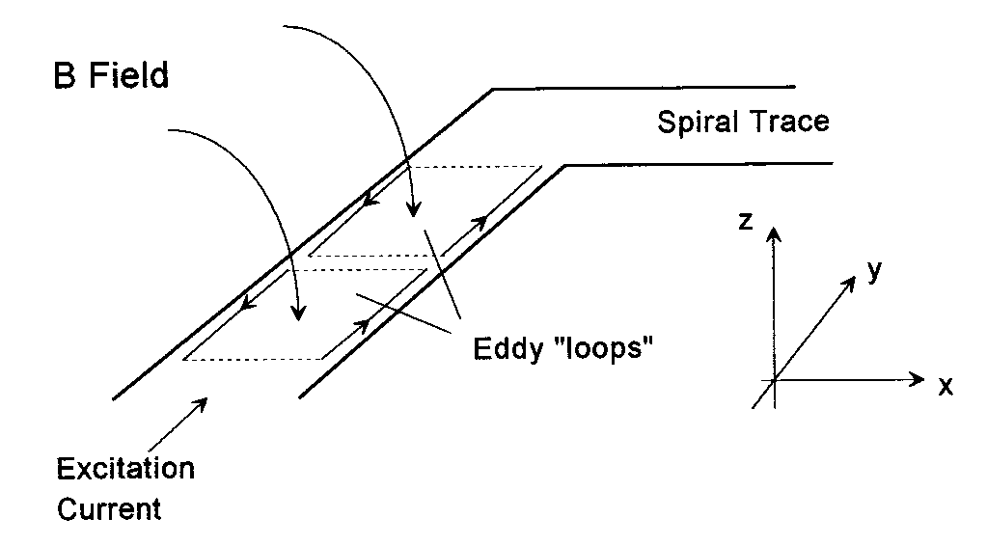
Eddy Currents [ref.17]
1) Eddy Currents
On substrate
On metal trace
2) Skin Effect
3) Proximity Effect
➔ Rs & Substrate loss increases

Slide 8
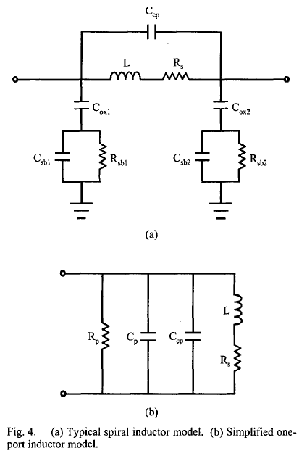
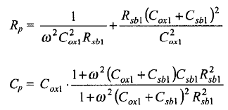
Spiral Inductor Lumped Modeling
Maximum Attainable Q
< 1
< 1

Slide 9
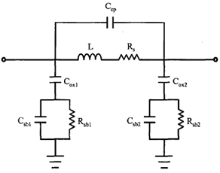
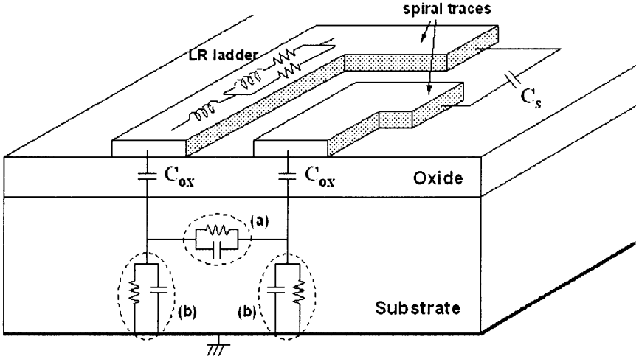
Spiral Inductor Lumped Modeling
Maximum Attainable Q
< 1
< 1
Increase Rp
Reduce Rs
Reduce Cox
Reduce Cs

Slide 10
Ways to improve Q
Physical Properties (width, spacing...)
Patterned Ground Shield (PGS)
Metal Stack, Thicker Metal Layer
High Resistivity Substrates
New inductor models
Oxide Etching

Slide 11
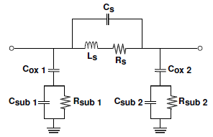
Ways to improve Q
1-High Resistivity Substrate [ref.2]
Play with substrate !
High resistivity substrate (Glass with relative permitivity: 5-6):
high Rsub (compared to Si)
Reduced Csub (compared to Si)
Impedance of the substrate network simply reduces to a single capacitance dominated by the smaller between Cox and Csub

Slide 12
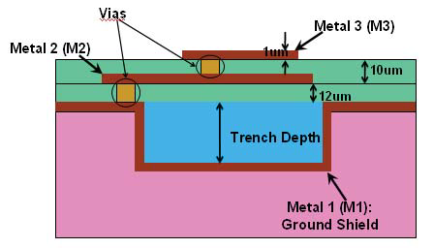
Ways to improve Q
2-Polymer Cavity [ref.15]
Play with substrate !
Increase Rp (Rsub)
Reduce Cp (Csub+Cox)
Polymer underneath (perm:2.75)
Higher resistivity (→ high Rp)
Lower permitivity (→ low Cp)

Slide 13
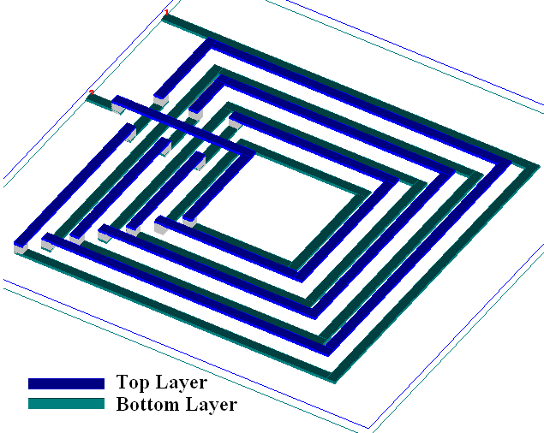
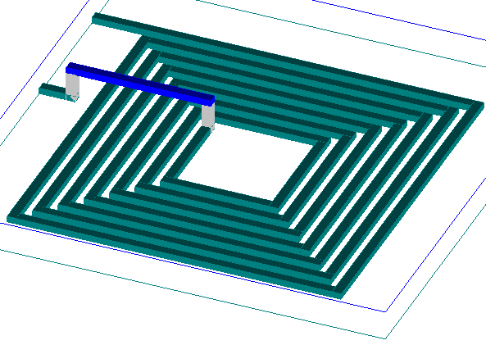
Ways to improve Q
3-Change Model [ref.10]
Series feed-forward capacitance or sum of all overlap capacitance, metal to metal cap, Cs

Slide 14
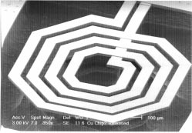
Ways to improve Q
4-Oxide Etching [ref.4]
Remove the oxide layer between the spiral and substrate by an optimized etching tech.
Improve the insulation to inductor
Relative permitivity becomes 1 (vacuum)
Cox capacitance minimized
Reduced substrate effect

Slide 15
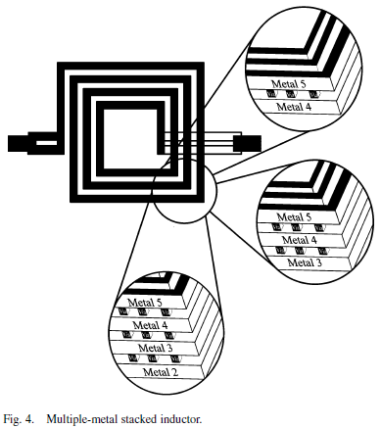
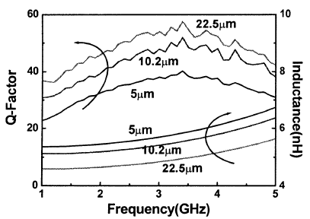
Ways to improve Q
5-Metal Thickness & Stack [ref.18]
Increase metal thickness for high-Q :
Increased metal sidewall areas of current
Decreased metal resistance, Rs
Stack the metals :
Combine metal layers through vias
Decreased metal resistance, Rs

Slide 16
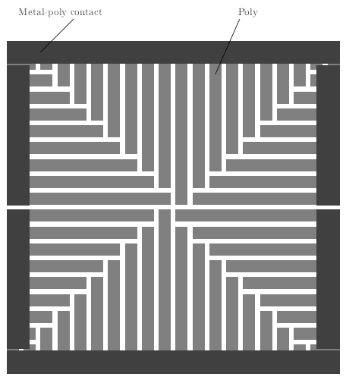
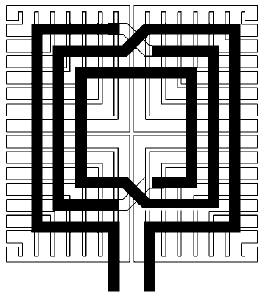
Ways to improve Q
6-Patterned Groung Shielding [ref.9]
Substrate Loss Factor approaches to unity as Rp→inf.
Rp approaches to inf. as Rsi→inf. or Rsi→0.
Patterned Groung Shielding acts as a short.
Slotted pattern reduces the negative mutual coupling. The slots act as open circuit. Prevents the build up of image current
➔ Q,NGS < Q,SGS < Q,PGS
* NGS: no ground shield
* SGS: solid groung shield
* PGS: patterned ground shield

Slide 17
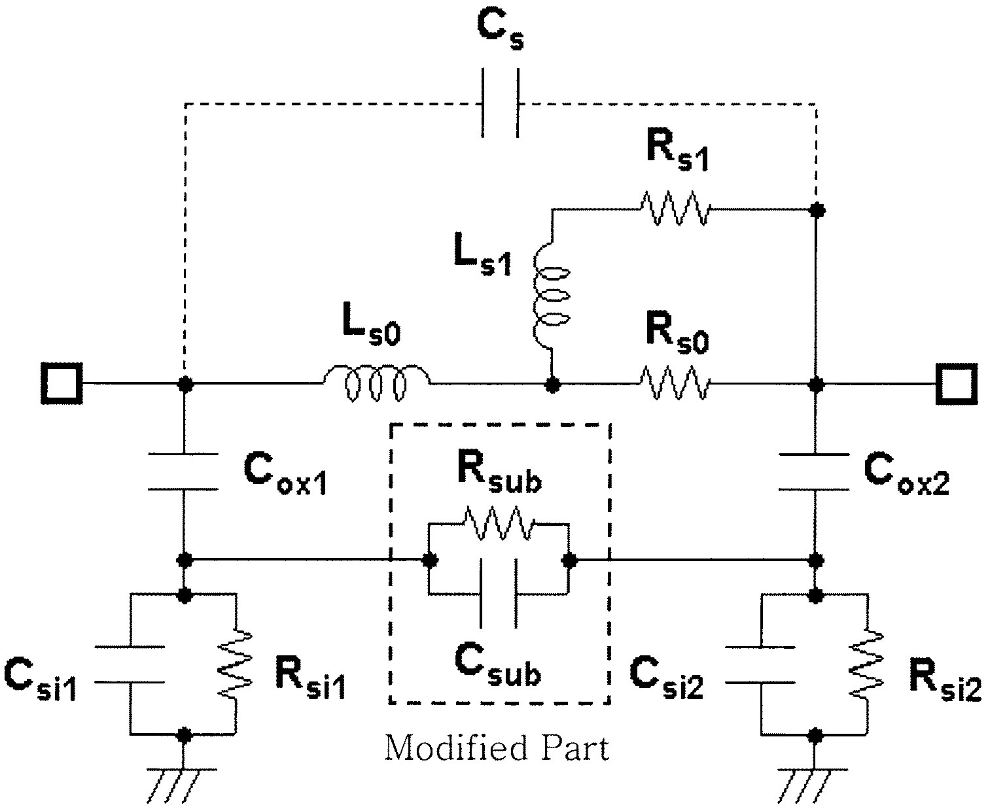
Summary
To improve factor :
Reduce Rs
Increase Rsub
Reduce Csub
Reduce Cox
Reduce Cs

