Slide 1
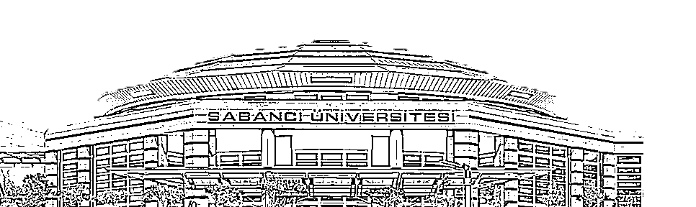
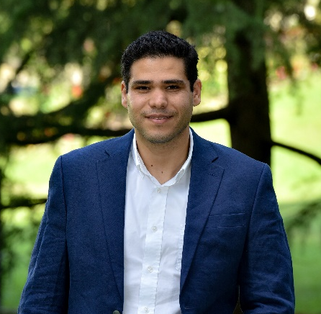

On Advancing mmWave Communications for Mobile Devices
Mohaned Chraiti

Slide 2


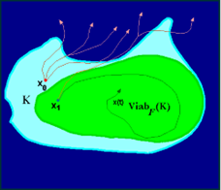
Outline
Career Path
mmWave
Viability theory for ToC
Education and research experience
Awards and Scholarships
Industrial experience
Grants and professional activities
Fundamental problems
Fast Beam forming
Phase noise and rapid variation of the channel
Proposed solutions and experimental results
ToC vs Semantic comm.
Viability theory
Quantifying unforeseen events
Transfer entropy

Slide 3


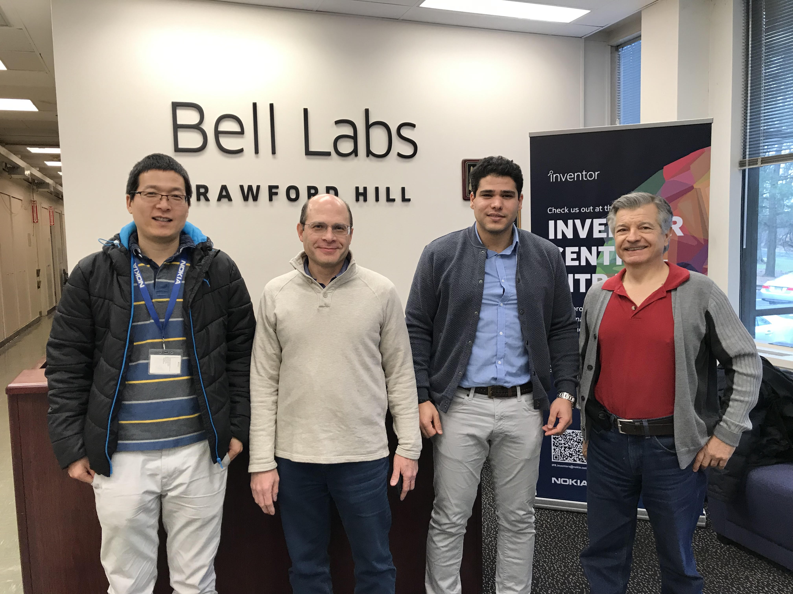






Career Path
Education and Research Experience
Assistant Professor
EE Department (July 2022-present)
Postdoctoral fellow
  LIDS at MIT (January 2020 - December 2021)
PhD in Electrical and Computer engineering
  Concordia University (January 2016 - October 2019)
Research topics
8
Duration: 6 months
Projects:
  mmWave
  Self-organizing network
9 yrs.
mmWave
Task Oriented Communications
Lossy compression
Digital Twin
SON
NOMA
UAV-communications
2.5 yrs.
4
7
Duration: 8 months
Projects:
  Physical-layer security
  Self-organizing network
Awards
Grants
Research
Scholarships
Industry
Awards
Governor General Gold Medal
Valedictorian of the School of Engineering
MSCA-PF
NSERC Fellowships (90,000$)
FQRNT Fellowship (110,000$)
FQRNT doctoral scholarship (60,000$)
Pervasive and Smart Wireless Applications
for the Digital Economy (21,000$)
Over 1.35M$ of grants
1.35M$
346K$
Most prestigious fellowship in Quebec:
7 award in Elec. Eng.
Grants
Most prestigious fellowship in Canada: 10 award in Elec. Eng.
Since 1873
“1” medal for each 2500 graduate student
Scholarships
5

Slide 4

mm ave
Sub-6GHz
600 MHz – 5GHz
Total available bandwidth < 5GHz
mmWave Sub-THz
6 GHz - 300 GHz: bandwidth in the order of dozens of GHz
Large bandwidth:
  High data rate
  Massive connectivity
The feasibility of mmWave communications for mobile devices remain a subject of controversial opinions
High path loss:
Large antenna array
Beam tracking
Validation:
Ray tracing simulator
Non-
Feasible
Non-feasible
Beam tracking:
Large overhead
Channel equalization and phase noise:
Large overhead
Validation:
Experimental results
Standard
Industry

Slide 5



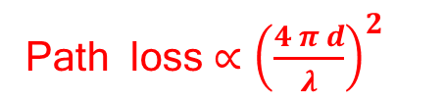
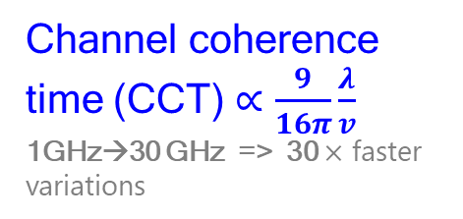







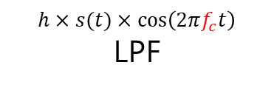




mmWave Communications
Fundamental challenges (1/2)
Beam coherence time (BCT)
BCT=CCT at sub-5GHz
$$>λ/2$$
$$r_{1}$$
Path loss $∝{\left(\frac{4 π d}{λ}\right)}^{2}$
$$h=r_{1}+r_{2}+…$$
$$R_{X}$$
Channel equalization
Down-converter+LPF
$$r_{2}$$
$$h×a_{n}$$
$$h×a_{n}×\frac{h^{∗}}{{\left|h\right|}^{2}}$$
$$h×s(t)×\cos\left(2πf_{c}t\right)$$
LPF
$$T_{X}$$
$$<λ/2$$
$${f_{c}+Δ}_{1}$$
$${f_{c}+Δ}_{2}$$
$$h_{1}$$
$$h_{2}$$
$$>λ/2$$
Phase noise
Mismatch between transmitter LO frequency and the receiver LO frequency
Channel coherence time (CCT) $∝\frac{9}{16π}\frac{λ}{v}$
1GHz→30 GHz => 30 $×$ faster variations
5

Slide 6
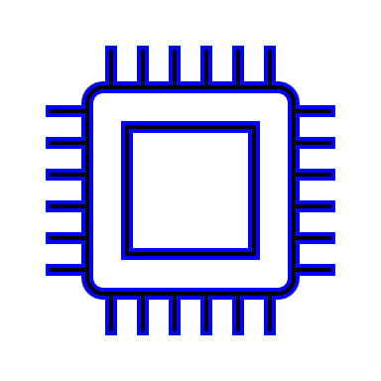
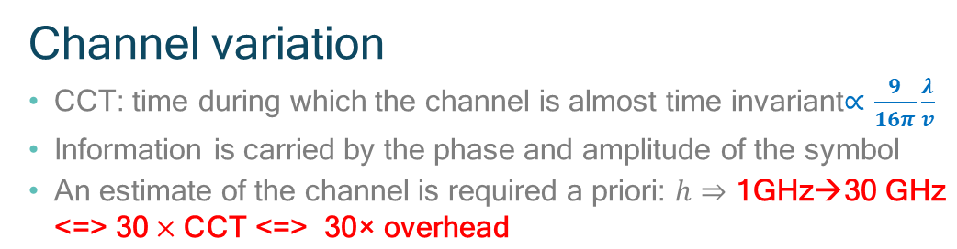
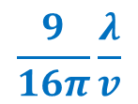
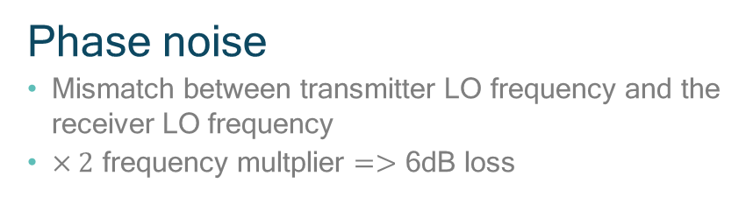
mmWave Communications
Fundamental challenges (2/2)
Channel variation
CCT: time during which the channel is almost time invariant$∝\frac{9}{16π}\frac{λ}{v}$
Information is carried by the phase and amplitude of the symbol
An estimate of the channel is required a priori: $h⇒\text{1}\text{GHz}\text{→30 }\text{GHz} \text{<=>}\text{ 30}×\text{CCT}\text{ <=> 30}\text{×} \text{overhead}$
$$\frac{9}{16π}\frac{λ}{v}$$
Alteration of the phase and amplitude of received symbols
Error probability
Phase noise
Mismatch between transmitter LO frequency and the receiver LO frequency
$×2$ frequency multplier $=>$ 6dB loss
Beam tracking
BCT: time over which the beam direction is almost invariant
Beamforming: CCT=BCT
Beam-steering:
  Sub-6GHz: CCT=BCT
  mmWave and sub-THz: BCT ? CCT
Received power
6

Slide 7
Fast and Low Overhead Beam Tracking
mm ave
Beamforming
Concept: precode the signal or configure the antennas phase-shifters according to an estimate of the channel
Advantage: achieves the maximum array gain
Drawbacks: large channel training overhead (short CCT, week channel, etc.)
Multiple antennas
Develop a beam-steering technique with short search time and minimum gain guarantee
Beam-steering
Concept: try different beams, then pick the best
Advantage: no need to estimate channel per antenna
Drawbacks:
  How often to update the beam direction? BCT ? CCT
  time consuming for exhaustive search
  no performance guarantee
7
Notes:
To replace
The advanateg that comes with mmWave is the small size of an antennas and hence the possibility to integrate large number of antenna in small device. In order to compensate for the loss, one may need to

Slide 8
Beam Coherence Time/Space
Definition
Channel estimate
is almost time invariant
Channel equalization
Error probability
Channel CT
Beam CT
Beam and width direction estimate are almost time invariant
Beam steering vector
Received power
Sub-6GHz: BCT=CCT

Slide 9
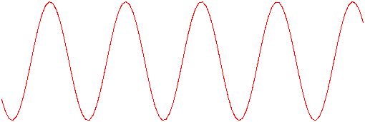


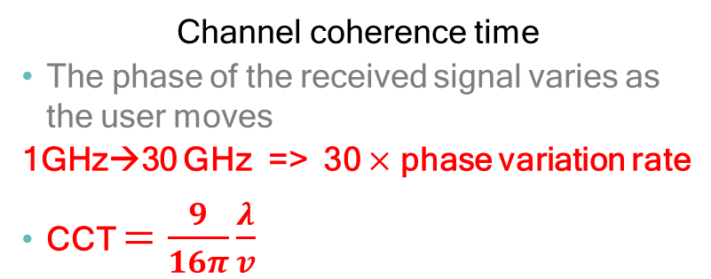

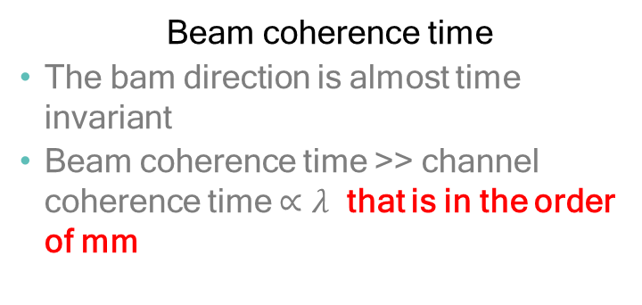

Beam Coherence Time/Space
CCT vs BCT: the case of free space transmissions (single ray)
0
Channel coherence time
The phase of the received signal varies as the user moves
1GHz→30 GHz => 30 $×$ phase variation rate
CCT $=\frac{9}{16π}\frac{λ}{v}$
$$\frac{π}{2}$$
$$π$$
0
Beam coherence time
The bam direction is almost time invariant
Beam coherence time >> channel coherence time $∝λ$ that is in the order of mm
$$π$$

Slide 10



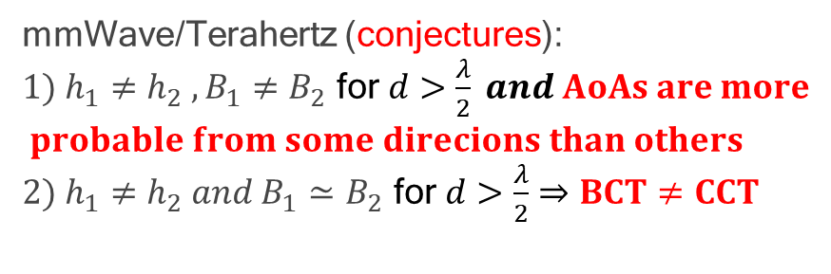
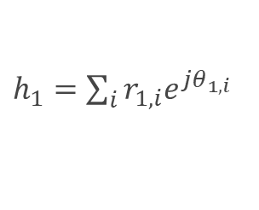
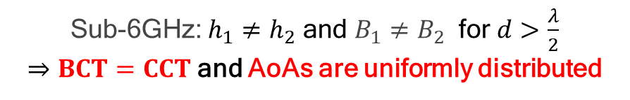
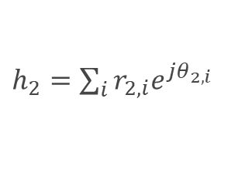


Beam Coherence Time/Space
Conjecture: sparse vs rich scattering
$h_{1}=\sum_{i}{r_{1,i}e^{{jθ}_{1,i}}}$
$h_{1}=re^{θ_{1}}$
d
d
$h_{2}=re^{θ_{2}}$
$h_{2}=\sum_{i}{r_{2,i}e^{jθ_{2,i}}}$
mmWave/Terahertz (conjectures):
${1) h_{1}≠h_{2} , B}_{1}≠B_{2}$ for $d>\frac{λ}{2} and AoAs are more$
$$probable from some direcions than others$$
${2) h_{1}≠h_{2} and B}_{1}≃B_{2}$ for $d>\frac{λ}{2}$ $⇒BCT≠CCT$
Sub-6GHz: $h_{1}≠h_{2}$ and $B_{1}≠B_{2}$ for $d>\frac{λ}{2}$
$⇒BCT=CCT$and AoAs are uniformly distributed

Slide 11

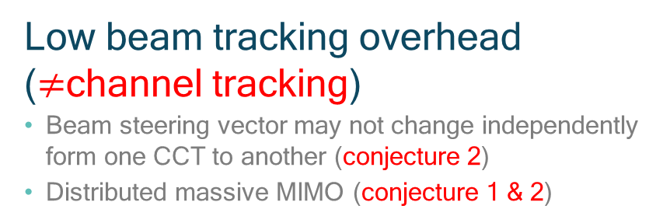
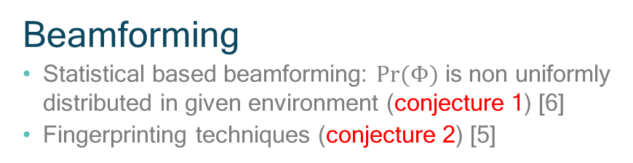
Beam Coherence Time/Space
Conjectures’ implications
Beamforming
Statistical based beamforming: $Pr⁡(Φ)$ is non uniformly distributed in given environment (conjecture 1) [6]
Fingerprinting techniques (conjecture 2) [5]
Low beam tracking overhead ($≠$channel tracking)
Beam steering vector may not change independently form one CCT to another (conjecture 2)
Distributed massive MIMO (conjecture 1 & 2)
Others works
Radio resource allocation often require SNR estimate
Multiplexing (conjecture 2)

Slide 12
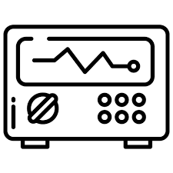


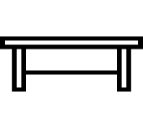




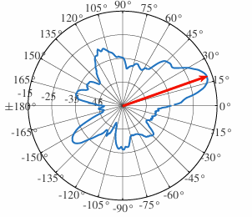
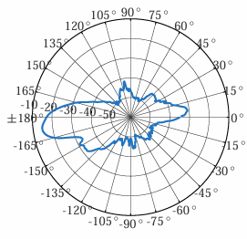


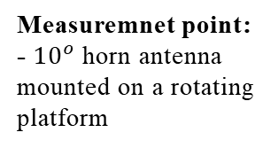
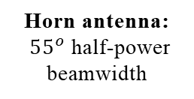
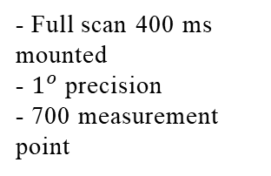
Beam Coherence Time/Space
Harsh propagation environment: Indoor office environment
Measuremnet point:
- $10^{o}$ horn antenna mounted on a rotating platform
- Full scan 400 ms mounted
- $1^{o}$ precision
- 700 measurement point
Experimental vs ray tracing
Two ray model does not match the experimental results [10]=> five ray's model
Preliminary results: radiation pattern at two close locations
…
Horn antenna:
${55}^{o}$ half-power beamwidth
30cm
…
5 m
118 m
Dynamic environment:
moving obstacles

Slide 13

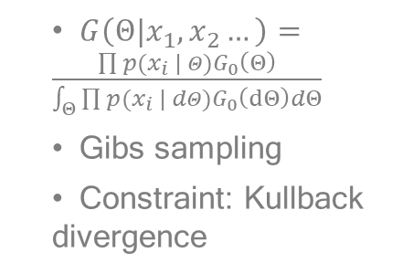
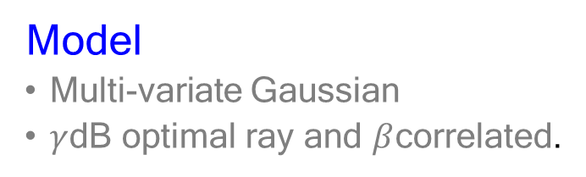
Beam Coherence Time/Space
AoAs statistics inference
Objecticve
Infer a statistical model about the AoAs: repetitive structure
AoAs correlation as a function of crossed distance
Bayesian learning
Beam coh. distance
$G\left(Θ|x_{1}, x_{2}…\right)=\frac{\prod{p(x_{i} | Θ)}G_{0}\left(Θ\right)}{\int_{Θ}{\prod{p(x_{i} | dΘ)}G_{0}\left(dΘ\right)dΘ}}$
Gibs sampling
Constraint: Kullback divergence
Correlation between beam pattern as functionof the crossed distance.
Model
Multi-variate Gaussian
$γ$dB optimal ray and $β$correlated.
Challenge
Non-parametric inference

Slide 14
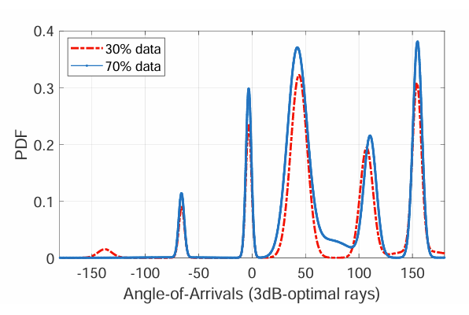
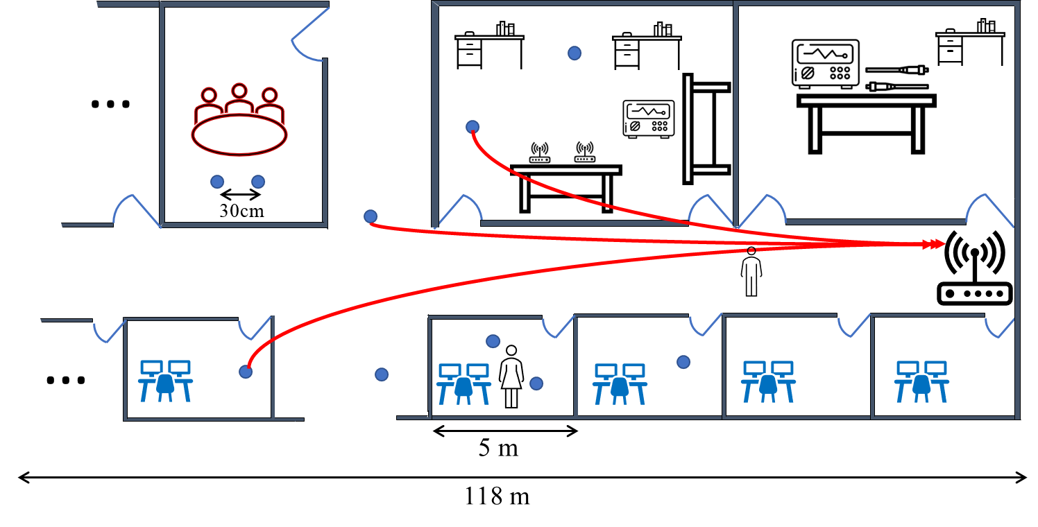
Beam Coherence Time/Space
Results: conjecture 1
AoAs are not uniformly distributed
The results differs from the existing belief of uni-modal distribution [6]
The distribution may differ from one environment to another

Slide 15
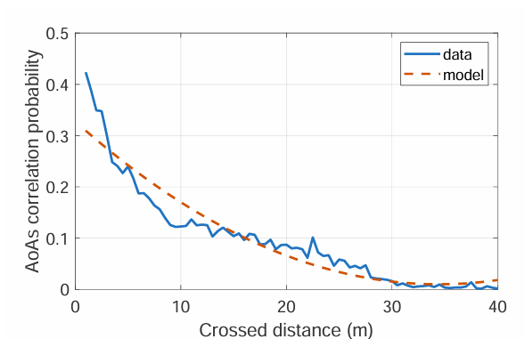
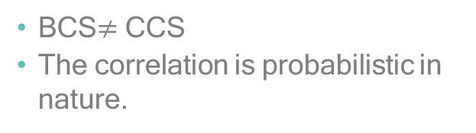
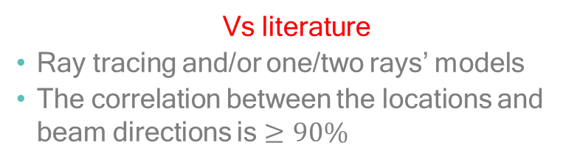
Beam Coherence Time/Space
Results: conjecture 2
BCS$≠$ CCS
The correlation is probabilistic in nature.
Vs literature
Ray tracing and/or one/two rays’ models
The correlation between the locations and beam directions is $≥90\%$

Slide 16


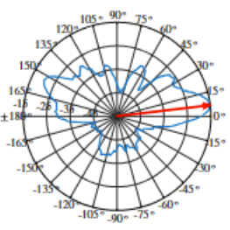









Fast Beam Search
Finger Printing (conjecture 2)
Finger printing technique
Principle: beam search according the steering vectors in a surrounding area (often collected offline)
Assumption (conjecture 2): there is correlation between the beam direction and the location of the user
=> Beam direction channel coefficient is almost constant in a given proximity
Advantage: low beam tracking overhead
Illustrative example:
$$S_{1}$$
$$u_{1}$$
$$u_{2}$$
$$S_{2}$$
$$u_{3}$$
Coverage area
$$u_{1}$$
$$u_{2}$$
$$S_{1}$$
$$S_{2}$$

Slide 17
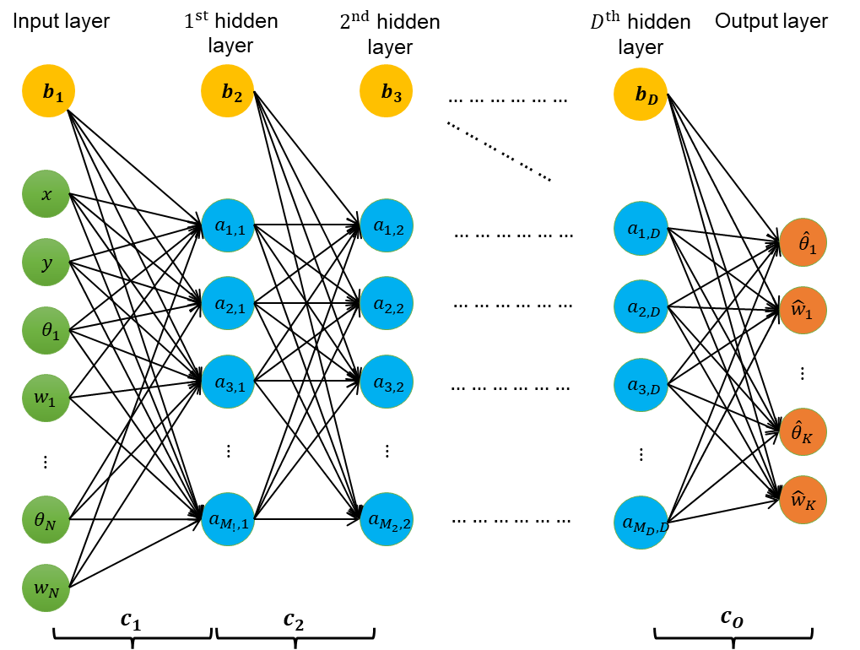
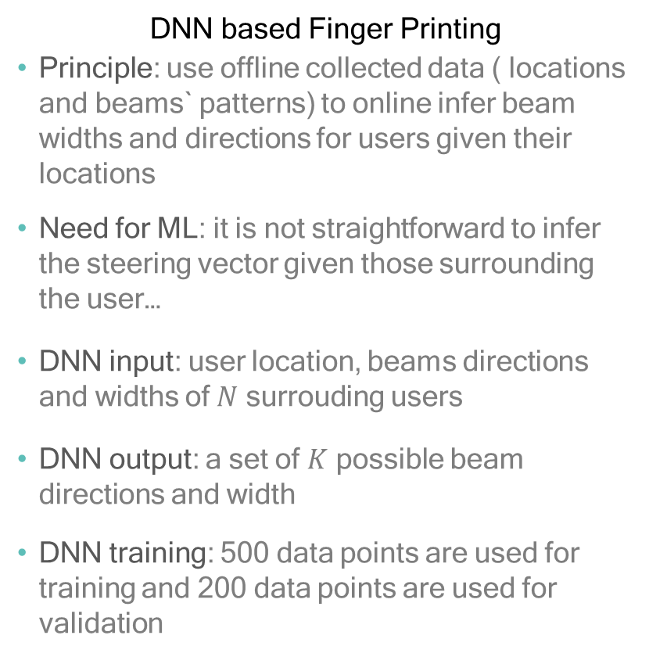
Fast Beam Search
Finger Printing: implementation DNN
DNN based Finger Printing
Principle: use offline collected data ( locations and beams` patterns) to online infer beam widths and directions for users given their locations
Need for ML: it is not straightforward to infer the steering vector given those surrounding the user…
DNN input: user location, beams directions and widths of $N$ surrouding users
DNN output: a set of $K$ possible beam directions and width
DNN training: 500 data points are used for training and 200 data points are used for validation
DNN architecture for fingerprint mmWave beamforming

Slide 18
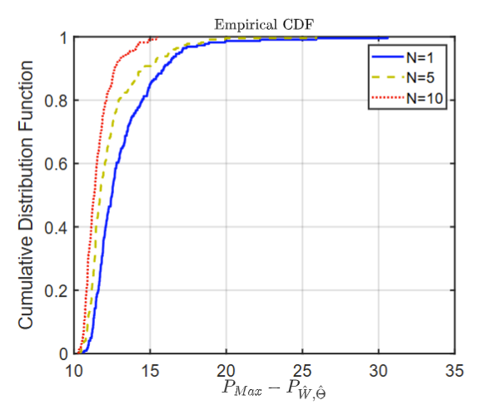
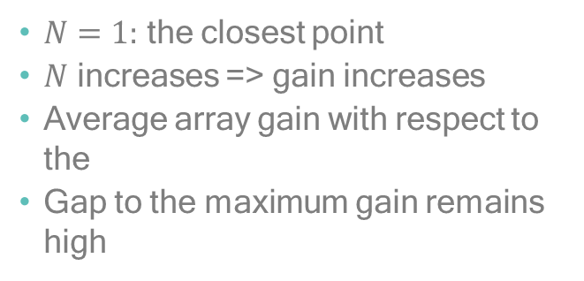
Fast Beam Search
Finger printing performance: perfect location side information
$N=1:$ the closest point
$N$ increases => gain increases
Average array gain with respect to the
Gap to the maximum gain remains high
The CDF of max-to-achievable gain for different values
of the surrounding N

Slide 19
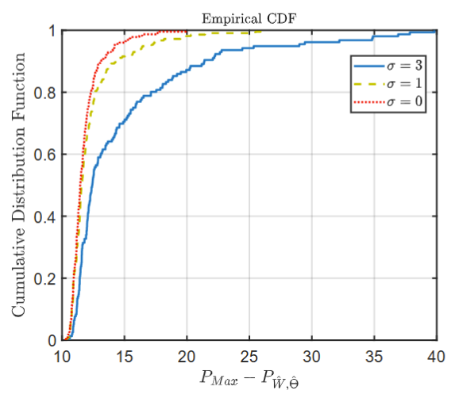
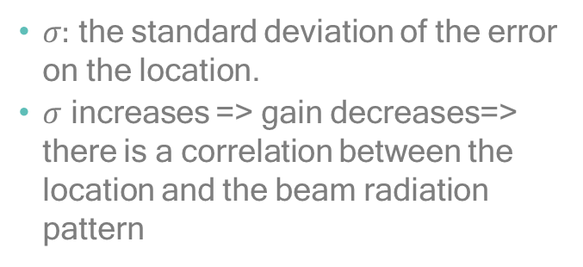
Fast Beam Search
Finger printing performance: non perfect location side information
$σ:$ the standard deviation of the error on the location.
$σ$ increases => gain decreases=> there is a correlation between the location and the beam radiation pattern
The CDF of max-to-achievable gain in presence of
localization error

Slide 20
Fast Beam Search
Finger printing: conclusion
Beam coherence space is higher than the channel coherence space
The correlation between the beam radiation patterns of adjacent users is probabilistic in nature
Finger printing technique may enhance the received power but a gap to the maximum remains. It can be used for initial phase to establish a connection with a user

Slide 21
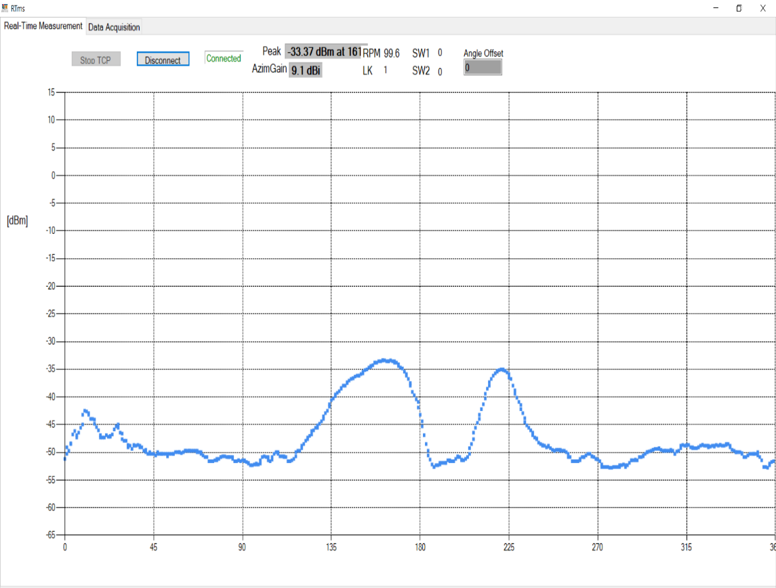
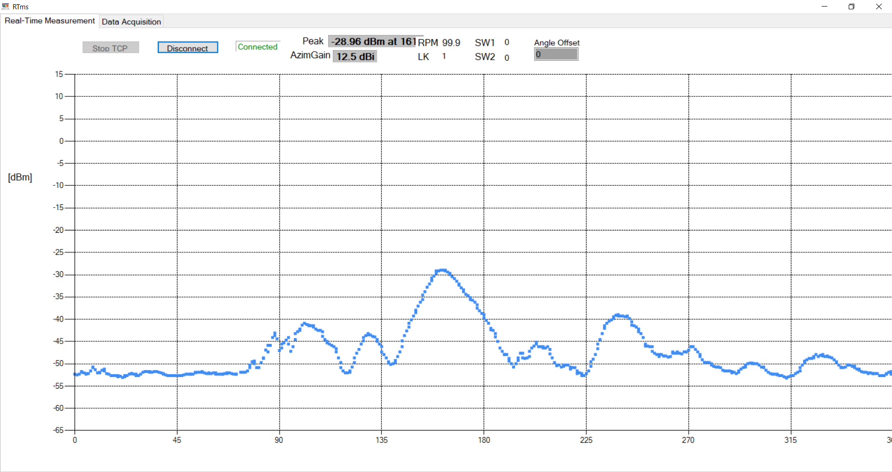
Fast Beam Search
Statistical based codebook design (conjecture 1)
Strong signals are more probable in certain directions
(The direction from the user to the access node is taken as a reference)
Different offices

Slide 22
Fast Beam Search
Statistical based codebook design: core idea
Updating the codebook
Collecting measurements {angle, power}
Codebook learning:
direction-beamwidth
Beam selection
Codebook broadcasting
Service provider
Users
Most probable beam directions and widths (statistical learning)
Select the beam
$(∈$codebook) that maximizes transmit/receive power.
Select the beam
(∈ codebook) that maximizes transmit/receive power.
Constraint:
gap to the maximum less than 5dB

Slide 23
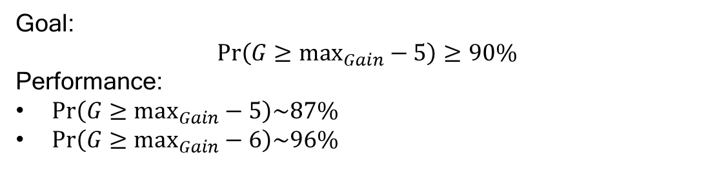
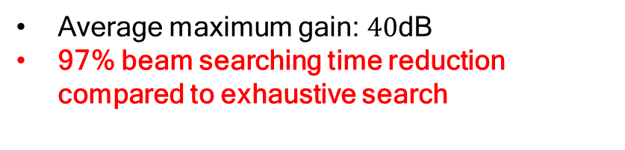
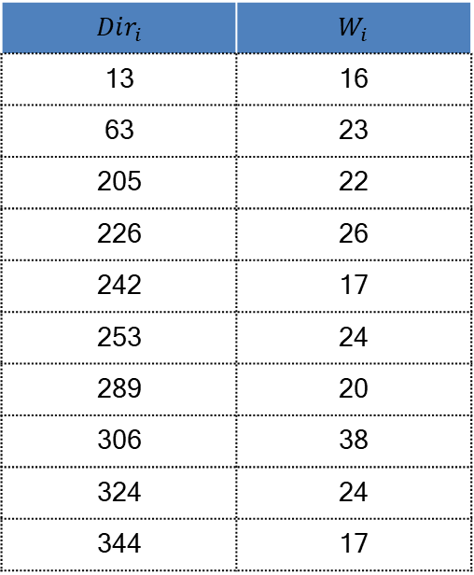
Fast Beam Search
Statistical based codebook design: performance
$$Dir_{i}$$ | $$W_{i}$$
13 | 16
63 | 23
205 | 22
226 | 26
242 | 17
253 | 24
289 | 20
306 | 38
324 | 24
344 | 17
Goal:
$$Pr\left(G≥\max_{Gain}−5\right)≥90\%$$
Performance:
$Pr\left(G≥\max_{Gain}−5\right)\sim 87\%$
$Pr\left(G≥\max_{Gain}−6\right)\sim 96\%$
Average maximum gain: $40$dB
97% beam searching time reduction compared to exhaustive search

Slide 24
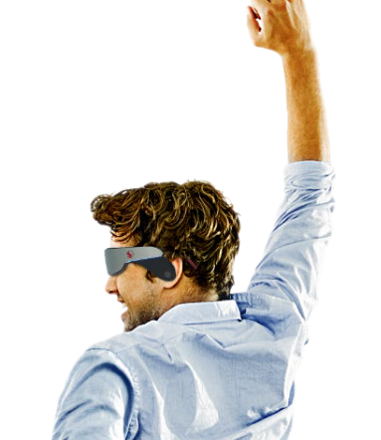
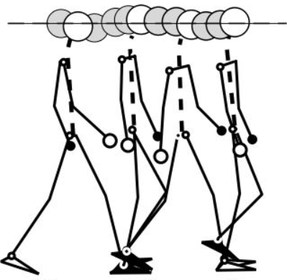

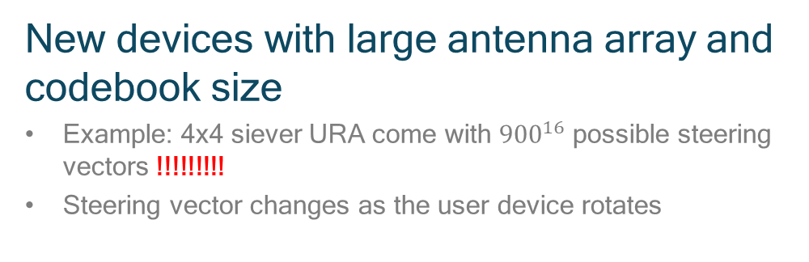
Fast Beam Search
Rotating devices
“Motion”
Rotating user device
Finger Printing and statical based beam steering techniques provide the beam direction with respect to a static reference direction
Neighbor users may be oriented toward different directions and tracking the beam direction with respect to a reference direction may not be practical
=> All the beam steering vector are equal probable=> exhaustive search?
New devices with large antenna array and codebook size
Example: 4x4 siever URA come with ${900}^{16}$ possible steering vectors !!!!!!!!!
Steering vector changes as the user device rotates
24
Channel Coherence Time is a physical priority of the channel and is immutable

Slide 25
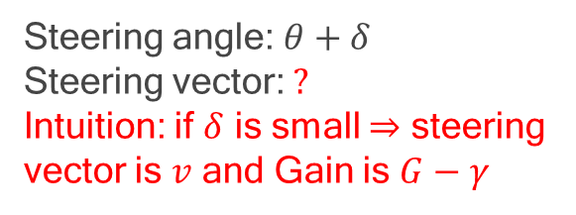

Fast Beam Search
Rotating devices: intuition
Steering angle: $θ$
Steering vector: $v$
Array Gain: $G$
Steering angle: $θ+δ$
Steering vector: $?$
Intuition: if $δ$ is small $⇒$ steering vector is $v$ and Gain is $G−γ$

Slide 26




Fast Beam Search
Rotating devices: codebook refinement
Reduce the codebook size until all angles are covered and the gain to the maximum does not exeed $γ$ dB

Slide 27


mm ave
Overcoming the Effect of the Phase Noise and the Rapid variation of the channel
Channel coherence time
The phase of the received signal varies as the user moves
$a_{n}h\left(t\right)×h^{∗}\left(t+δ\right)={α a}_{n}$ $e^{jφ}$
1GHz→30 GHz => 30 $×$ phase variation rate
CCT$=\frac{9}{16π}\frac{λ}{v}$
CCT is a physical property of the channel and is immutable
Phase noise
Mismatch between transmitter LO frequency and the receiver LO frequency
$a_{n}e^{j2πf_{c}}×$ $e^{−j2π{(f}_{c}+Δ)}=a_{n}e^{jΔ}$
=> constellation rotation
$×2$frequency multiplier => 6 dB degradation
Hardware limit

Slide 28






Phase Noise and Short CCT
Fundamental problems
Coherent transmission
Information is carried by the phase and amplitude of the symbol
An estimate of the channel and phase noise tracking are required a priori
0
$$\frac{π}{2}$$
$$π$$
Mobility
Channel coefficient changes as IoE device moves
Many IoE are highly mobile (e.g., UAV and Autonomous cars)
0
Performance
CCT is time necessary to cross a distance in the order of mm
1GHz→30 GHz => 30$×$ overhead
CCT is inversely proportional to the IoE speed
Channel training overhead >1/3 of the bandwidt
$$π$$
$$\frac{9}{16π}\frac{λ}{v}$$
28
Notes:
As you may know Typically the binary information are mapped into symbols defined by a phase and amplitude then transmitted. As the signal goes through the channel, I will be received with random amplitude and phase which we call the channel coefficient. So to disassociate the information symbol form the channel, the receiver need an estimate of the channel prior to transmission. The problem is the device moving and as it moves the phase and the amplitude changes as well. Let observe togther hwo this happen. As the mobile divoce move the pahse of the received signal changes. So that the channel coherence capture the time beyond which th For instance it could goes froma peak to zero if the device cross a distance of equlate to quarter of wave length. As you may expected the large the wave lengh (means the lower the frequency) that

Slide 29

Phase Noise and Short CCT
Other facts
Very short mmWave CCT at high speed
Speed | Coherence time | OFDM symbols
30 Km/h | 2.1e-4 | 3
100 Km/h | 6.4e-5 | 0.9
Channel training
Worst case scenario
Highest speed
Channel Coherence Time is a physical priority of the channel and is immutable
“Motion”
Motion reduces further the CCT
MmWave Channel coherence time is the time necessary to cross a distance in the order of millimeters
Effective speed of a mobile device is larger than the walking/cycling/car speed
29

Slide 30







Phase Noise and Short CCT
Solution
- 4dB error probability
coherence time
$∝\frac{d}{v}≈8000×\frac{λ}{v}$
estimation uncertainty
dozens of meters
Proposed solution
Channel estimation
power loss due to overhead
coherence time
$∝\frac{λ}{v}$
new estimate each mm of displacement

Slide 31
Viability
Theory for ToC
Quantifying the Impact of the Unknown on the Performance of ToC

Slide 32


Outline
Viability theory for ToC
Power plant: ToC
Results
ToC vs Semantic comm.
Viability theory
Transfer entropy
System model
Problem Formulation
Simulations
Conclusions

Slide 33




Viability Theory for ToC
Task-oriented vs Semantic Communications
Semantic:
types
number
Shapes…
ToC:
Final action (stop the vehicle)
Presence of an obstacle at X meters
The integrity of data
Counter intuitive example:
Red light: a tree is in the road
Green light: the tree is removed from the road
Example: Autonomous vehicle assisted by a control unit in the cloud

Slide 34

Viability Theory for ToC
Core idea
Core idea
Develop a general framework to assess the minimum communication rate that ensures proper operations of the system
It is deemed to be difficult to incorporate unforeseen events while using exiting optimization principle
Risk assessment is implicit while applying the viability theory
Viability space can be determined through optimization, machine learning or other tools, but differs in concept to typical optimization
Typical optimization concept:
Shortest path⬄ one solution as per the objective function
Viability theory concept:
Through the longest path there is a larger room for errors ⬄ larger viable space

Slide 35

Viability Theory for ToC
Viability space
Viable space K: The space of the states in which the constraints (including the safety) are fulfilled
Viability Kernel: The space of the states from which the system starts and remains while evolving within the viable space (avoid dead ends)
Non-viable space: the space of the possible states where one or multiple constraints are not satisfied
The closer is the state to the center of the kernel, the lowest is the probability to be propelled into a non-viable state given an unforeseen event

Slide 36



Viability Theory for ToC
Size of the viability kernel: communication rate, environment and system capability
Communication channel
Actor:
Initially Less knowledgeable than the control unit
Control/assistance unit:
Trained model
“Chirurgical precision”
Environment
Viability kernel by analogy to the probability distribution
Case 1: high communication rate Case 2: low communication rate
$$\operatorname{Pr}\left(s→s^{′}\right)∈\overline{K_{viab}}$$
$$\operatorname{Pr}\left(s→s^{′}\right)∈\overline{K_{viab}}$$

Slide 37

Viability Theory for ToC
Transfer Entropy : knowledge transfer
Core idea
The capacity of the actor to learn from the decisions of the control unit and vice versa are often overlooked to reduce the communication rate
Transfer Entropy: quantifies the flow of information between two random processes by analyzing causality
The impact of the control unit decisions/directives at the previous (N − 1) time slots on the state of the actor is quantified as follows:
Actor
Flow of information between two random processes
$${R_{ITL}\left((N+1)T\right)=\frac{1}{N}H(u(NT)|x\left(NT\right),x\left(NT−T\right)…x\left(1\right),u\left(NT−T\right), u\left(NT−2T\right),…)} +\frac{1}{N}DI (u\left(NT\right), u\left(NT−T\right),…→x\left(NT\right), x\left(NT−2T\right)…)$$
Control/assistance unit

Slide 38



Power plant: ToC
System model
System model
Power Plant: it is one of the basic system often studied in dynamic control theory
Sate variables: temperature and pressure
Control inputs: the rate at which the heat is supplied to the plant and the rate at which a pneumatic piston is displaced
Objective: adjust the communication rate to keep the state variables within the viability kernel
The process requires cycling the plant repeatedly through three operating points (normalized numerical values):
X1 = (0, 0), X2 = (2.5, 2), and X3 = (1, 3) (neighborhoods)
the system must visit three states’ levels cyclically in order
Power plant
Communication and information flow
Control unit

Slide 39

Power plant: ToC
Mathematical formulation
$$\inf_{x\left((N+1)T\right)∈K_{viab}}{c\left(u(\left(N+1\right)T)\right)−R_{ITL}(\left(N+1\right)T)}$$
where the in-the-loop transfer entropy is given by
$${R_{ITL}\left((N+1)T\right)=\frac{1}{N}H(u(NT)|x\left(NT\right),x\left(NT−T\right)…x\left(1\right),u\left(NT−T\right), u\left(NT−2T\right),…)} +\frac{1}{N}DI (u\left(NT\right), u\left(NT−T\right),…→x\left(NT\right), x\left(NT−2T\right)…)$$

Slide 40


Coherence Time/Sapce
Simulation results: example in [9]
Evolution of the communication rate with time and its impact on the state of the system at phase-I
The proposed solution decrease the communication rate by 50% in Phase, by 12% in Phase-III, and by 14% in Phase-III

Slide 41
Conclusions
Incorporate the viability theory and directed information reduce the communication rate from ToC perspective
Proposes a ToC framework to implicitly quantify unforeseen events
Demonstrates the integration of viability theory into TOC with an academic example of power plant system

