Slide 1
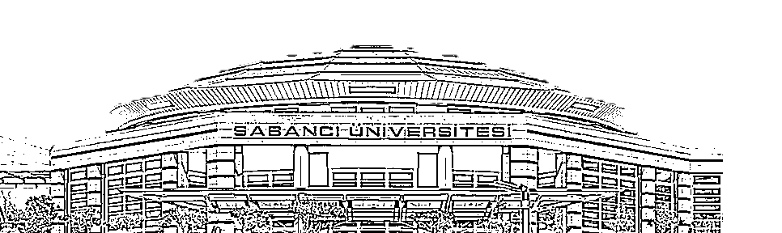
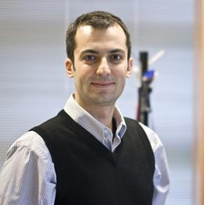
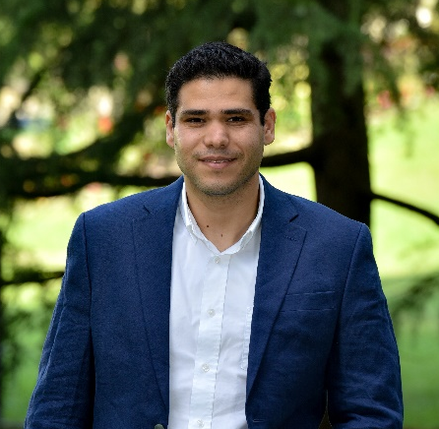



On the Efficacy of Fingerprint-Based mmWave Beamforming in NLOS Environments: Experimental Validation
Mohaned Chraiti
Ali Ghrayeb

Slide 2



Outline
Coherence Time
Finger printing
Results
Definition
Beam coherence time vs channel coherence time
Conjecture
Principle
AI empowered Finger Printing
Experimental set up
Array gain
Conclusion

Slide 3
Coherence Time/space
Definition
Finger printing
Principle: beam search according the steering vectors in a surrounding area (often collected offline)
Assumption: there is correlation between the beam direction and the location of the user
=> Beam direction channel coefficient is almost constant in a given proximity
Advantage: low beam tracking overhead
Channel estimate
is almost time invariant
Channel equalization
Error probability
Channel CT
Beam CT
Beam and width direction estimate are almost time invariant
Beam steering vector
Received power
Sub-6GHz: BCT=CCT

Slide 4
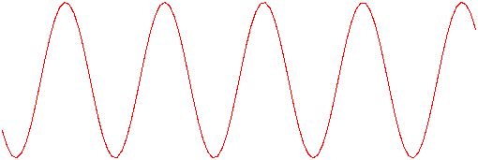


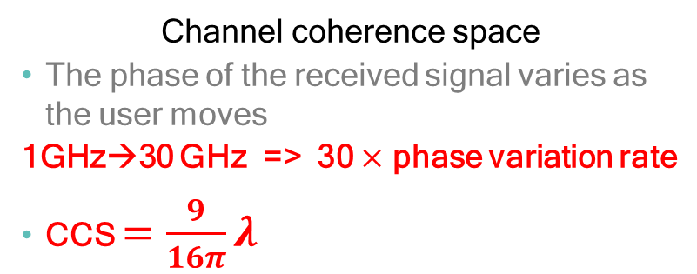

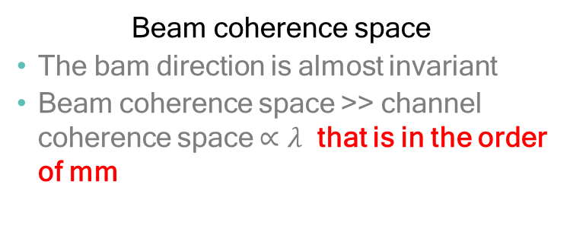

Coherence Time/Space
CCS vs BCS: the case of free space transmissions (single ray)
0
Channel coherence space
The phase of the received signal varies as the user moves
1GHz→30 GHz => 30 $×$ phase variation rate
CCS $=\frac{9}{16π}λ$
$$\frac{π}{2}$$
$$π$$
0
Beam coherence space
The bam direction is almost invariant
Beam coherence space >> channel coherence space $∝λ$ that is in the order of mm
$$π$$

Slide 5



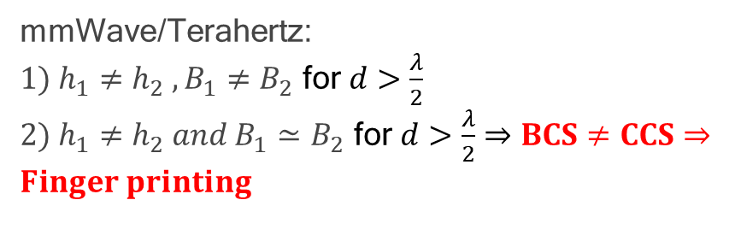
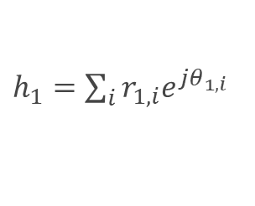
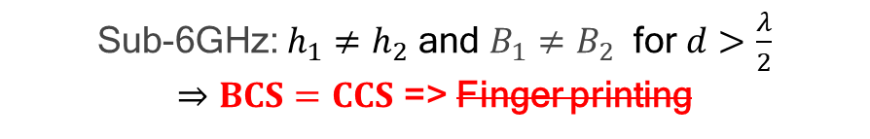
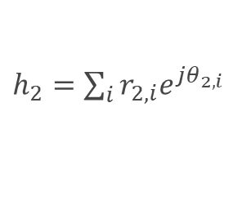


Coherence Time/Sapce
Sparse vs rich scattering
$h_{1}=\sum_{i}{r_{1,i}e^{{jθ}_{1,i}}}$
$h_{1}=re^{θ_{1}}$
d
d
$h_{2}=re^{θ_{2}}$
$h_{2}=\sum_{i}{r_{2,i}e^{jθ_{2,i}}}$
mmWave/Terahertz:
${1) h_{1}≠h_{2} , B}_{1}≠B_{2}$ for $d>\frac{λ}{2}$
${2) h_{1}≠h_{2} and B}_{1}≃B_{2}$ for $d>\frac{λ}{2}$ $⇒BCS≠CCS⇒Finger printing$
Sub-6GHz: $h_{1}≠h_{2}$ and $B_{1}≠B_{2}$ for $d>\frac{λ}{2}$
$⇒BCS=CCS$ => Finger printing

Slide 6

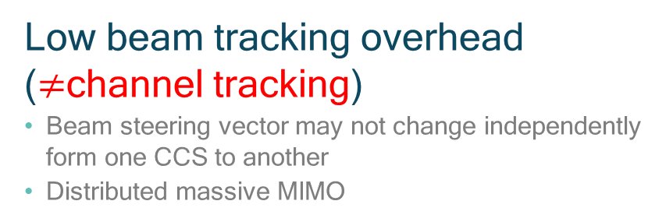
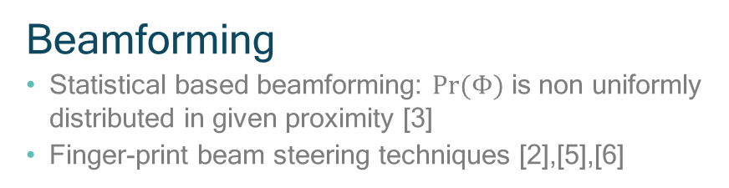
Coherence Time/Space
Conjecture Implications
Beamforming
Statistical based beamforming: $Pr⁡(Φ)$ is non uniformly distributed in given proximity [3]
Finger-print beam steering techniques [2],[5],[6]
Low beam tracking overhead ($≠$channel tracking)
Beam steering vector may not change independently form one CCS to another
Distributed massive MIMO
Others works
Radio resource allocation often require SNR estimate
Multiplexing

Slide 7
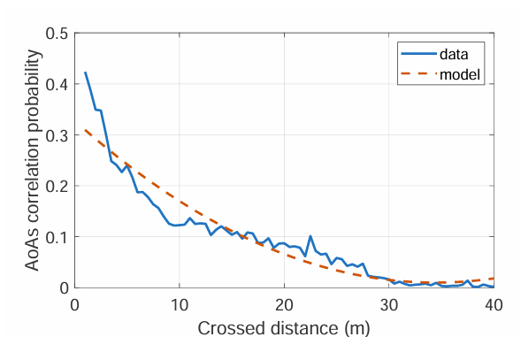
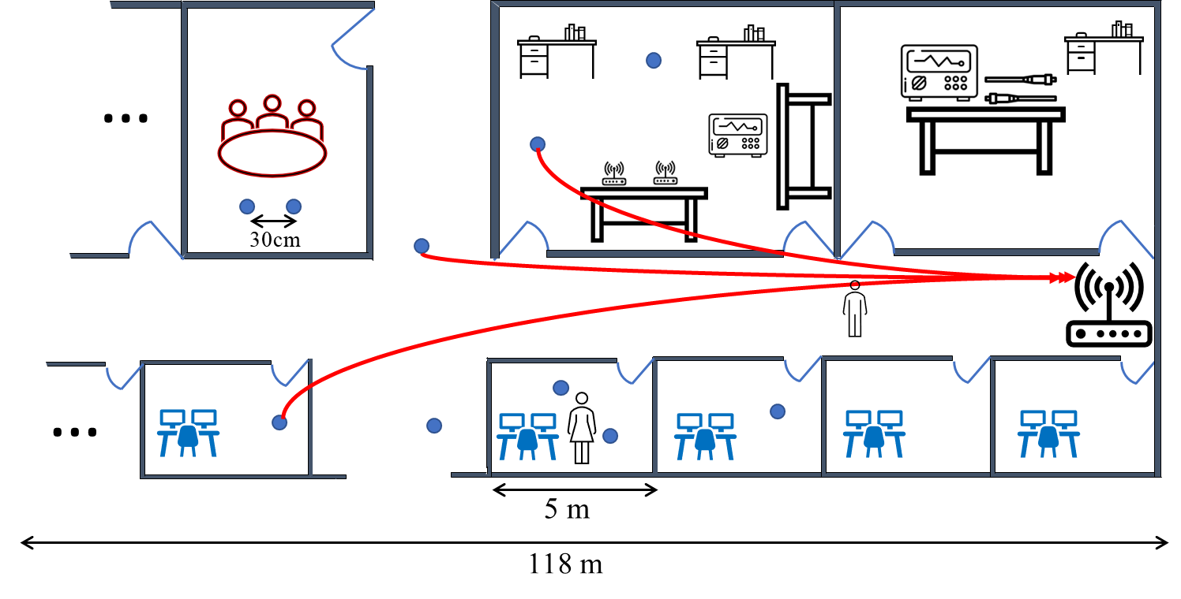
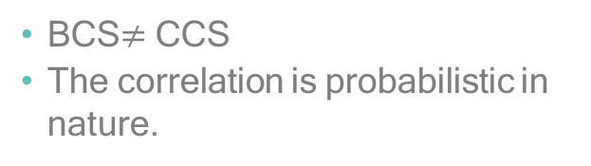
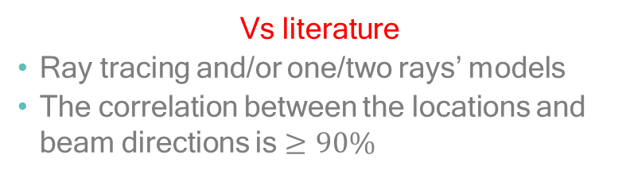
Coherence Time/Sapce
Preliminary results
BCS$≠$ CCS
The correlation is probabilistic in nature.
Vs literature
Ray tracing and/or one/two rays’ models
The correlation between the locations and beam directions is $≥90\%$

Slide 8


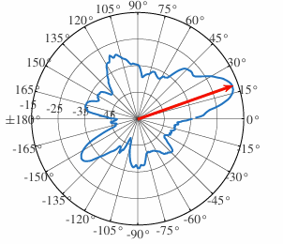
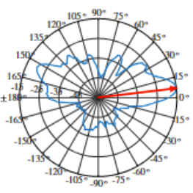
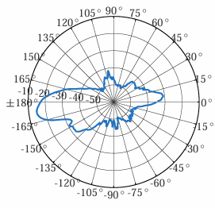









Finger printing
Principle
Preliminary results
There a probability that users in a given proximity have almost similar antenna radiation patterns: mmWave BCT>>CCT
Users in different surroundings most likely to experience different antenna radiation patterns
Illustrative example:
$$S_{1}$$
$$u_{1}$$
$$u_{2}$$
$$S_{2}$$
$$u_{3}$$
Coverage area
$$u_{1}$$
$$u_{2}$$
$$S_{1}$$
$$S_{2}$$

Slide 9
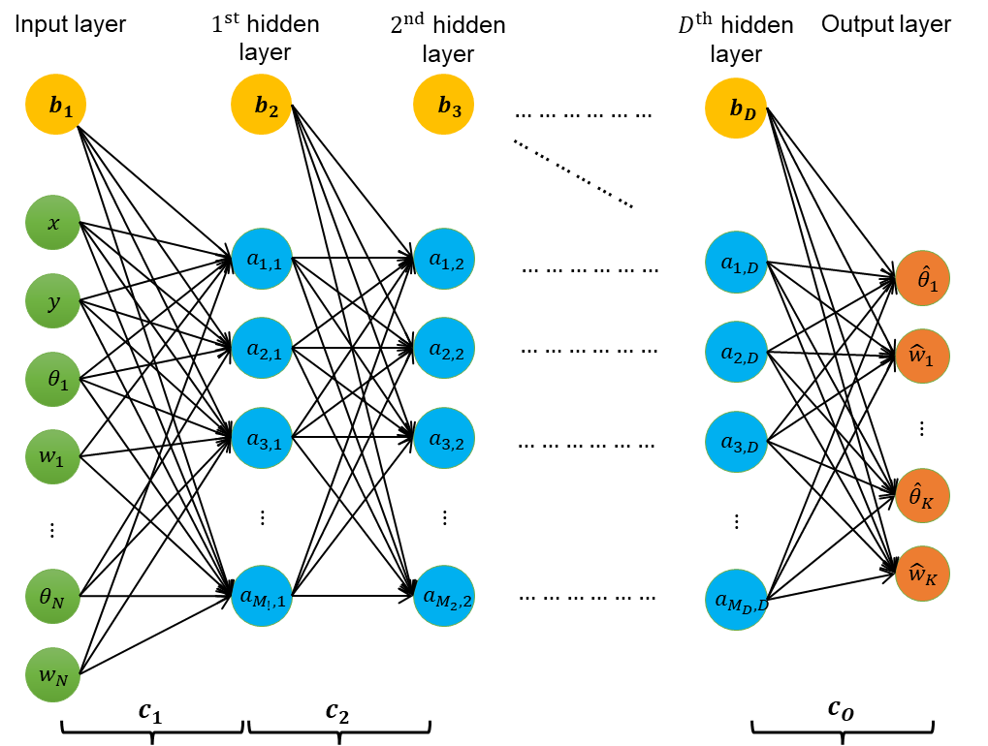
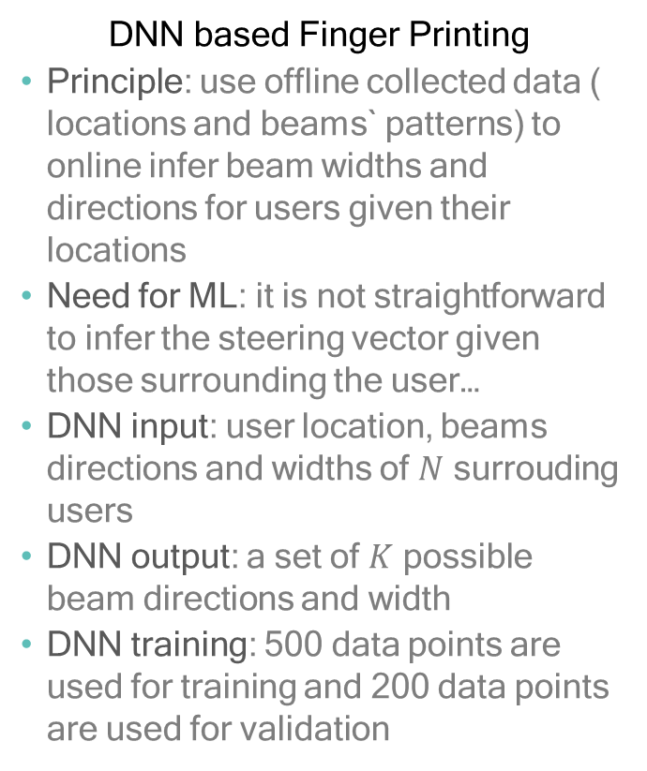
Finger printing
Implementation: DNN
DNN based Finger Printing
Principle: use offline collected data ( locations and beams` patterns) to online infer beam widths and directions for users given their locations
Need for ML: it is not straightforward to infer the steering vector given those surrounding the user…
DNN input: user location, beams directions and widths of $N$ surrouding users
DNN output: a set of $K$ possible beam directions and width
DNN training: 500 data points are used for training and 200 data points are used for validation
DNN architecture for fingerprint mmWave beamforming

Slide 10

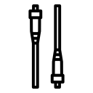

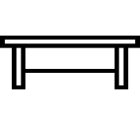






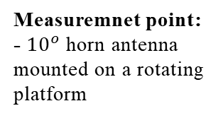
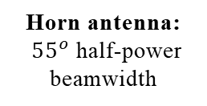
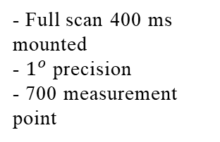
Results
Harsh propagation environment: Indoor office environment
Measuremnet point:
- $10^{o}$ horn antenna mounted on a rotating platform
- Full scan 400 ms mounted
- $1^{o}$ precision
- 700 measurement point
…
Experimental vs ray tracing
Two-ray model does not match the experimental results [10]=> five ray's model
Horn antenna:
${55}^{o}$ half-power beamwidth
30cm
…
5 m
118 m
Dynamic environment:
moving obstacles

Slide 11
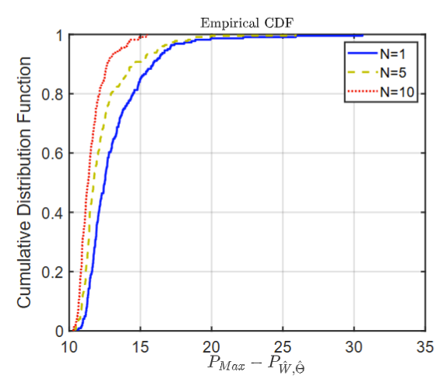
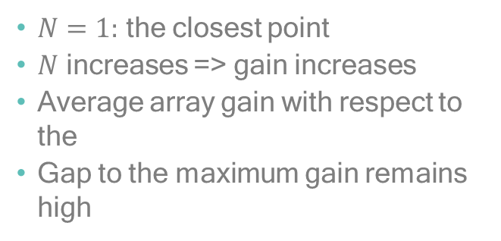
Results
Array gain: perfect location side information
$N=1:$ the closest point
$N$ increases => gain increases
Average array gain with respect to the
Gap to the maximum gain remains high
The CDF of max-to-achievable gain for different values
of the surrounding N

Slide 12
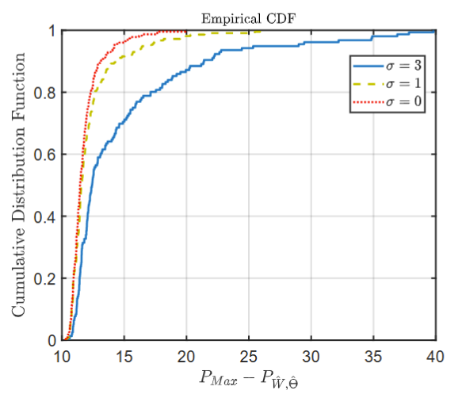
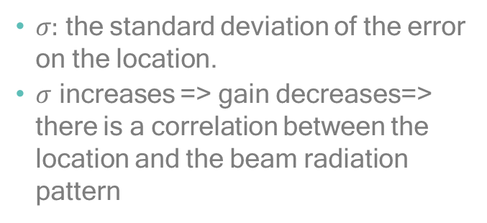
Results
Array gain: non perfect location side information
$σ:$ the standard deviation of the error on the location.
$σ$ increases => gain decreases=> there is a correlation between the location and the beam radiation pattern
The CDF of max-to-achievable gain in presence of
localization error

Slide 13
Conclusions
Beam coherence space is higher than the channel coherence space
The correlation between the beam radiation patterns of adjacent users is probabilistic in nature
Finger printing technique may enhance the received power but a gap to the maximum remains. It can be used for initial

