Slide 1
Consolidate Viability and Information Theories for Task-Oriented Communications: The Case of Remote Power Plants
Ozgur Ercetin
Mohaned Chraiti
Rustu E. Karakaya

Slide 2
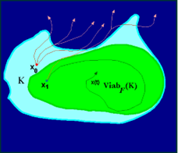
Outline
Viability theory for ToC
Power plant: ToC
Results
ToC vs Semantic comm. Viability theory
Transfer entropy
System model Problem Formulation
Simulations
Conclusions

Slide 3
Viability Theory for ToC Task-oriented vs Semantic Communications
Semantic:
types
number
Shapes…
ToC:
Final action (stop the vehicle)
Presence of an obstacle at X meters
The integrity of data
Counter intuitive example:
Red light: a tree is in the road
Green light: the tree is removed from the road
Example: Autonomous vehicle assisted by a control unit in the cloud

Slide 4
Viability Theory for ToC Core idea
Core idea
Develop a general framework to assess the minimum communication rate that ensures proper operations of the system
It is deemed to be difficult to incorporate unforeseen events while using exiting optimization principle
Risk assessment is implicit while applying the viability theory
Viability space can be determined through optimization, machine learning or other tools, but differs in concept to typical optimization
Typical optimization concept:
Shortest path⬄ one solution as per the objective function
Viability theory concept:
Through the longest path there is a larger room for errors ⬄ larger viable space

Slide 5
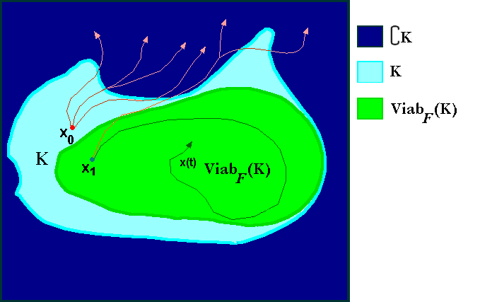
Viability Theory for ToC Viability space
Viable space K: The space of the states in which the constraints (including the safety) are fulfilled
Viability Kernel: The space of the states from which the system starts and remains while evolving within the viable space (avoid dead ends)
Non-viable space: the space of the possible states where one or multiple constraints are not satisfied
The closer is the state to the center of the kernel, the lowest is the probability to be propelled into a non-viable state given an unforeseen event

Slide 6
Viability Theory for ToC Size of the viability kernel: communication rate, environment and system capability
Communication channel
Actor:
Initially Less knowledgeable than the control unit
Control/assistance unit:
Trained model
“Chirurgical precision”
Environment
Viability kernel by analogy to the probability distribution
Case 1: high communication rate Case 2: low communication rate
$$\operatorname{Pr}\left(s→s^{′}\right)∈\overline{K_{viab}}$$
$$\operatorname{Pr}\left(s→s^{′}\right)∈\overline{K_{viab}}$$

Slide 7
Viability Theory for ToC Transfer Entropy : knowledge transfer
Core idea
The capacity of the actor to learn from the decisions of the control unit and vice versa are often overlooked to reduce the communication rate
Transfer Entropy: quantifies the flow of information between two random processes by analyzing causality
The impact of the control unit decisions/directives at the previous (N − 1) time slots on the state of the actor is quantified as follows:
Actor
Flow of information between two random processes
$${R_{ITL}\left((N+1)T\right)=\frac{1}{N}H(u(NT)|x\left(NT\right),x\left(NT−T\right)…x\left(1\right),u\left(NT−T\right), u\left(NT−2T\right),…)} +\frac{1}{N}DI (u\left(NT\right), u\left(NT−T\right),…→x\left(NT\right), x\left(NT−2T\right)…)$$
Control/assistance unit

Slide 8
Power plant: ToC System model
System model
Power Plant: it is one of the basic system often studied in dynamic control theory
Sate variables: temperature and pressure
Control inputs: the rate at which the heat is supplied to the plant and the rate at which a pneumatic piston is displaced
Objective: adjust the communication rate to keep the state variables within the viability kernel
The process requires cycling the plant repeatedly through three operating points (normalized numerical values):
X1 = (0, 0), X2 = (2.5, 2), and X3 = (1, 3) (neighborhoods)
the system must visit three states’ levels cyclically in order
Power plant
Communication and information flow
Control unit

Slide 9
Power plant: ToC Mathematical formulation
$$\inf_{x\left((N+1)T\right)∈K_{viab}}{c\left(u(\left(N+1\right)T)\right)−R_{ITL}(\left(N+1\right)T)}$$
where the in-the-loop transfer entropy is given by
$${R_{ITL}\left((N+1)T\right)=\frac{1}{N}H(u(NT)|x\left(NT\right),x\left(NT−T\right)…x\left(1\right),u\left(NT−T\right), u\left(NT−2T\right),…)} +\frac{1}{N}DI (u\left(NT\right), u\left(NT−T\right),…→x\left(NT\right), x\left(NT−2T\right)…)$$

Slide 10
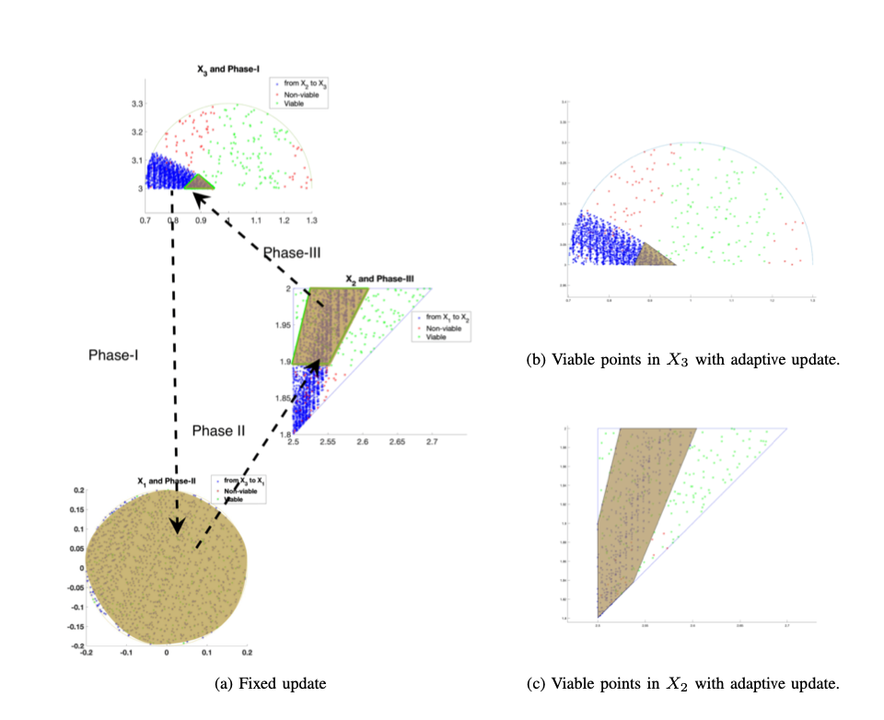
Coherence Time/Sapce Simulation results: example in [9]
Evolution of the communication rate with time and its impact on the state of the system at phase-I
The proposed solution decrease the communication rate by 50% in Phase, by 12% in Phase-III, and by 14% in Phase-III

Slide 11
Conclusions
Incorporate the viability theory and directed information reduce the communication rate from ToC perspective
Proposes a ToC framework to implicitly quantify unforeseen events
Demonstrates the integration of viability theory into TOC with an academic example of power plant system

