Slide 1
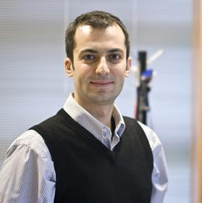
On the Space/Time Correlation of mmWave AoAs: Concept and Experimental Validation
Ozgur Ercetin
Mohaned Chraiti

Slide 2
Outline
Coherence Time
Conjunctures
Results
Definition Beam coherence time vs channel coherence time
Impact of rich scattering Implications
Experimental set up Coherence space
Correlation function

Slide 3
Coherence Time Definition
Channel estimate is almost time invariant
Channel equalization
Error probability
Channel CT
Beam CT
Beam and width direction estimate are almost time invariant
Beam steering vector
Received power

Slide 4
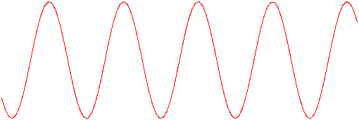
Coherence Time CCT vs BCT: the case of free space transmissions (single ray)
0
Channel coherence time
The phase of the received signal varies as the user moves
1GHz→30 GHz => 30 $×$ phase variation rate
CCT $=\frac{9}{16π}\frac{λ}{v}$
$$\frac{π}{2}$$
$$π$$
0
Beam coherence time
The bam direction is almost time invariant
Beam coherence time >> channel coherence time $∝λ$ that is in the order of mm
$$π$$

Slide 5
Conjunctures Sparse vs rich scattering
$h_{1}=\sum_{i}{r_{1,i}e^{{jθ}_{1,i}}}$
$h_{1}=re^{θ_{1}}$
d
d
$h_{2}=re^{θ_{2}}$
$h_{2}=\sum_{i}{r_{2,i}e^{jθ_{2,i}}}$
mmWave/Terahertz (conjunctures): ${1) h_{1}≠h_{2} , B}_{1}≠B_{2}$ for $d>\frac{λ}{2} and AoAs are more$
$$probable from some direcions than others$$
${2) h_{1}≠h_{2} and B}_{1}≃B_{2}$ for $d>\frac{λ}{2}$ $⇒BCT≠CCT$
Sub-6GHz: $h_{1}≠h_{2}$ and $B_{1}≠B_{2}$ for $d>\frac{λ}{2}$ $⇒BCT=CCT$and AoAs are uniformly distributed

Slide 6
Conjuncture Implications
Beamforming
Statistical based beamforming: $Pr⁡(Φ)$ is non uniformly distributed in given environment (conjuncture 1) [6]
Fingerprinting techniques (conjuncture 2) [5]
Low beam tracking overhead ($≠$channel tracking)
Beam steering vector may not change independently form one CCT to another (conjuncture 2)
Distributed massive MIMO (conjuncture 1 & 2)
Others works
Radio resource allocation often require SNR estimate
Multiplexing (conjuncture 2)

Slide 7
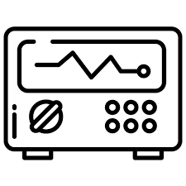
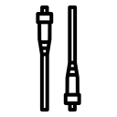
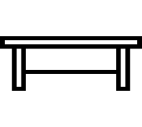
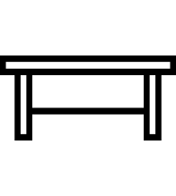
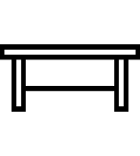
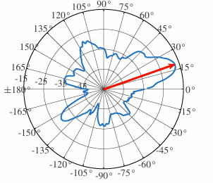
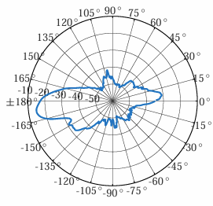
Results Harsh propagation environment: Indoor office environment
Measuremnet point: - $10^{o}$ horn antenna mounted on a rotating platform
- Full scan 400 ms mounted
- $1^{o}$ precision - 700 measurement point
Experimental vs ray tracing
Two ray model does not match the experimental results [10]=> five ray's model
Preliminary results: radiation pattern at two close locations
…
Horn antenna: ${55}^{o}$ half-power beamwidth
30cm
…
5 m
118 m
Dynamic environment: moving obstacles

Slide 8
Results AoAs statistics inference
Objecticve
Infer a statistical model about the AoAs: repetitive structure
AoAs correlation as a function of crossed distance
Bayesian learning
Beam coh. distance
$G\left(Θ|x_{1}, x_{2}…\right)=\frac{\prod{p(x_{i} | Θ)}G_{0}\left(Θ\right)}{\int_{Θ}{\prod{p(x_{i} | dΘ)}G_{0}\left(dΘ\right)dΘ}}$
Gibs sampling
Constraint: Kullback divergence
Correlation between beam pattern as functionof the crossed distance.
Model
Multi-variate Gaussian
$γ$dB optimal ray and $β$correlated.
Challenge
Non-parametric inference

Slide 9
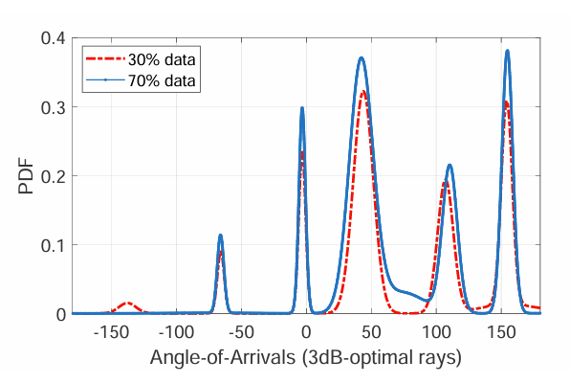
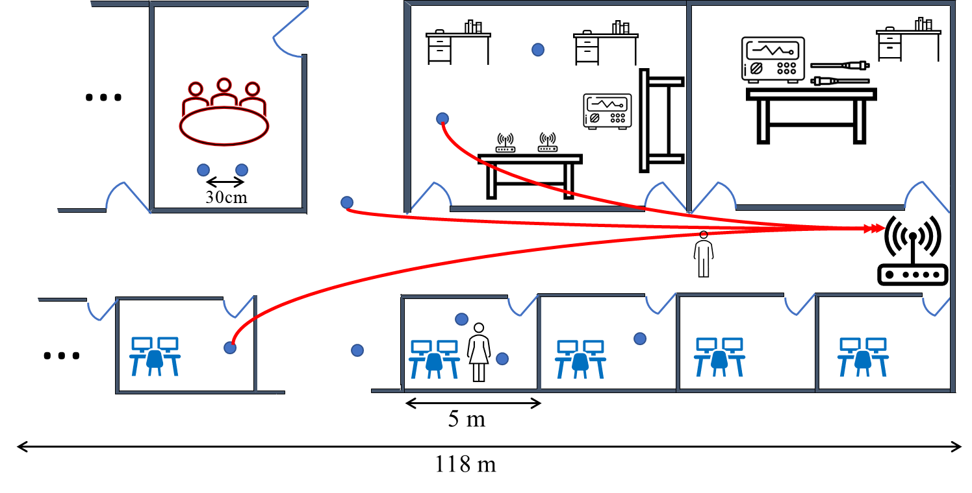
Results Conjuncture 1
AoAs are not uniformly distributed
The results differs from the existing belief of uni-modal dsirobution [6]
The distribution may differ from one environment to another

Slide 10
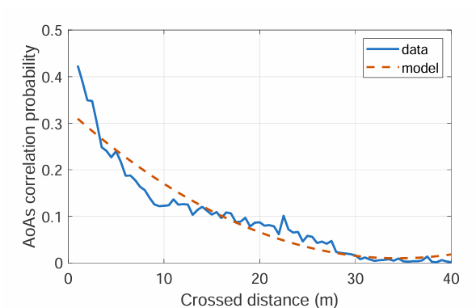
Results Conjuncture 2
BCT$≠$ CCT
The correlation is probabilistic in nature.

