Slide 1

PRE AND POST ACTIVITIES USING WEB 2.0 TOOLS
Eva Buyuksimkesyan

Slide 2
Why do we use pre activities?

Slide 3




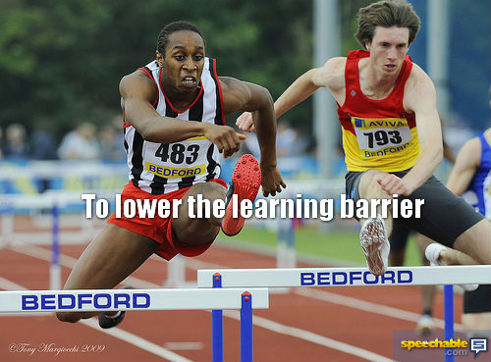
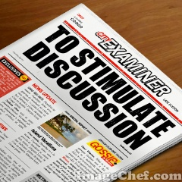

Slide 4
Why do we use post activities?

Slide 5




Slide 6
Technology is great because …

Slide 7


Slide 8









OUR FAVE TOOLS
blogs
wikis

Slide 9
Creating Slide Shows
Windows moviemaker
Photo peach http://photopeach.com/
Animoto http://animoto.com
Search stories https://searchstories-intl.appspot.com/en-us/creator/

Slide 10
Posters & online noticeboards
Glogster www.glogster.com
Tabblo http://www.tabblo.com/studio
Wallwisher http://www.wallwisher.com/
Linoit http://en.linoit.com/

Slide 11
Word Posters
Wordle http://www.wordle.net/
Worditout http://worditout.com/
WordSift
http://www.wordsift.com/visualize

Slide 12
Animation tools
GoAnimate http://goanimate.com/
Domo animate http://domo.goanimate.com/
Xtranormal
http://www.xtranormal.com/

Slide 13
Audio Tools
Audacity Free, open source software for recording and editing sounds
Mybrainshark narrate documents, powerpoints, photos
Freesound.org a collaborative database of Creative Commons Licensed sounds

Slide 14
Some more
Voicethread http://voicethread.com/
Fakebook www.classtools.net
Prezi http://prezi.com/
Tabblo http://www.tabblo.com/studio
Youblisher http://www.youblisher.com/
BigHugeLabs http://bighugelabs.com/

Slide 15
FYI
Cooltoolsforschool http://cooltoolsforschools.wikispaces.com/
Cool tools for 21st century learners http://cooltoolsforschools.wikispaces.com/
ScoopIt http://www.scoop.it/
EVO sessions http://evosessions.pbworks.com

Slide 16

Pre/Post Reading
Record your comments to the voicethread.
What did you like about the book?
Who was your favourite character?
What did you learn about the writer and the era?
Watch the slideshow and write down the characters. Which of them you think shouldn’t be in this slideshow.
Scan the text and find out which of the super heroes from the slideshow were mentioned in the text.

Slide 17
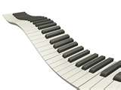
Pre/Post Listening
Task: research how people lived in Iron Age and prepare an animation.
In groups write down what you’ve found out about Iron Age people.
Create an animation based on what you’ve heard / learned from your reseach

Slide 18

Pre / Post Speaking
Watch the video twice
Write down what you remember
Discuss the poem
Prepare a compilation album. Choose 5 songs that you think they represent you. Tell me why you have chosen them

Slide 19

Pre / Post Writing
Brainstorm ideas on wallwisher.
Write your own story

Slide 20

Pre /Post Readers
A Web Quest:
Click on the links and answer the questions
Create a fakebook account for one of the characters.

Slide 21

Pre /Post Vocabulary
Paste the text and it will be sifted.
Create anagrams and animation for the anagrams

Slide 22
Acknowledgements
www.fodey.com
www.imagechef.com
www.bighugelabs.com
www.wordle.net
www.speechable.com

Slide 23
THANK YOU http://evasimkesyan.edublogs.org
@evab2001

