Slide 1
Academic Writing
Rahim Dehkharghani, PhD
University of Bonab
2016, April

Slide 2
Outline
What makes good writing
What not to do
A few tips for writing
Parts of an academic paper
Evaluation factors of a Journal
Latex
Plagiarism
Interview
How to submit a paper

Slide 3
Outline
What makes good writing
What not to do
A few tips for writing
Parts of an academic paper
Evaluation factors of a Journal
Latex
Plagiarism
Interview
How to submit a paper

Slide 4
What makes good writing?
Good writing communicates an idea clearly and effectively
Good writing is elegant and stylish (Revision)

Slide 5
What makes good writer?
Inborn Talent?
Years of English and humanities classes?
An artistic nature?
Divine inspiration?
If no, then what?

Slide 6
What makes good writer?
Having something to say.
Logical thinking.
A few simple, learnable rules of style (you’ll learn in this workshop).
Take-home message: Good writing can be learned!

Slide 7
What makes good writer?
Read, pay attention, and imitate.
Talk about your research before trying to write about it.
Write to engage your readers—try not to bore them!
Stop waiting for “inspiration.”
Accept that writing is hard for everyone.
Revise. Nobody gets it perfect on the first try.
Learn how to cut ruthlessly. Never become too attached to your words.
Find a good editor!

Slide 8
Outline
What makes good writing
What not to do
A few tips for writing
Parts of an academic paper
Evaluation factors of a Journal
Latex
Plagiarism
Interview
How to submit a paper

Slide 9
What not to do
“These findings imply that the rates of ascorbate radical production and its recycling via dehydroascorbate reductatse to replenish the ascorbate pool are equivalent at the lower irradiance, but not equivalent at higher irradiance with the rate of ascorbate radical production exceeding its recycling back to ascorbate.”
=>
“These findings imply that, at low irradiation, ascorbate radicals are produced and recycled at the same rate, but at high irradiation, they are produced faster than they can be recycled back to ascorbate.”

Slide 10
So what?
Complex ideas don’t require complex language.
Scientific writing should be easy and even enjoyable to read!

Slide 11
Cut the clutter
This paper provides a review of the basic tenets of cancer biology study design, using as examples studies that illustrate the methodologic challenges or that demonstrate successful solutions to the difficulties inherent in biological research.
=>
This paper reviews cancer biology study design, using examples that illustrate specific challenges and solutions.

Slide 12
Cut the clutter
Long words and phrases that could be short…
Wordy version Crisp version
A majority of most
A number of many
Are of the same opinion agree
Less frequently occurring rare
All three of the the three
Give rise to cause
Due to the fact that because
Have an effect on affect

Slide 13
Don’t turn verbs into nouns
Provide a review of -> review
Offer confirmation of -> confirm
Make a decision -> decide
Shows a peak -> peaks
Provide a description of -> describe

Slide 14
Don’t bury the main verb
One study of 930 adults with multiple sclerosis (MS) receiving care in one of two managed care settings or in a fee-for-service setting found that only two-thirds of those needing to contact a neurologist for an MS- related problem in the prior 6 months had done so (Vickrey et al 1999).

Slide 15
Cut the clutter, More techniques
Omit the negation
She was not often right.
=> She was usually wrong
Eliminate superfluous uses of “there are/there is”
There was a long line of bacteria on the plate.
=>Bacteria lined the plate
Omit needless prepositions
They agreed that it was true.
=>They agreed it was true

Slide 16
Outline
What makes good writing
What not to do
A few tips for writing
Parts of an academic paper
Evaluation factors of a Journal
Latex
Plagiarism
Interview
How to submit a paper

Slide 17
A few tips for writing
Use the active voice
My first visit to Boston will always be remembered by me
I will always remember my first visit to Boston
Is it OK to use ”We” or “I”? Yes it is!
Use verbs instead of nouns

Slide 18
A few tips for writing: Punctuation
Increasing power to separate:
Comma ,
Colon :
Dash – (less formal)
Parentheses () (less formal)
Semicolon ;
Period .

Slide 19
Examples for punctuation
This approach works better than previous ones; it has lower time complexity.
This approach includes three steps: Tokenization, Normalization, and Stemming.
Iran has many small universities–e.g., university of Bonab-and some large universities–e.g., university of Tehran.
The number of students at university of Bonab is more than 4000 (about 4100).

Slide 20
A few tips for writing: Parallelism
Unparallel:
Locusts denuded fields in Utah, rural Iowa was washed away by torrents, and in Arizona the cotton was shriveled by the placing heat.
Parallel:
Locusts denuded fields in Utah, torrents washed away rural Iowa, and blazing heat shriveled Arizona’s cotton.

Slide 21
Overview: Principles of effective writing
1. Cut unnecessary words and phrases; learn to part with your words!
2. Use the active voice (subject + verb + object)
3. Write with verbs: use strong verbs, avoid turning verbs into nouns, and don’t bury the main verb!

Slide 22
Steps in the writing process
1. Prewriting (70%)
Collect, synthesize, and organize information
Brainstorm take-home messages
Work out ideas away from the computer
Develop a road map/outline
2. Writing the first draft (10%)
Putting your facts and ideas together in organized prose
3. Revision (20%)
Read your work out loud
Get rid of clutter
Do a verb check
Get feedback from others

Slide 23
Outline
What makes good writing
What not to do
A few tips for writing
Parts of an academic paper: Abstract
Evaluation factors of a Journal
Latex
Plagiarism
Interview
How to submit a paper

Slide 24
Parts of an academic paper
Abstract
Introduction
Related Work
Suggested approach
Results
Discussion and Comparison
Conclusion

Slide 25
Abstract
Overview of the main story
Gives highlights from each section of the paper
Limited length (100-300 words, typically)
Stands on its own
Used with title, for electronic search engines
Most often, the only part people read

Slide 26
Outline
What makes good writing
What not to do
A few tips for writing:
Parts of an academic paper: Introduction
Evaluation factors of a Journal
Latex
Plagiarism
Interview
How to submit a paper

Slide 27
Introduction
Background, application: known information
Knowledge gap: unknown information
Hypothesis, question: purpose statement
Approach: proposed solution
Usually 3 to 5 paragraphs

Slide 28
Outline
What makes good writing
What not to do
A few tips for writing
Parts of an academic paper: Related Work
Evaluation factors of a Journal
Latex
Plagiarism
Interview
How to submit a paper

Slide 29
Related Work
Give an overview of outstanding previous work
Cite the original reference
Make a relation among cited references

Slide 30
Outline
What makes good writing
What not to do
A few tips for writing
Parts of an academic paper : Suggested Approach
Evaluation factors of a Journal
Latex
Plagiarism
Interview
How to submit a paper

Slide 31
Suggested Approach
Give a clear overview of what was done
Give enough information to replicate the study (like a recipe!)
Be complete, but make life easy for your reader!
1. Break into smaller sections with subheadings
2. Cite a reference for commonly used methods
3. Display in a flow diagram or table where possible
You may use jargon and the passive voice more liberally in the methods section

Slide 32
Outline
What makes good writing
What not to do
A few tips for writing
Parts of an academic paper : Results
Evaluation factors of a Journal
Latex
Plagiarism
Interview
How to submit a paper

Slide 33
Evaluation (Results)
Summarize what the data show
Point out simple relationships
Cite figures or tables that present supporting data
Avoid simply repeating the numbers that are already available in tables and figures.

Slide 34
Outline
What makes good writing
What not to do
A few tips for writing
Parts of an academic paper : Discussion
Evaluation factors of a Journal
Latex
Plagiarism
Interview
How to submit a paper

Slide 35
Discussion
Answer the question asked.
Support your conclusion (your data, others’ data)
Defend your conclusion (anticipate criticisms)
Give the “big-picture” take-home message

Slide 36
Outline
What makes good writing
What not to do
A few tips for writing
Parts of an academic paper : Conclusion and future work
Evaluation factors of a Journal
Latex
Plagiarism
Interview
How to submit a paper

Slide 37
Conclusion and future work
Summarize what has been done
Mention the advantages and disadvantages of the work
Express the application of the work
Suggest future work for interested readers

Slide 38
Outline
What makes good writing
What not to do
A few tips for writing
Parts of an academic paper : Comparison
Evaluation factors of a Journal
Latex
Plagiarism
Interview
How to submit a paper

Slide 39
Comparison
Compare your work with state-of-the-art works
Highlight advantages of your work compared to previous works

Slide 40
Outline
What makes good writing
What not to do
A few tips for writing
Parts of an academic paper : Background and preliminaries
Evaluation factors of a Journal
Latex
Plagiarism
Interview
How to submit a paper

Slide 41
Background and preliminaries
Add it if something is crucial to know before reading the paper
For some concepts you can also refer the reader to other works

Slide 42
Outline
What makes good writing
What not to do
A few tips for writing
Parts of an academic paper
Evaluation factors of a Journal
Latex
Plagiarism
Interview
How to submit a paper

Slide 43
Evaluation factors of a Journal
SJR (Scientific Journal Ranking)
IPP (Impact per Publication)
SNIP (Source Normalized Impact per Paper)

Slide 44
Citations of an author

Slide 45
Outline
What makes good writing
What not to do
A few tips for writing
Parts of an academic paper
Evaluation factors of a Journal
Latex
Plagiarism
Interview
How to submit a paper

Slide 46
Latex
Has been very common in last decade
A simple code is written which creates a PDF format of an article
Each journal/conference has a specific format

Slide 47
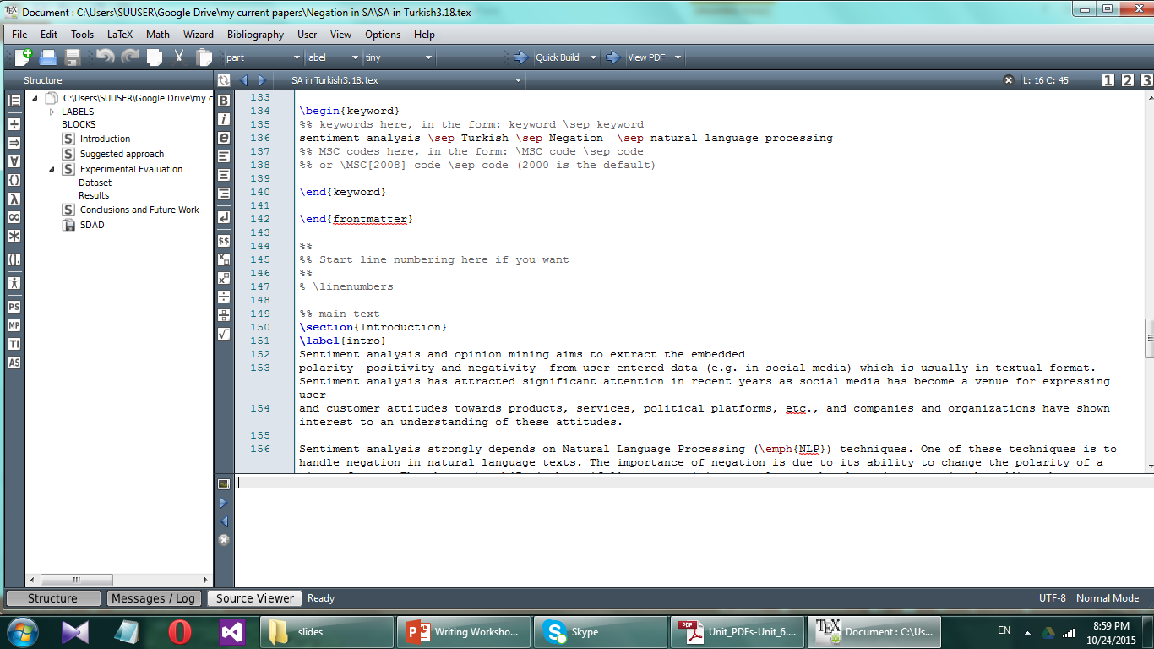
Latex

Slide 48
Outline
What makes good writing
What not to do
A few tips for writing
Parts of an academic paper
Evaluation factors of a Journal
Latex
Plagiarism
Interview
How to submit a paper

Slide 49
Plagiarism
Passing off other people’s writing (or tables and figures) as your own. Including:
Cutting and pasting sentences or even phrases from another source
Slightly rewriting or re-arranging others’ words
“borrowing” material from sites like Wikipedia

Slide 50
Outline
What is good writing
Parts of an academic paper
Evaluation factors of a Journal
Latex
Plagiarism
Interview
Paper review
How to submit a paper

Slide 51
Interview

Slide 52
Outline
What makes good writing
What not to do
A few tips for writing
Parts of an academic paper
Evaluation factors of a Journal
Latex
Plagiarism
Interview
How to submit a paper

Slide 53
How to submit a paper?
Write a draft and revise it
Put it into the requested template
Submit it online
Notifications:
Full accept
Accept with minor revisions
Accept with major revisions (reject with resubmission allowance)
reject

Slide 54
Why papers get rejected?!
Too big claims without justification
Repeating other people’s work in a different way
Inability in expressing the accomplished work
(Bad writing!)

Slide 55
Writing center at University of Bonab
Holding Workshops such as this one
Setting up English discussion sessions
Setting up English courses such as TOEFL, IELTS, GRE
Teaching students how to write an academic paper
Editing the papers of students (and maybe faculty members)

Slide 56
Curriculum Vitae
Introduce your scientific background
It is the first thing other people read to know you
No longer than 3 or 4 pages
More important things first

Slide 57
Curriculum Vitae
Education
Publication
Research interest
Honors and awards
Language skills
Computer skills
Work experience
References

Slide 58
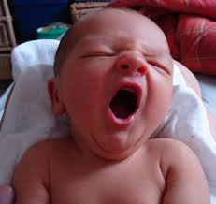
Thanks for Listening
Resource: Online course of Dr Christian Saniani (Stanford university)
Contact : rahim.dehkharghani@gmail.com
Webpage: http://myweb.sabanciuniv.edu/rdehkharghani

