Slide 1
C.7.7

Slide 2
C.7.7

Slide 3
C.7.7

Slide 4
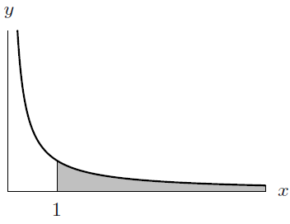
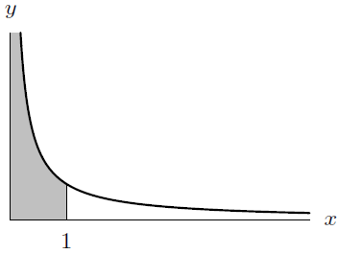
C.7.7

Slide 5
C.7.7

Slide 6
C.7.7

Slide 7
C9.1

Slide 8
C9.1

Slide 9
C9.1

Slide 10
C9.1

Slide 11
C9.1

Slide 12
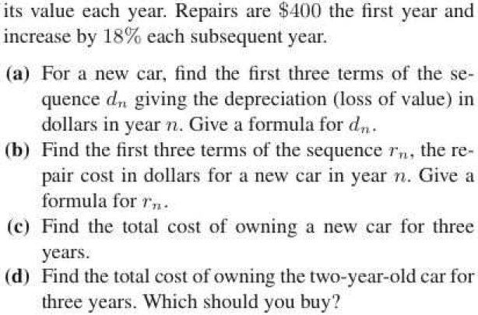
C9.1

Slide 13
C9.2

Slide 14
C9.2

Slide 15
C9.2

Slide 16
C9.2

Slide 17
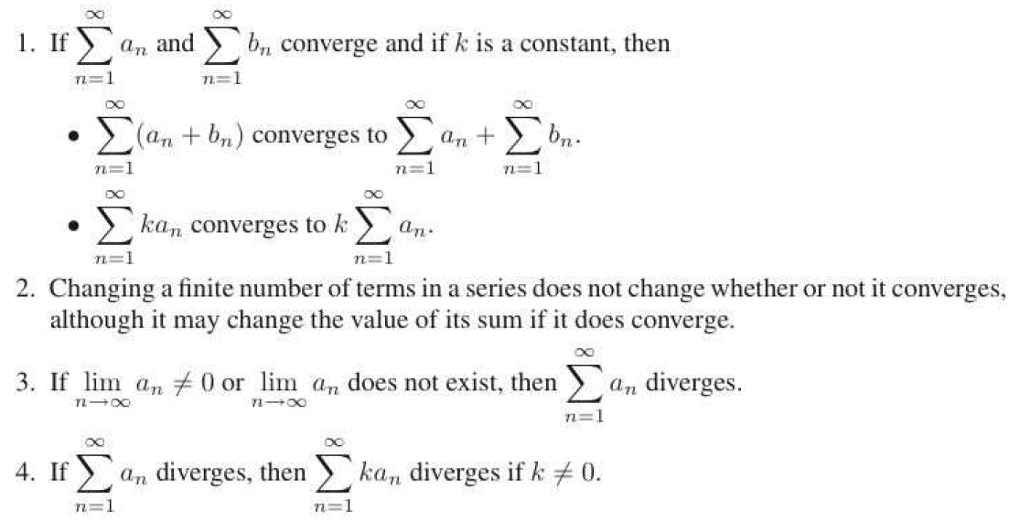
C9.3

Slide 18
C9.3

Slide 19
C9.3

Slide 20
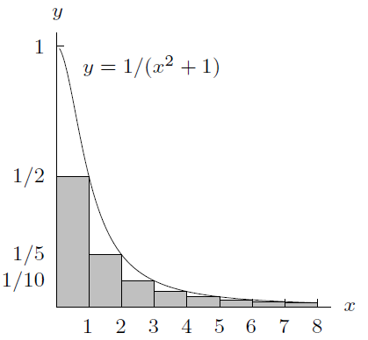
C9.3

Slide 21
C9.3

Slide 22
C9.3

Slide 23
C9.3

