Slide 1
C9.4

Slide 2
C9.4

Slide 3
C9.4

Slide 4
C9.4

Slide 5
C9.4

Slide 6
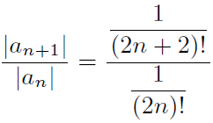
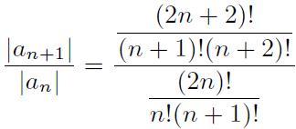
C9.4

Slide 7
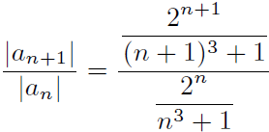
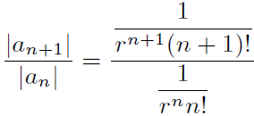
C9.4

Slide 8
C9.4

Slide 9
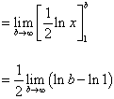
C9.4

Slide 10
C9.4

Slide 11
C9.4

Slide 12
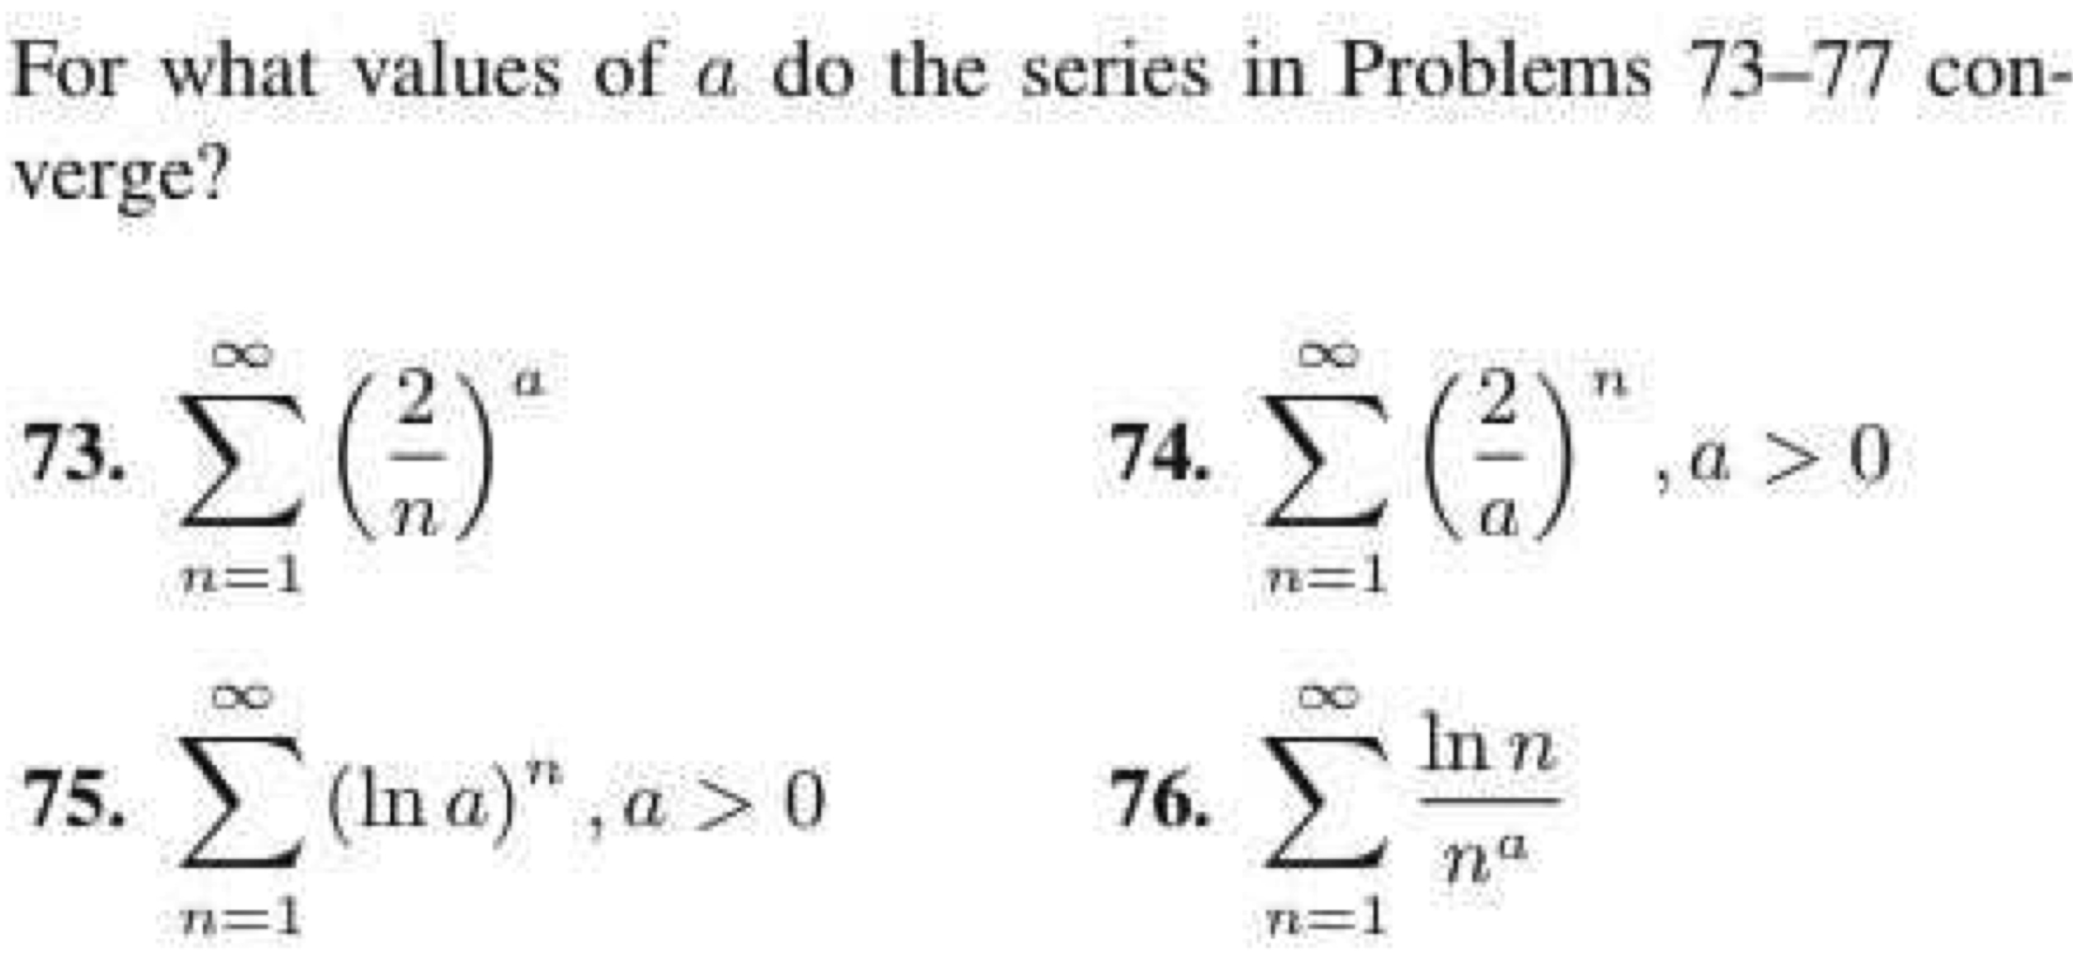
C9.4

Slide 13
C9.5

Slide 14
C9.5

Slide 15
C9.5

Slide 16
C9.5

