Slide 1
C10.1

Slide 2
C10.1

Slide 3
C10.1

Slide 4
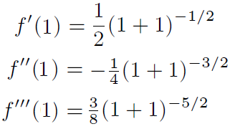
C10.1

Slide 5
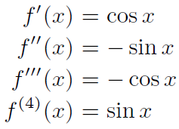
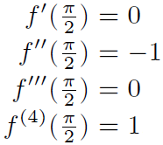
C10.1

Slide 6
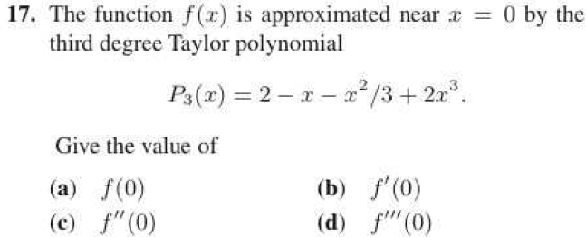
C10.1

Slide 7
C10.1

Slide 8
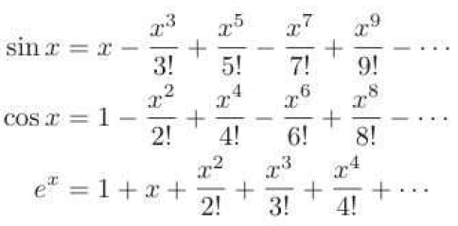
C10.2

Slide 9
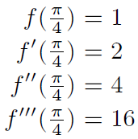
C10.2

Slide 10
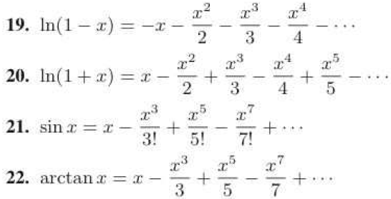
C10.2

Slide 11
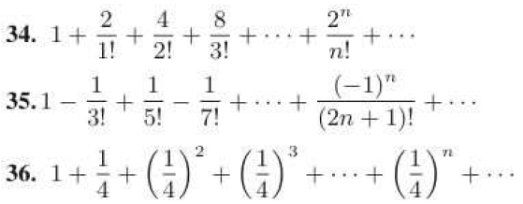
C10.2

Slide 12
C10.3

Slide 13
C10.3

Slide 14
C10.3

Slide 15
C10.3

