Slide 1
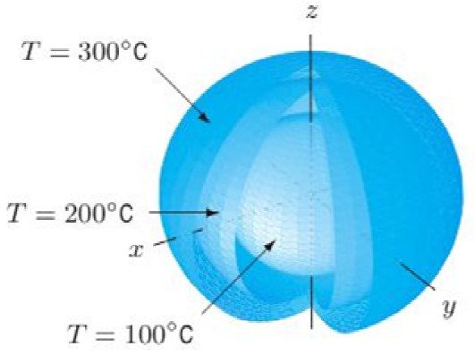
C9.5

Slide 2
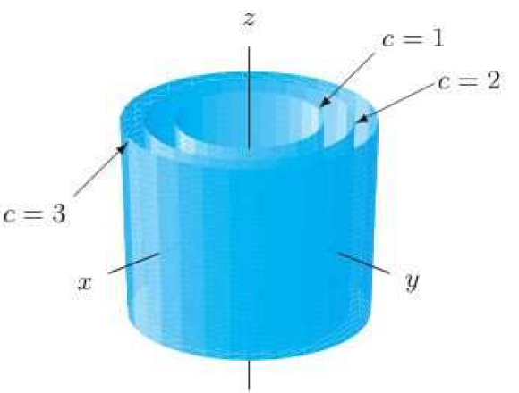
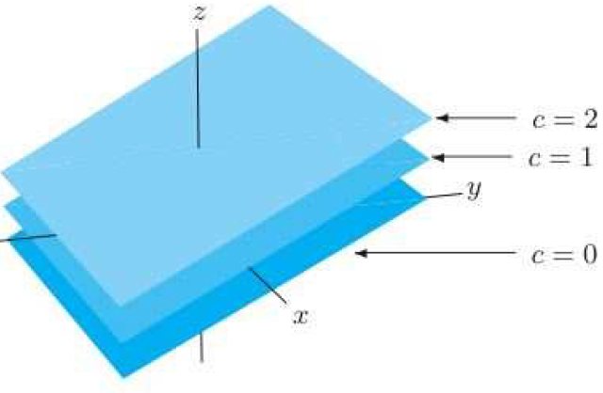
C9.5

Slide 3
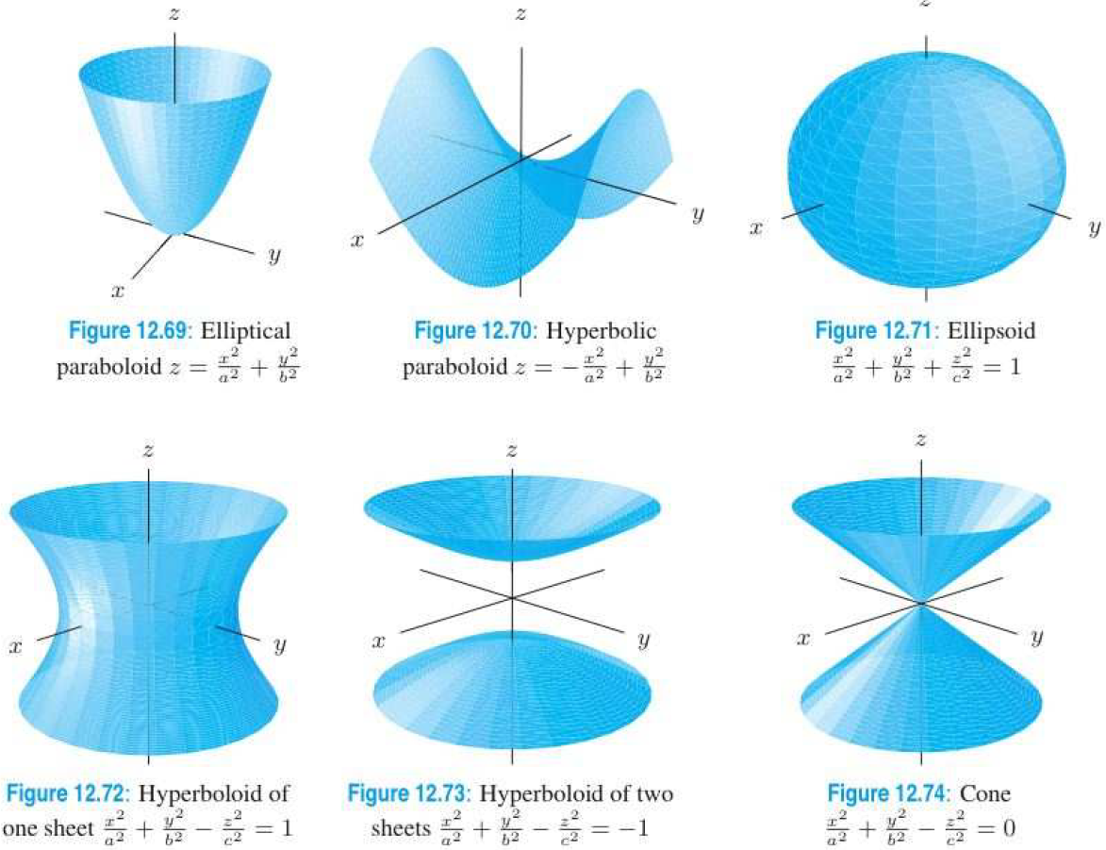
C9.5

Slide 4
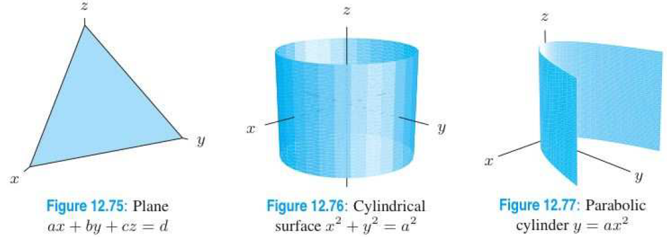
C9.5

Slide 5
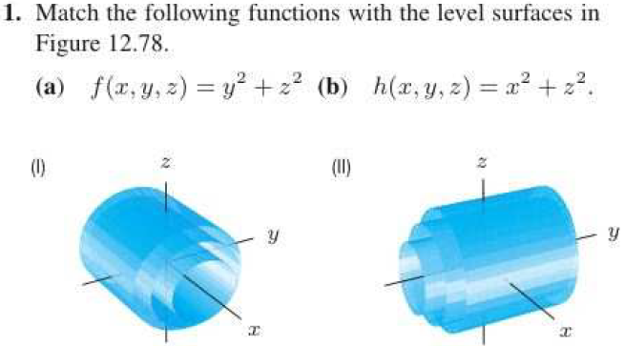
C9.5

Slide 6
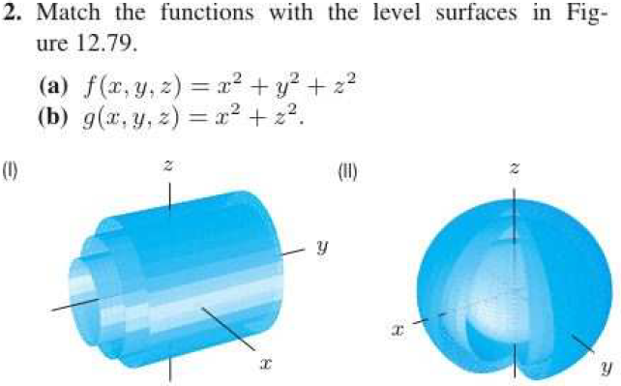
C9.5

Slide 7
C9.5

Slide 8
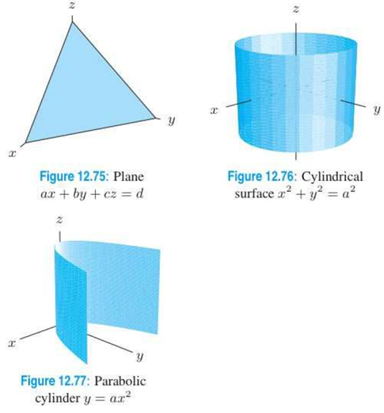
C9.5

Slide 9
C9.5

Slide 10
C9.5

Slide 11
C9.6

Slide 12
C9.6

Slide 13
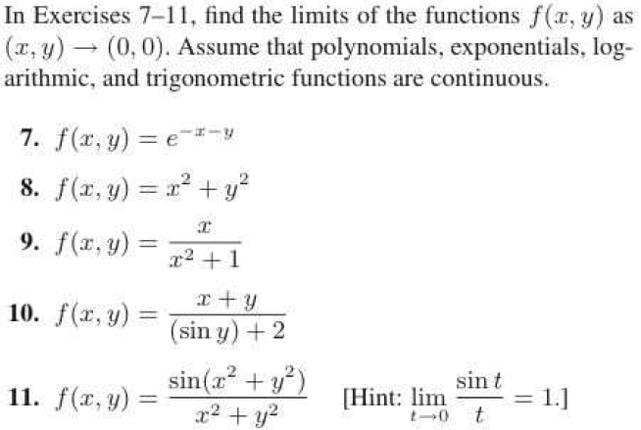
C9.6

