Slide 1
C14.4

Slide 2
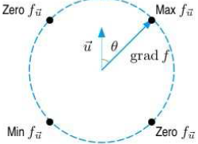
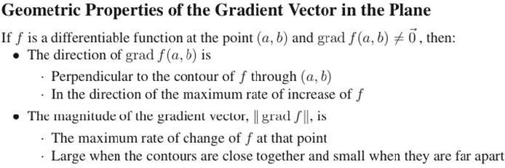
C14.4

Slide 3
C14.4

Slide 4
C14.4

Slide 5
C14.4

Slide 6
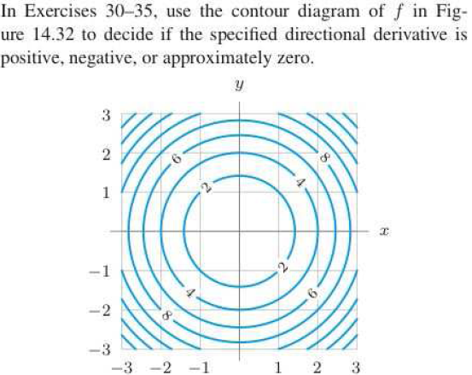
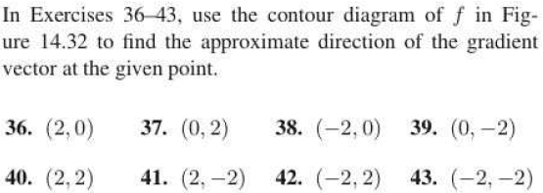
C14.4

Slide 7
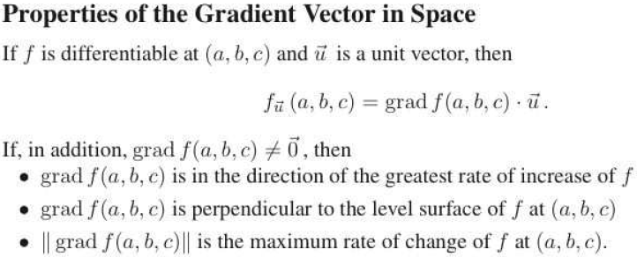
C14.5

Slide 8
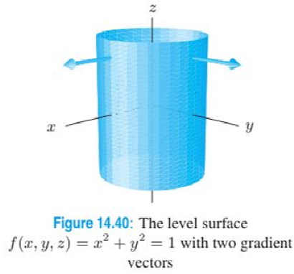
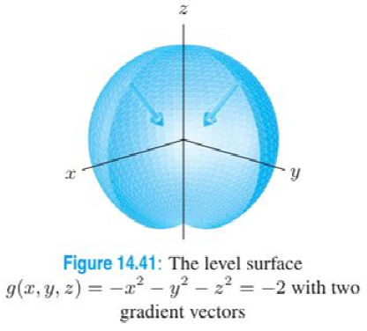
C14.5

Slide 9
C14.5

Slide 10
C14.5

