Slide 1
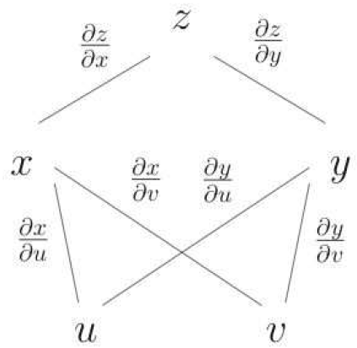
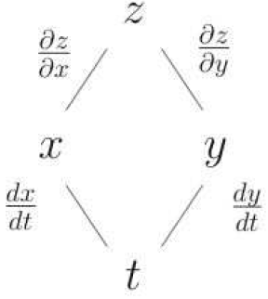
C14.6

Slide 2
C14.6

Slide 3
C14.6

Slide 4
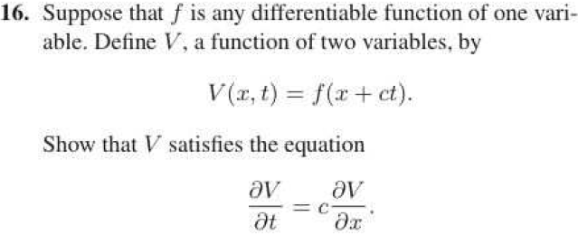
C14.6

Slide 5
C14.6

Slide 6
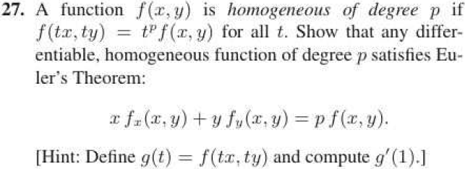
C14.6

Slide 7
C14.7

Slide 8
C14.7

Slide 9
C14.7

Slide 10
C14.7

Slide 11
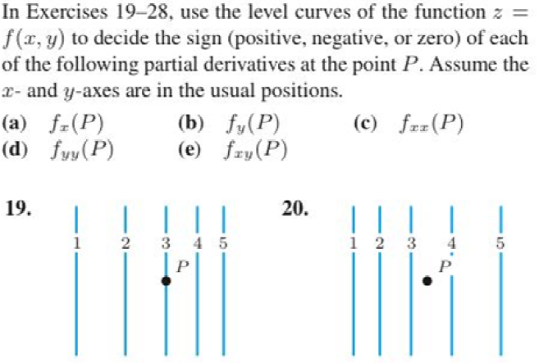
C14.7

Slide 12
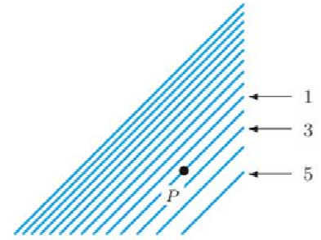
C14.7

Slide 13
C14.7

Slide 14
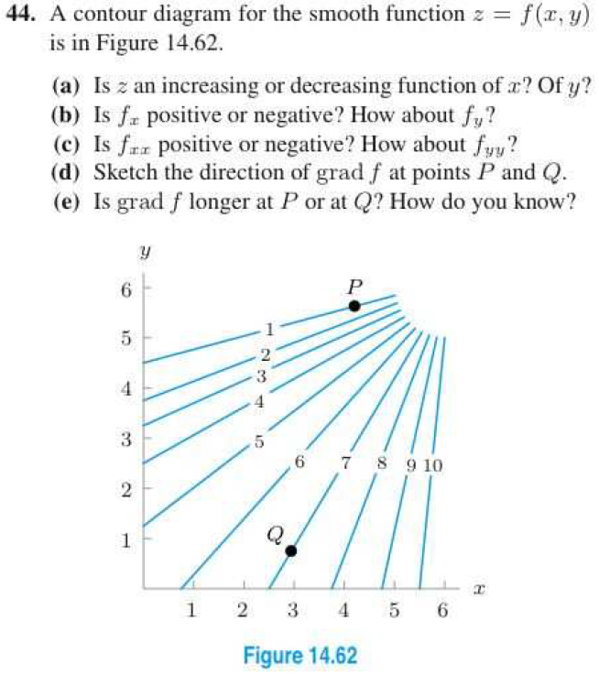
C14.7

