Slide 1
C15.3

Slide 2
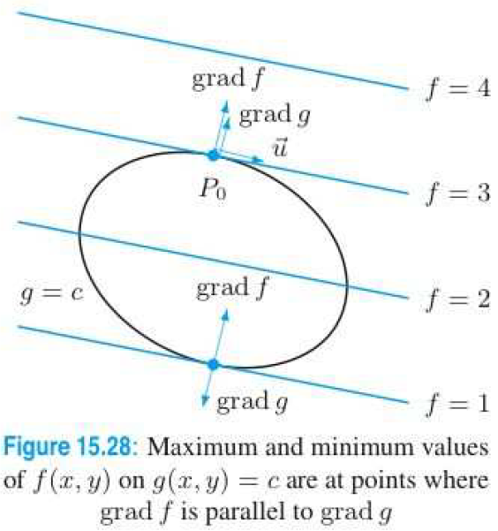
C15.3

Slide 3
C15.3

Slide 4
C15.3

Slide 5
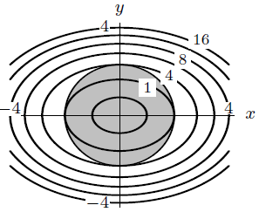
C15.3

Slide 6
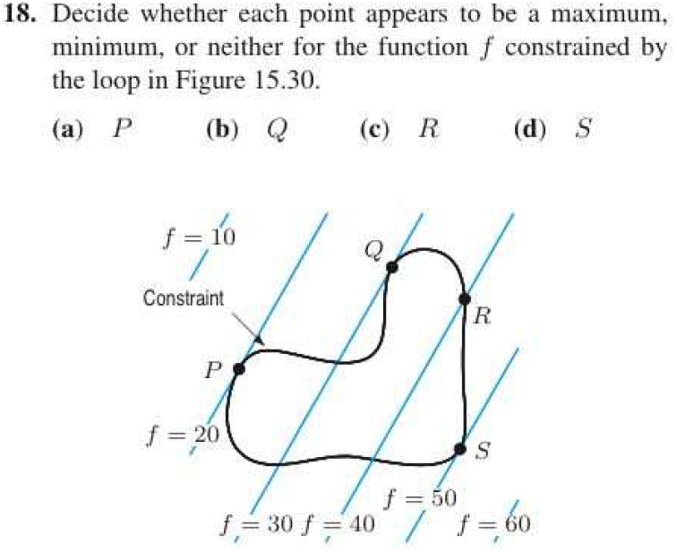
C15.3

Slide 7
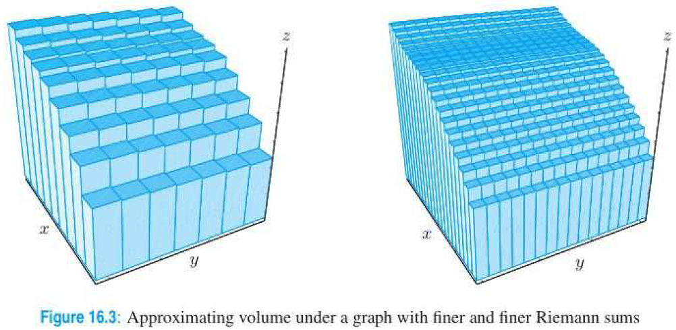
C16.1

Slide 8
C16.1

Slide 9
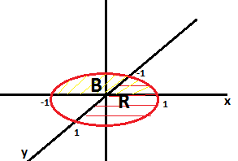
C16.1

Slide 10
C16.2

Slide 11
C16.2

Slide 12
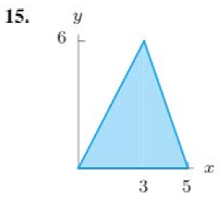
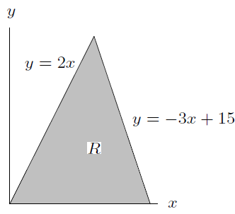
C16.2

Slide 13
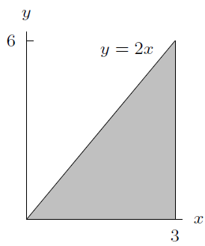
C16.2

Slide 14
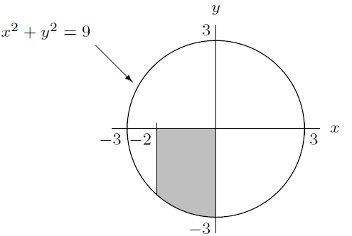
C16.2

Slide 15
C16.2

Slide 16
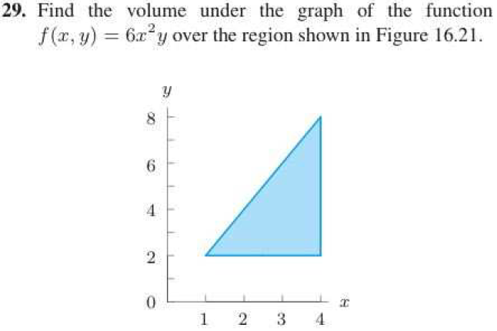
C16.2

